Slide 1
Kentucky Kemistry
John Handshoe-Hazard High School

Slide 2
Kentucky Kemistry
We conceived Kentucky Kemistry as a result of my students and I discussing common historical practices and the chemistry behind them.
One of the more common and familiar practices was that of soap making.
We thought this would be an excellent method of integrating scientific principles into everyday situations common to our area’s past.
We also wanted to ensure that the students were exposed to all levels of Bloom’s Taxonomy.

Slide 3
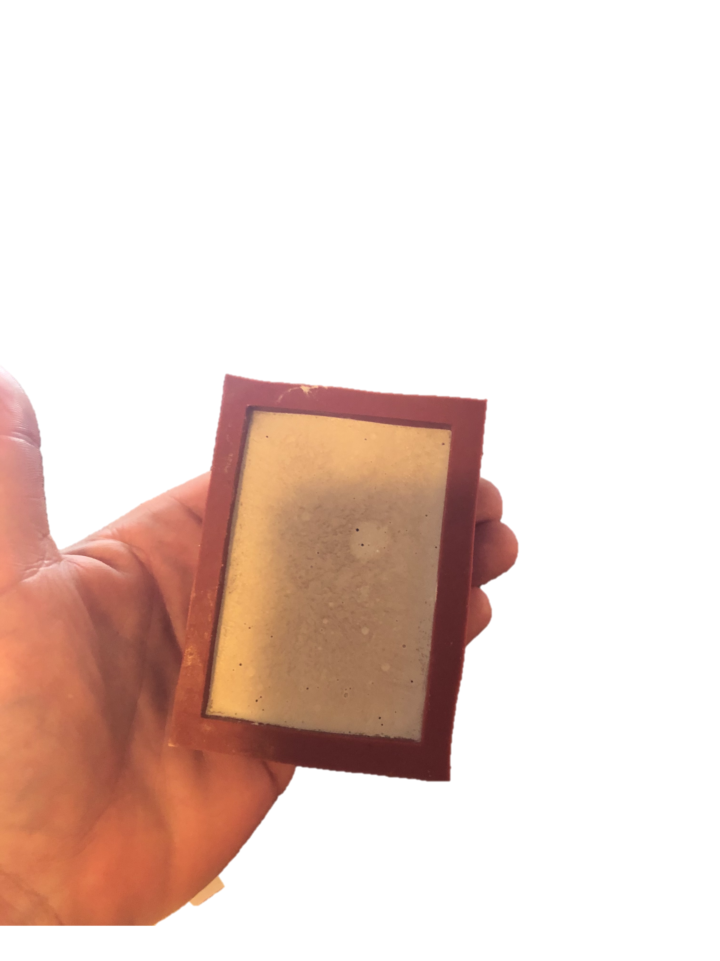
Kentucky Kemistry
The students would first learn the process of soapmaking and the chemistry behind it, then apply that knowledge by teaching community members the process.
The community members would produce their soap for their use.
The students were selected, and the process was demonstrated for them.
The next step was for the students to perform the process for themselves.
A Facebook page was to be created advertising the workshop for the community.
Unfortunately, we were unable to complete the whole project due to the restrictions put in place because of the Coronavirus.
Our First Bar
Of Soap

Slide 4
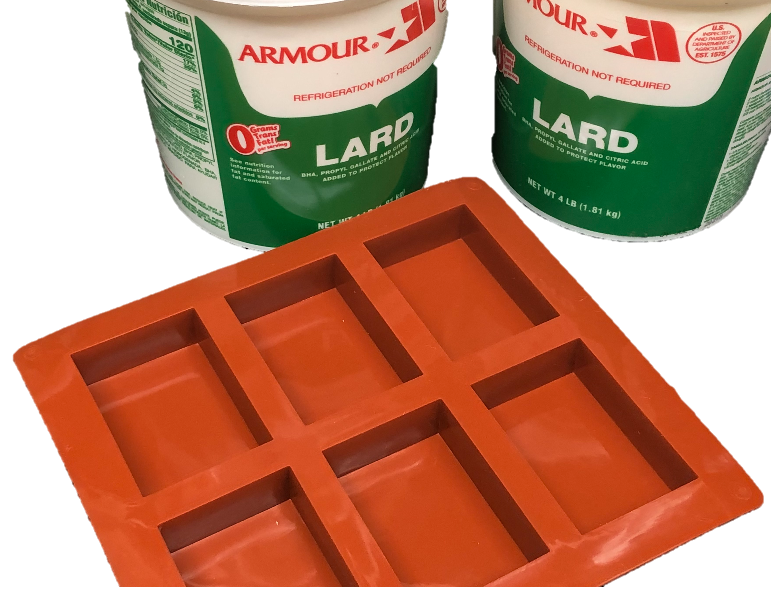
Kentucky Kemistry
Conclusion
Our project progressed to the point of the students creating their own soap and the creation of a Facebook page.
The project itself will be continued upon our return to school or restarted next year with a new group of students.
Eventually, we would like to incorporate this and other activities common to our region into a club-type organization within our school.

