Slide 1
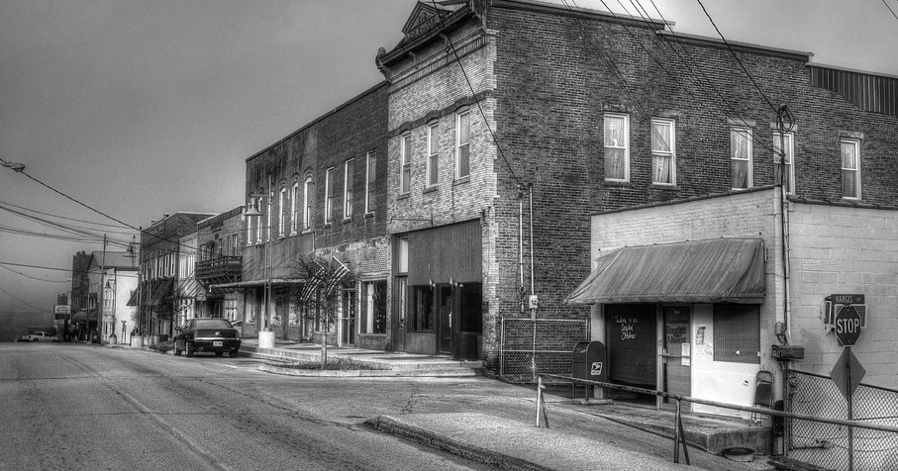
Jackson Independent’s Student Senate Community Challenge
Redesigning Main Street
Data Collection from JACKSON ISD COMMUNITY SURVEY
JCS is in partnership with KVEC and REL Appalachia.

Slide 2
MS Student Leadership Team Presenting Community Challenge Project in Frankfort, KY

Slide 3
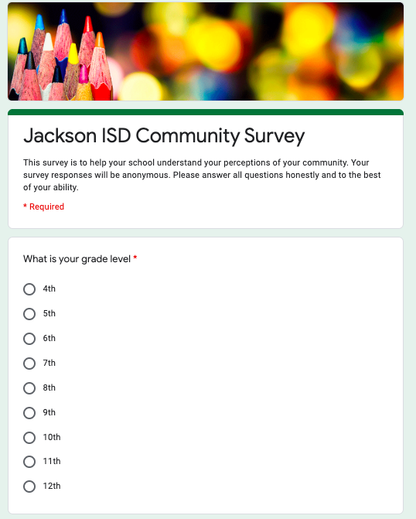
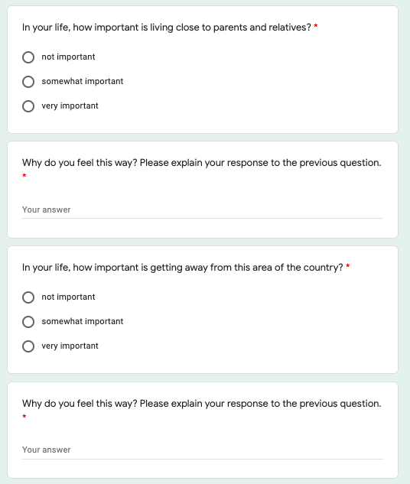
Jackson ISD Community Survey
Survey was posted on JCS Website

Slide 4
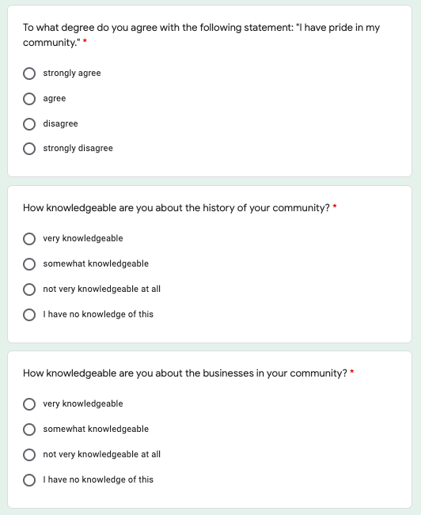
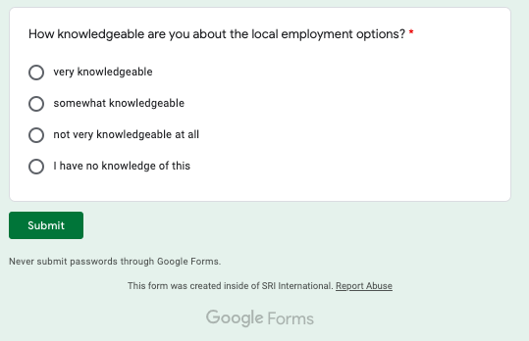
Jackson ISD Community Survey

Slide 5
Percentage of students per grade that took survey. 178 Responses

Slide 6
In your life, how important is living close to parents and relatives?

Slide 7
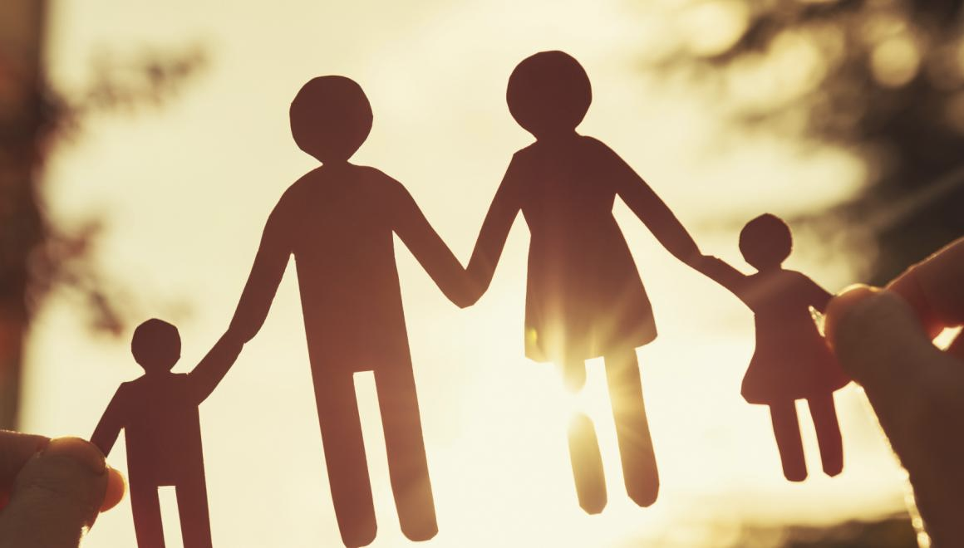
How important is it to live near your family? Why do you feel this way
Because
I need my family
They keep me safe, provide for me, take me to church, teach me about God and other important things in life, ex.
I want to be connected and close to family because they are an important part in my life and
I love them very much.
I love to be surrounded by people that I love and people that love me,
it makes me so happy!
It is very important because we always see each other special events or a family reunion to see all the family.

Slide 8
In Your life, how important is getting away from this area of the country?

Slide 9
How important is getting away from this area of the country?
Not Important
Because this is my home.
I'm happy where I live, and I would want my family to grow up in the same loving environment I grew up in.
I love where I live.
I like living in the country, there are so many things to do outside.
Very Important
The career that I want to do is not offered here.
More things you can do.
This area of the country offers little to no opportunities for some careers of which I wish to pursue.
Experience things I might not be able to experience here.

Slide 10
To what degree do you agree with the following statement:
“I have PRIDE
in my Community.”

Slide 11
How knowledgeable are you about the
history of your community?

Slide 12
How knowledgeable are you about the businesses in your community?

Slide 13
How knowledgeable are you about the local employment options?

Slide 14
Middle School Leadership Team Meets with Mayor Laura Thomas to discuss their ideas and dreams about Jackson.

Slide 15
JCS Middle School Leadership Team and Students work with Crystal Media in co-operation with Zoo Fam Production

Slide 16
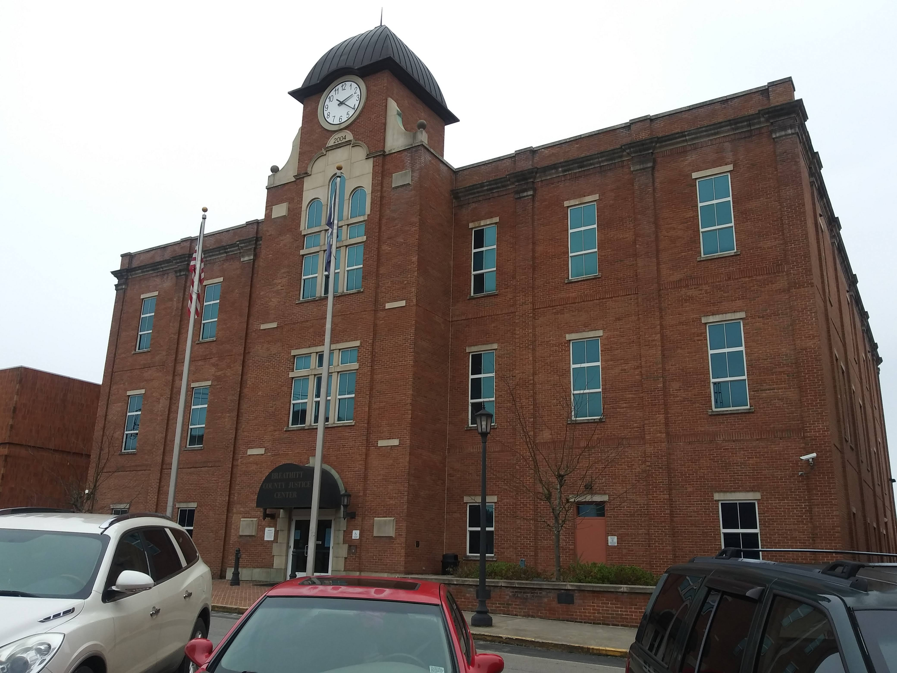
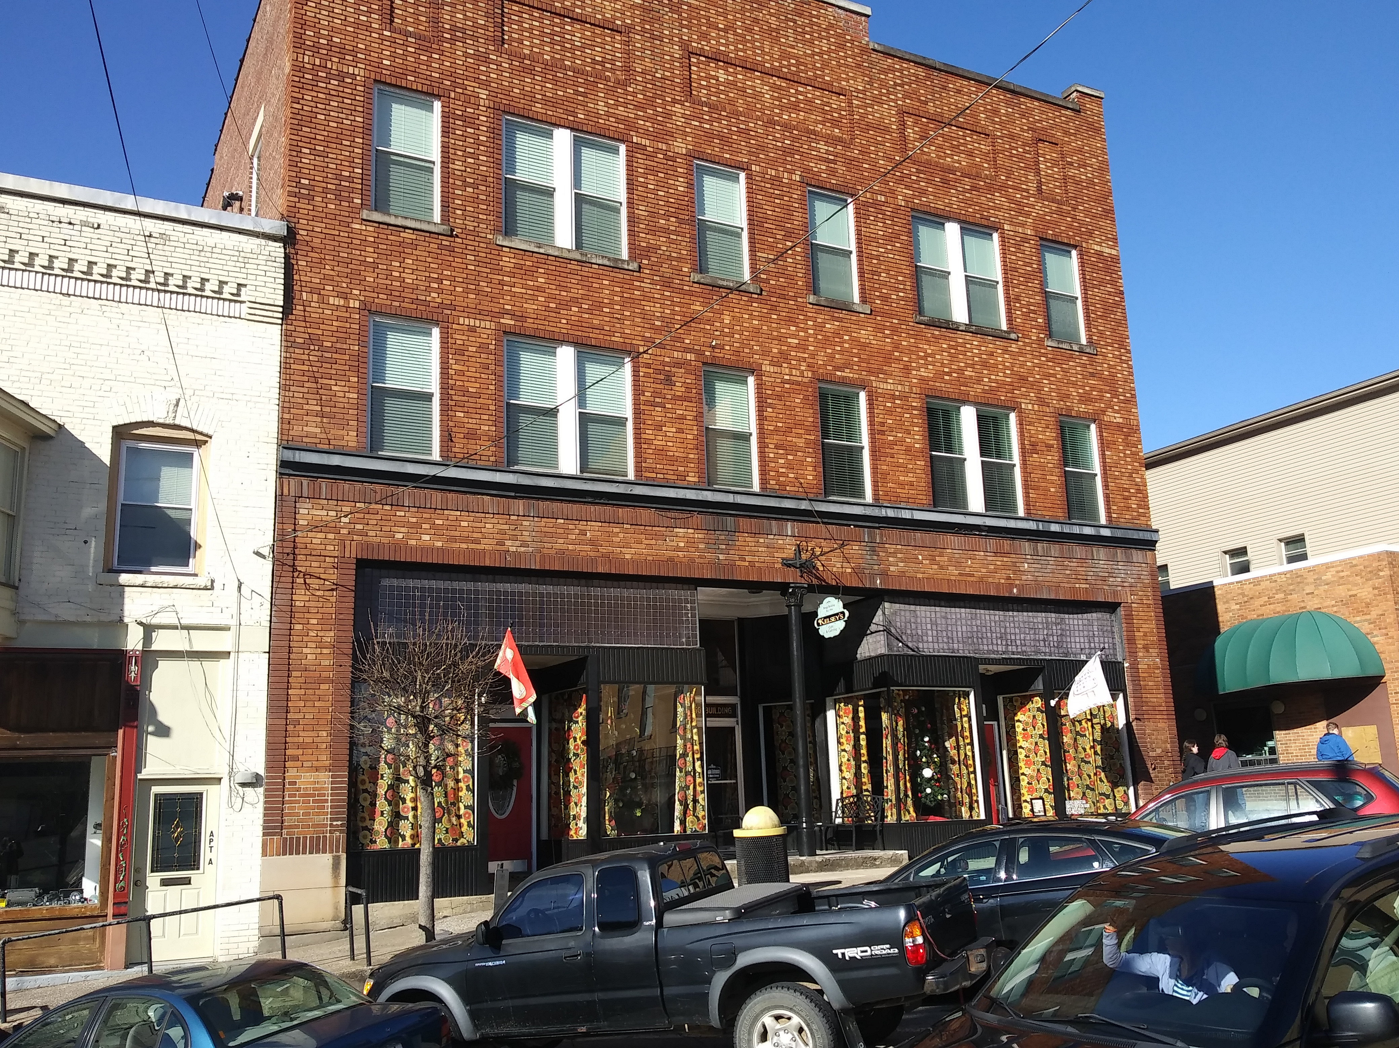
Mr. Coots’ STEM Class used digital cameras to capture building images for students to create Models

Slide 17
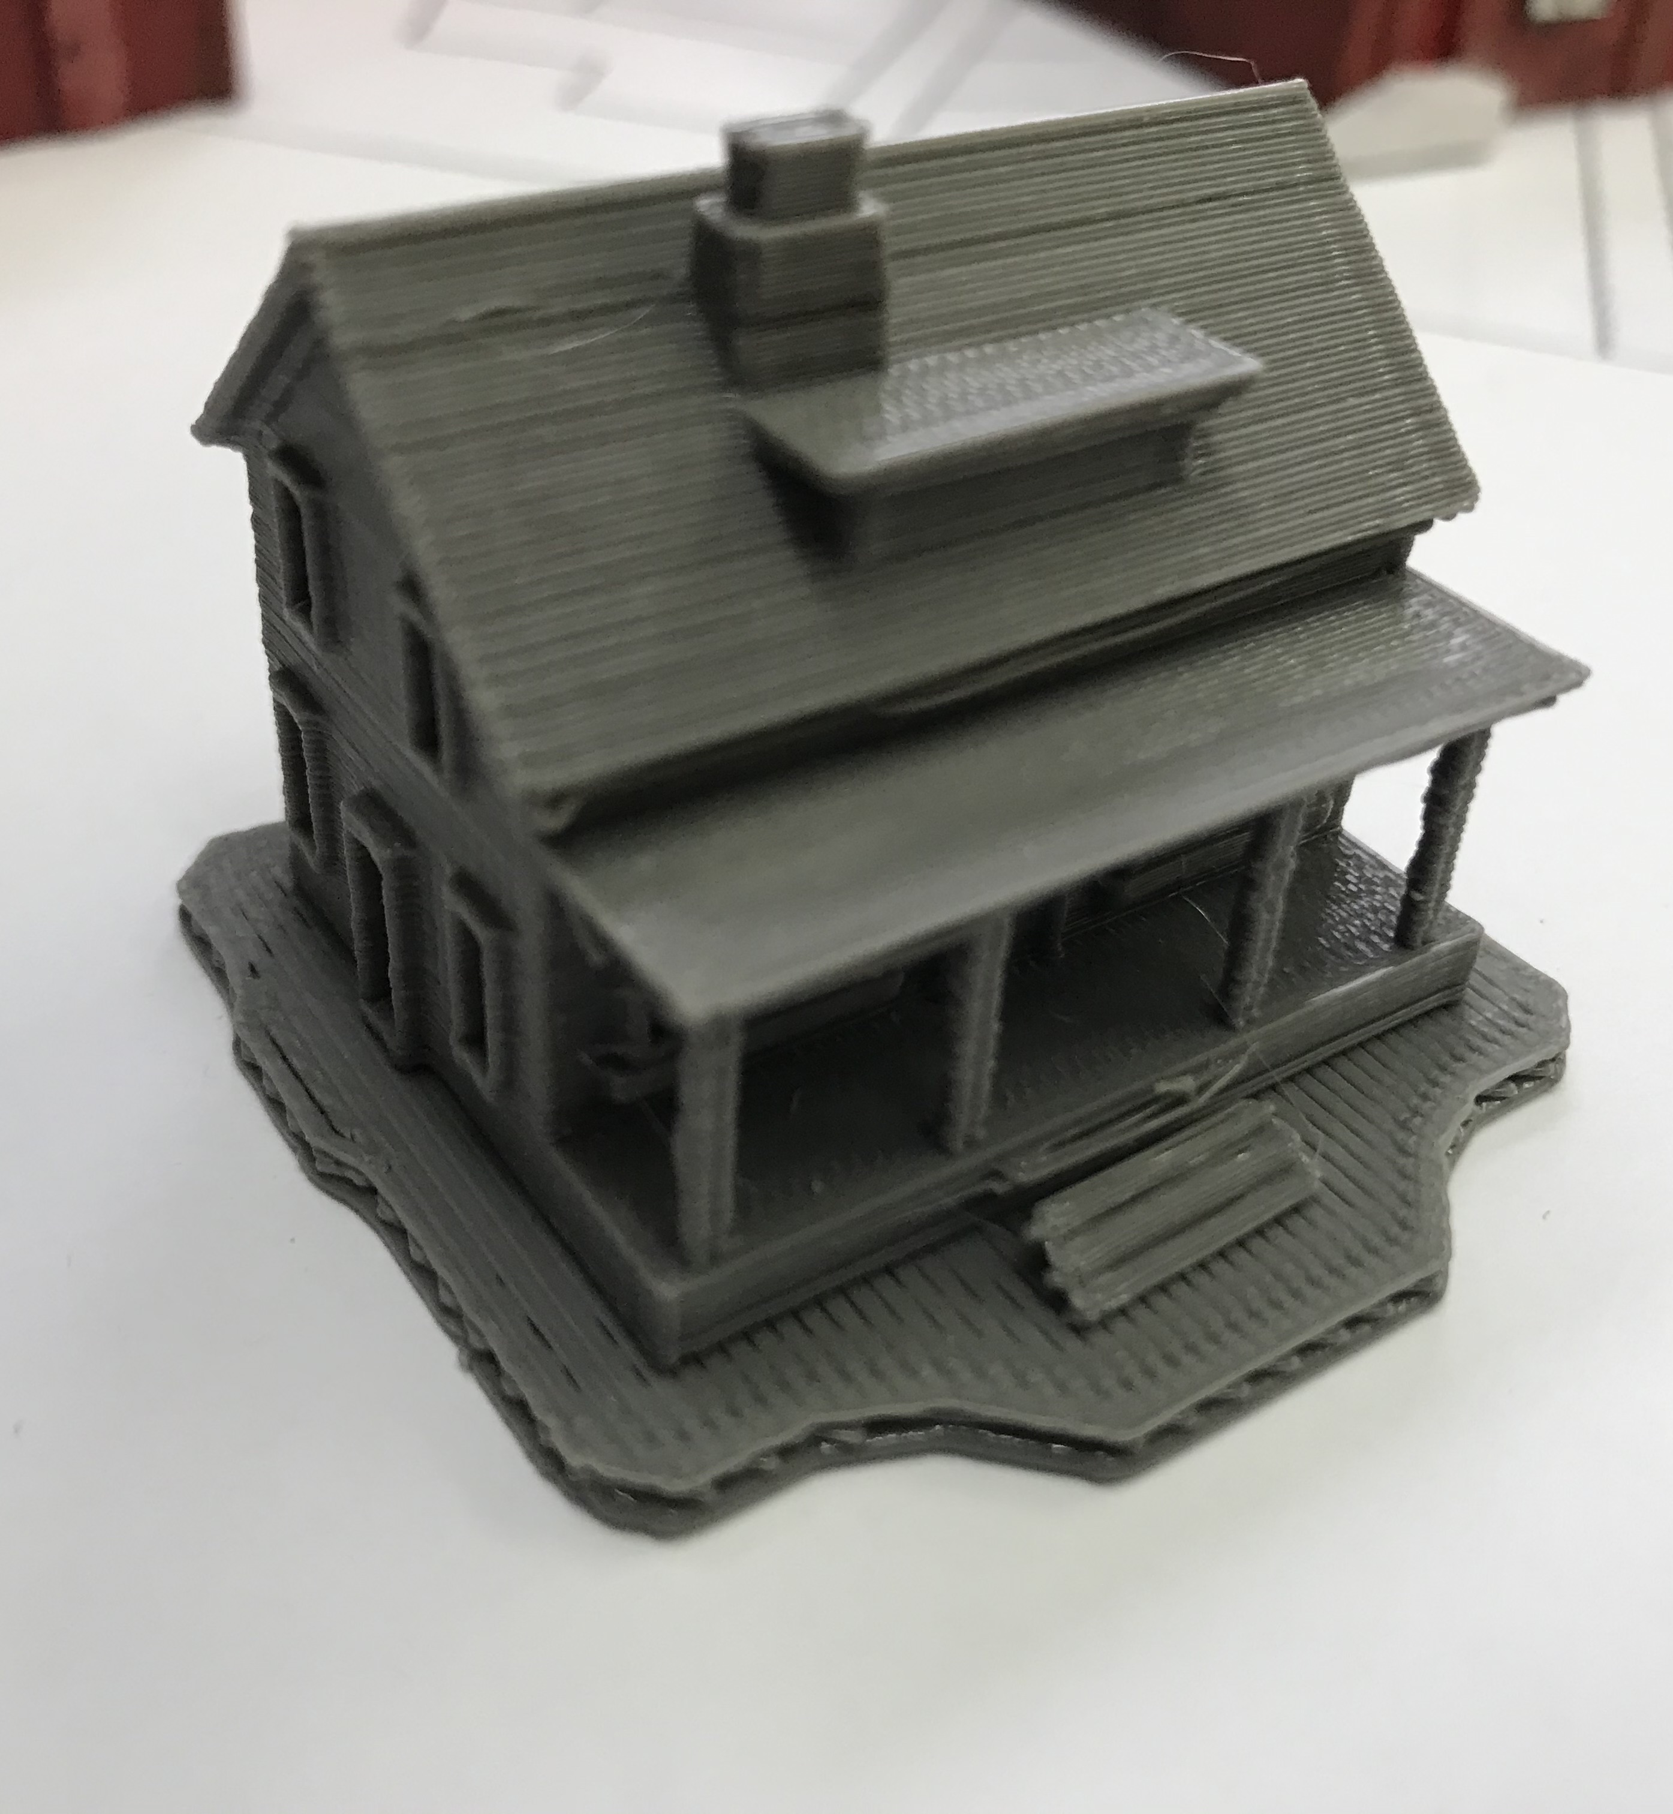
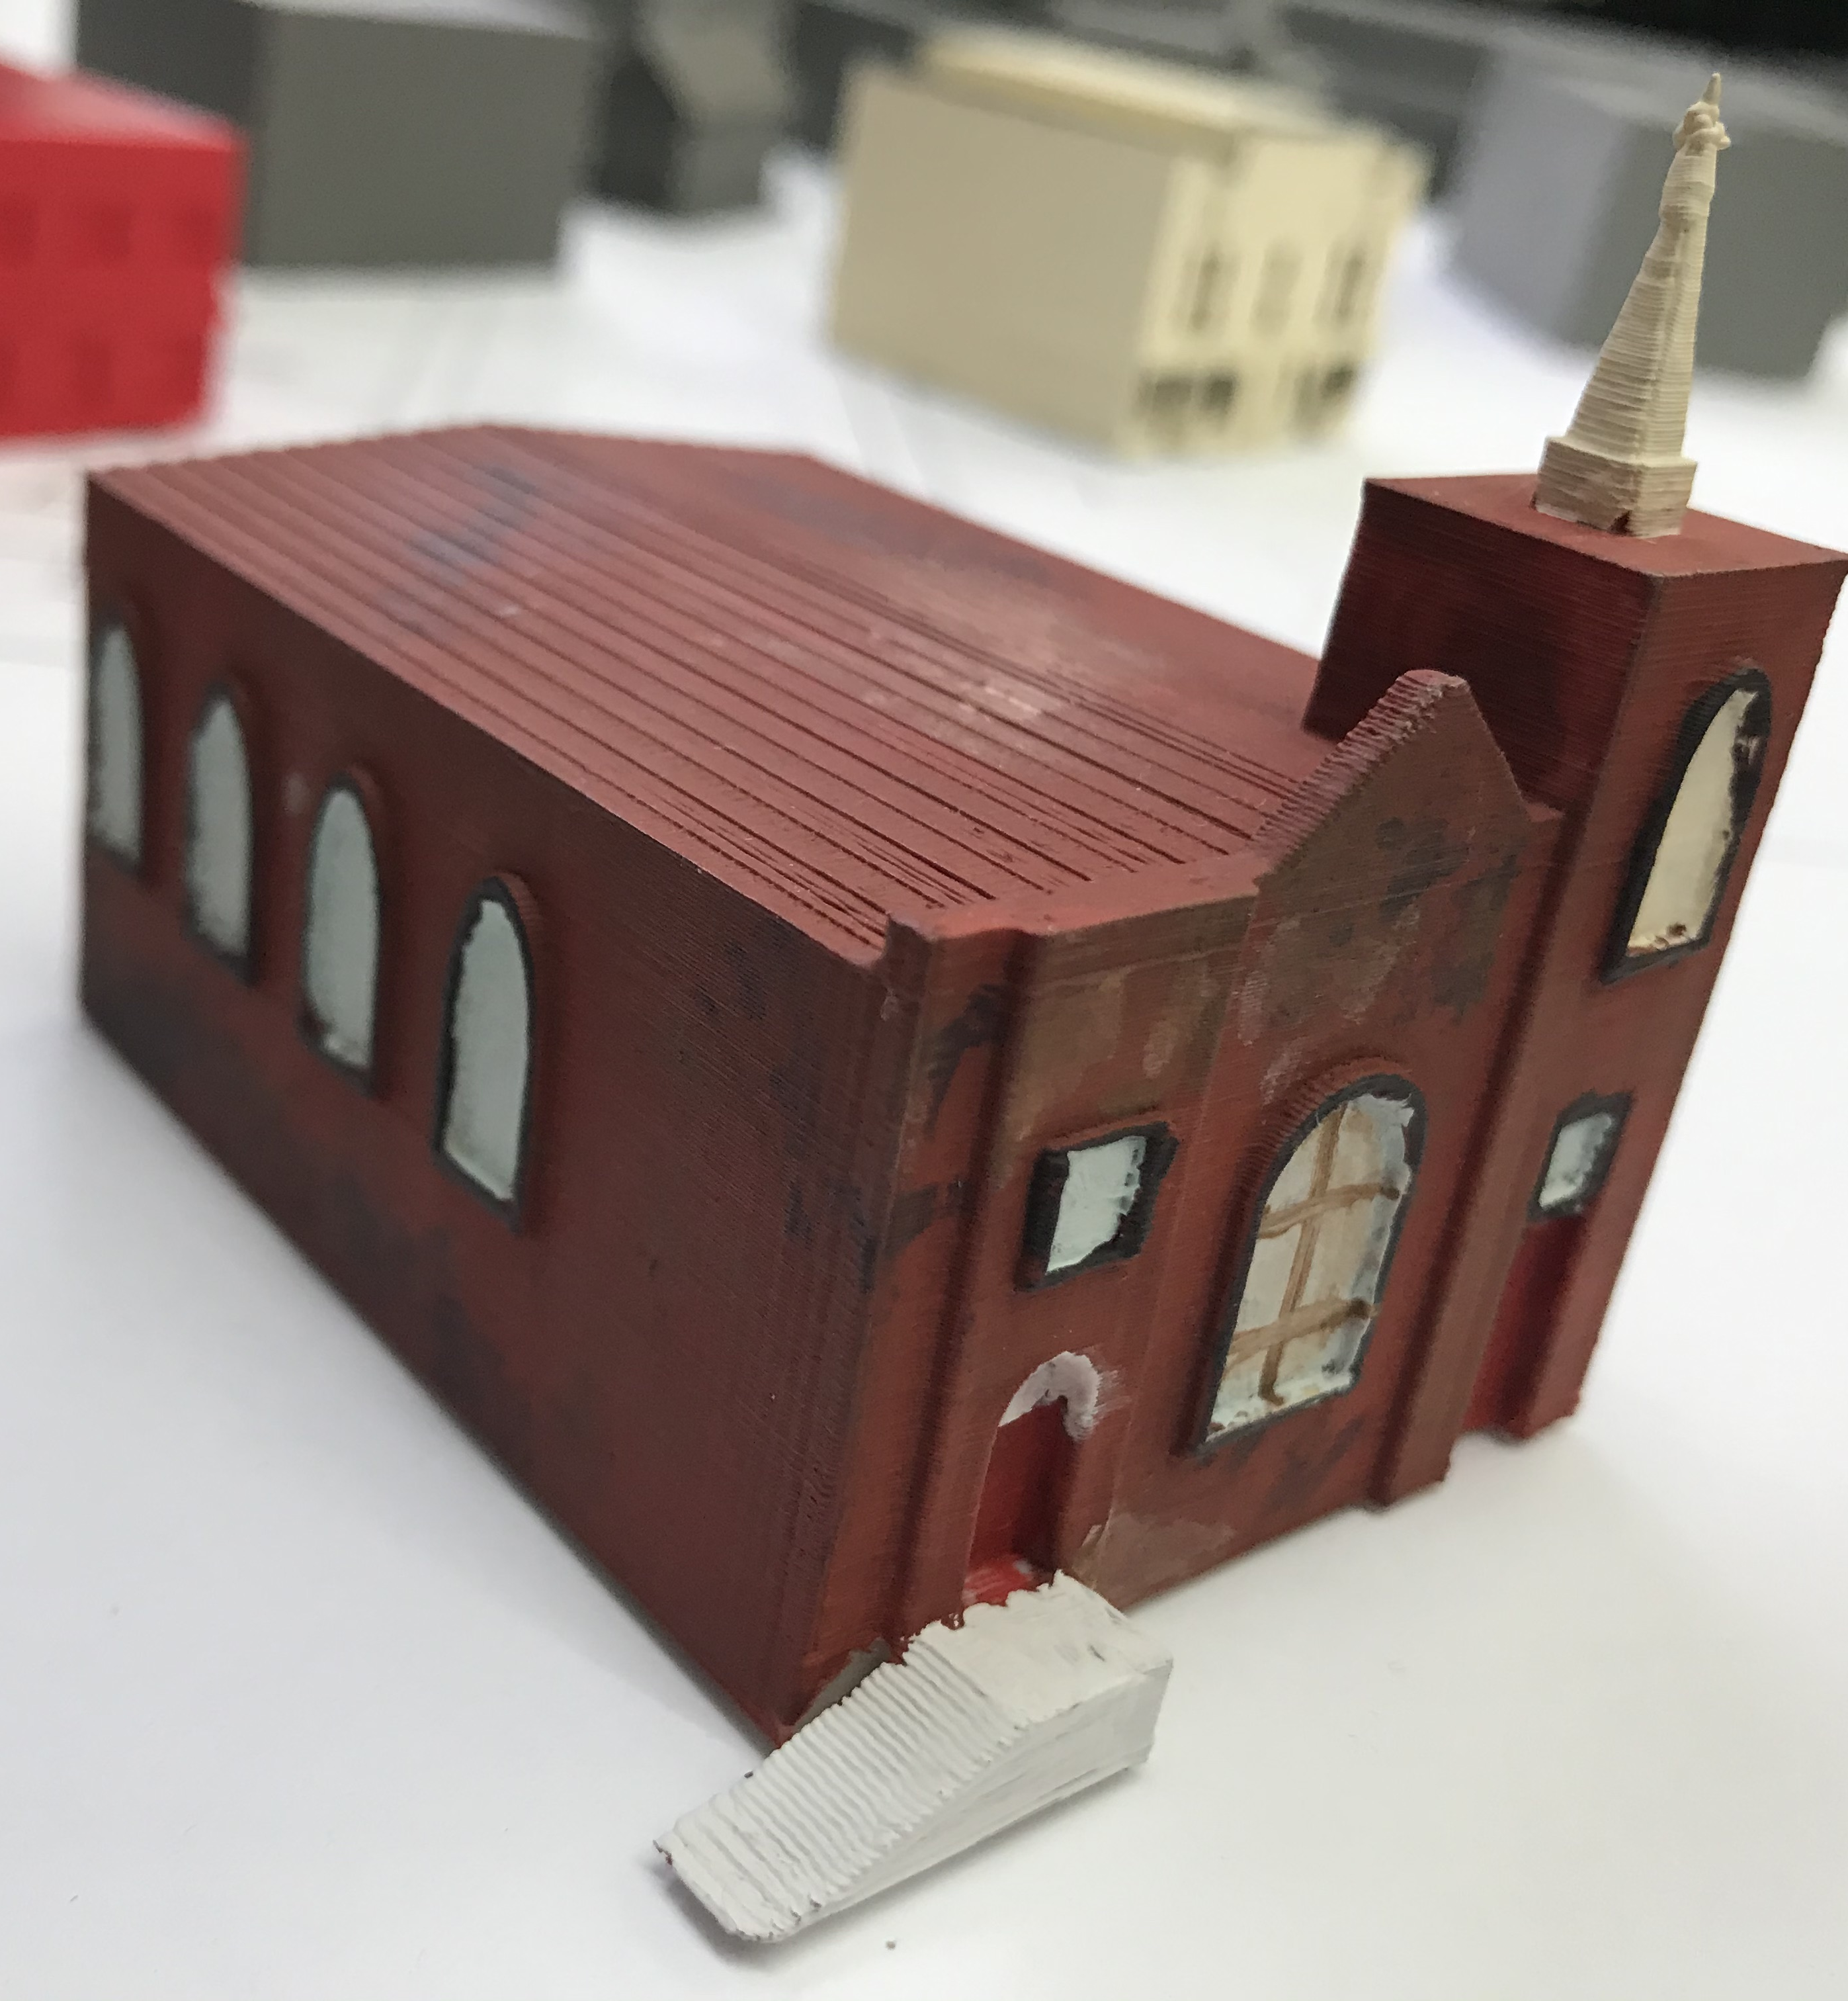
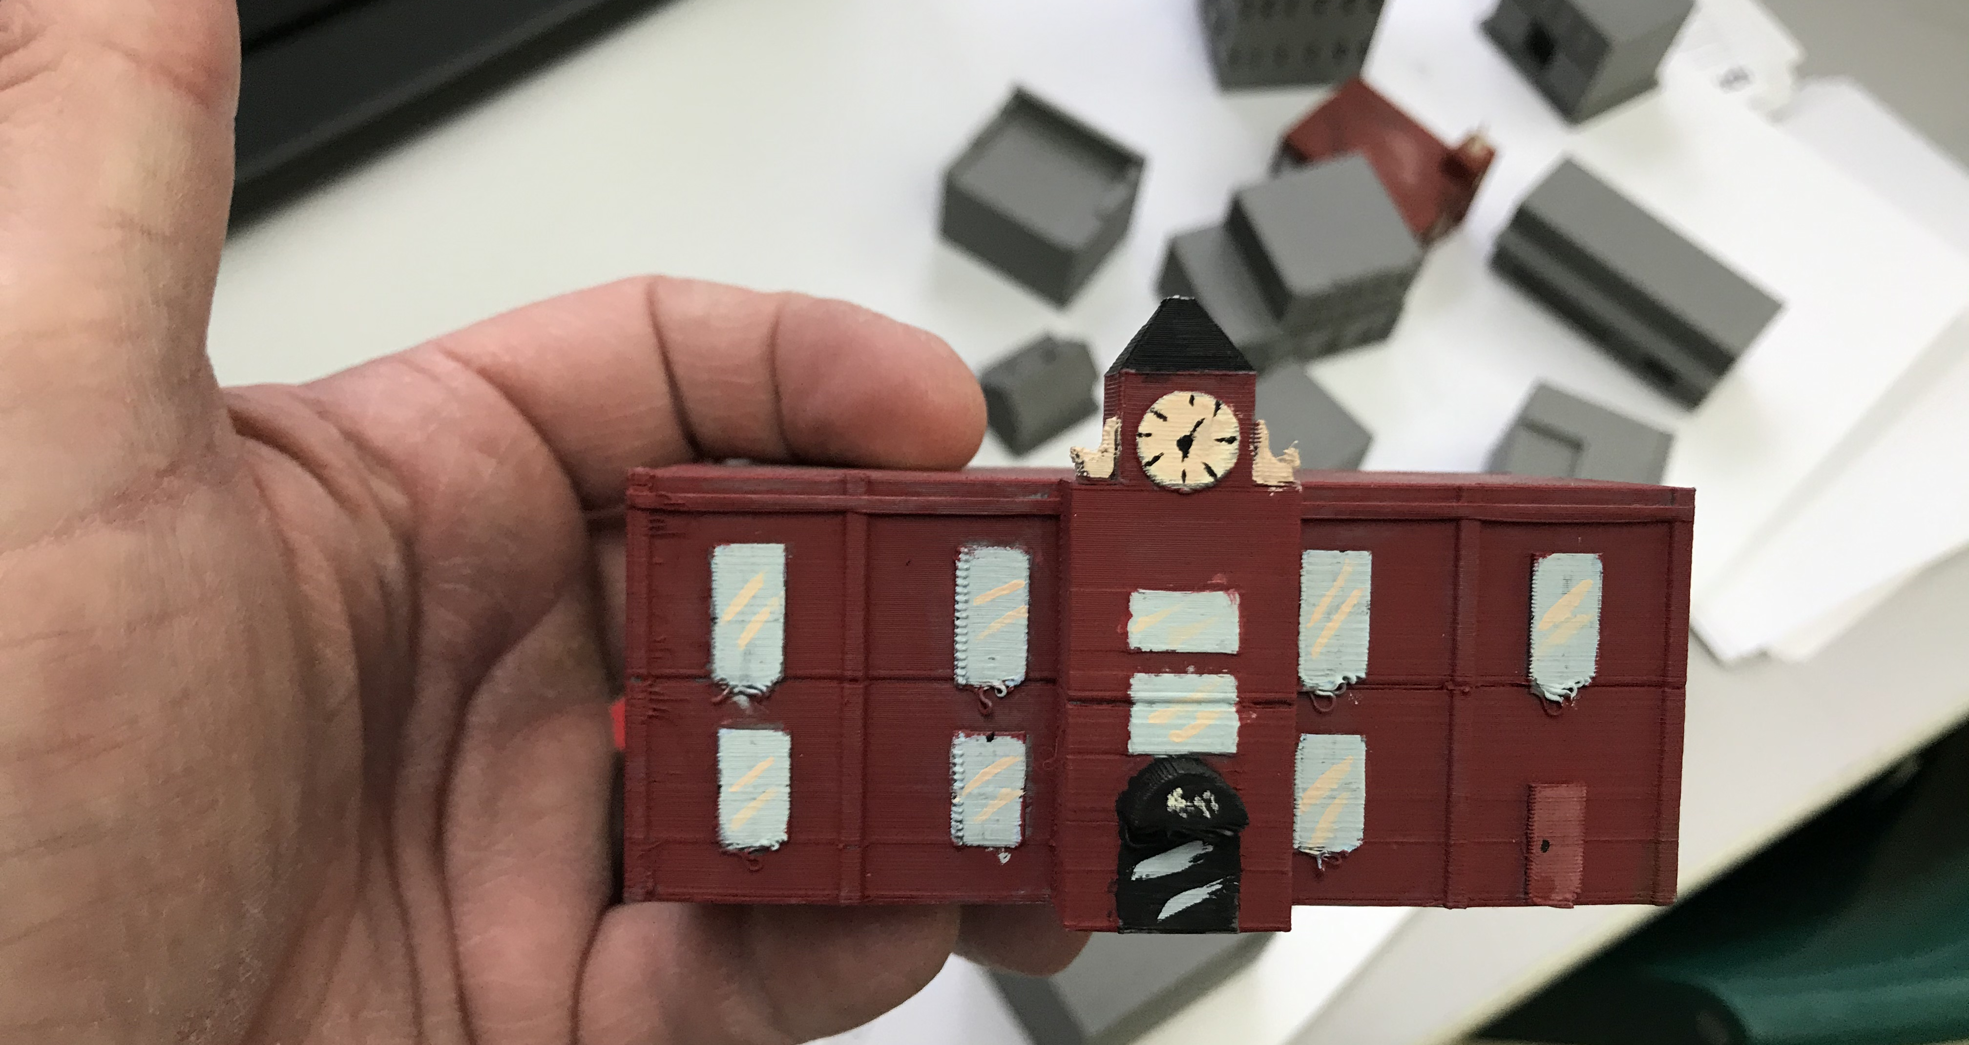
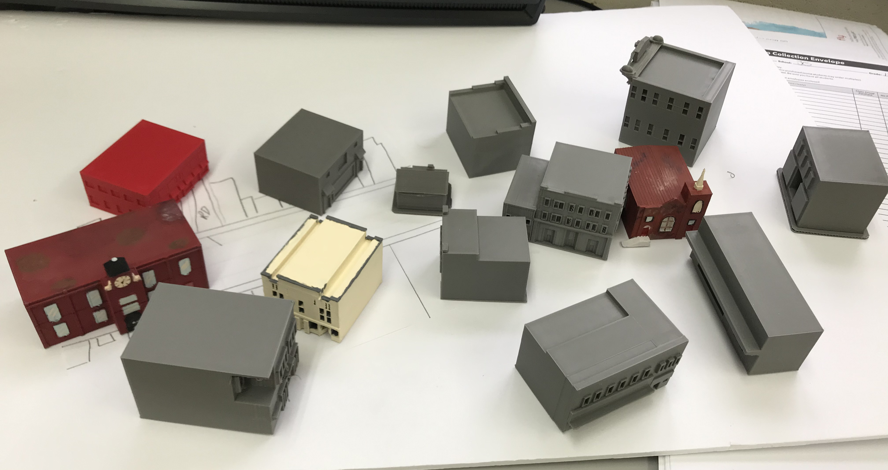
Student Models: Students used Tinckercad to design models and worked with Art Class to finalize models

