Slide 1
Harmony Director
for Paintsville
April Sexton
Paintsville Independent Schools Music Department

Slide 2
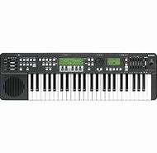

Slide 3
How can I give highly concentrated training in harmony, intonation, rhythm, and timing efficiently within a limited time in order to help improve overall student performance?

Slide 4
I began implementing the use of the Yamaha HD-200 Harmony Director keyboard at the end of February (it was in such high demand that the Harmony Director was on back-order until then) to address the problem with harmony, intonation, rhythm, and timing issues in our band to prepare us for Concert Assessment in March. Even the little use of the Yamaha HD-200 Harmony Director keyboard did help excel our school band quicker towards great blend, intonation, harmony, rhythm and timing, In the future, I will use this with my choir and general music classes as well to start them off on the right foot towards early musical literacy accuracy giving them a better understanding of exact rhythms, timing, harmony, and intonation from the beginning.
The Yamaha HD-200 Harmony Director Keyboard is a comprehensive teaching tool that brings harmony training, rhythm training, and sense of timing together in one convenient electronic keyboard. The level of understanding gained by using this instructional keyboard program has helped, even in the small amount of time it’s been used, to take our ensemble's musicianship to the next level. Almost all Japanese school bands use this special training tool that, until now, has only been available in Japan. The Yamaha Harmony Director keyboard allows me to teach through examples rather than words alone, the kind of harmonic understanding that normally takes many years of experience to develop.

Slide 5
In the fall I said that by the end of the school year there should be a noticeable difference in the band and choir’s overall intonation and sense of rhythm and timing along with the elementary music classes. These noticeable differences will be evident at our end-of-the-year concerts and performance events, and we will be able to measure these noticeable differences with the judges comments and scores at our annual Band Assessment Festival.
I was only able to use the Harmony Director for a few weeks with my band, but I could tell a noticeable difference in how quickly the students were able to make adjustments based on what they were hearing me play through the Harmony Director. At our annual Band Assessment Festival we only had 13/17 players due to sickness, yet we were still able to score a Proficient rating. I do believe that was partly due to our use of the Harmony Director. Next year we hope to be Distinguished.

Slide 6
What did you do?
At the beginning of the year I requested a Harmony Director, which is a keyboard that is so much more than a keyboard. The Harmony Director can be used as a metronome (to help keep a steady beat), a tuner (to help everyone play or sing in tune with each other), and it can quickly transpose to a different key. For example, trumpets are in the key of Bb, whereas keyboards are in the key of C. Instead of having to mentally transpose the trumpet part in my head while playing it on the keyboard, on the Harmony Director I can push a button to transpose the entire keyboard into the key of Bb and push another button to make it sound like a real trumpet and play along with my trumpet section so they can hear what their part is supposed to sound like exactly. In choir, I had the sheet music for a song we wanted to sing, but it was too high for their voice ranges. With the Harmony Director, I was able to push the transpose button and put the keyboard in a key that fit my choir’s vocal ranges while still being able to read the sheet music in my hand.

Slide 7
Why did you do it?
I teach over 300 kids a week. Some of them I see everyday for 45 minutes, and others I only see once a week for 45 minutes. That’s a lot of kids with a short amount of time. I am constantly looking for ways to improve my teaching and help what I’m teaching to “stick”. I was looking for yet another way that I could give highly concentrated training in harmony, intonation, rhythm, and timing efficiently within a limited time in order to help improve overall student performance.

Slide 8
How did it work?
I honestly don’t feel like I’ve used my Harmony Director enough to have the results I was looking for yet, but I’ve used it just enough to be able to tell that it’s going to work. When I received the Harmony Director I instantly began using it with my band because we had concert assessment coming up in a few weeks (All bands across the state and nation participate in a type of assessment where bands play certain songs for a panel of judges who have their music in front of them. The judges follow along looking and listening for the band to play correct notes, rhythms, phrases, expression, etc.). The past two years the number one judge’s comment had been about our lack of playing consistently in tempo, so this year that was my main focus this year. From the beginning of the school year I had been using a metronome with every band rehearsal; however, the metronome I was using was difficult to use (it was difficult to change the tempo, change the beat, it had to be set up across the room from me so it was difficult for me to get to it and adjust it quickly, etc.). With the Harmony Director, I am able to have it right in front of my director’s podium so even while I’m conducting I can reach down at any moment and turn the metronome on or off, change the tempo, change the beat emphasis, etc. and all this without having to interrupt the band. As a result, this year at assessment we were commended by all the judges on our precise tempos and accurate rhythms.

Slide 9
How did it/will it impact student learning?
The Harmony Director has impacted student learning by making it easier for me as the director to access tools to help my ensembles (such as the metronome, the transposition tool, the different instruments I can access, etc.). An ensemble can only be as good as their director, and as the director improves, student learning will definitely be impacted in a positive way.

Slide 10
What did you learn? (Evidence may include: data, photographs, student work, tools, video, etc.)
I have learned that, if used to its fullest potential, any teaching aid can help students improve in their overall performance in any subject area. In my case, I believe the Harmony Director is helping to accelerate how quickly my students are able to learn and understand a concept and put it into practice. I am looking forward to using the Harmony Director from the beginning of the school year next year to get a better idea of how much impact it truly does have on my ensembles.

Slide 11
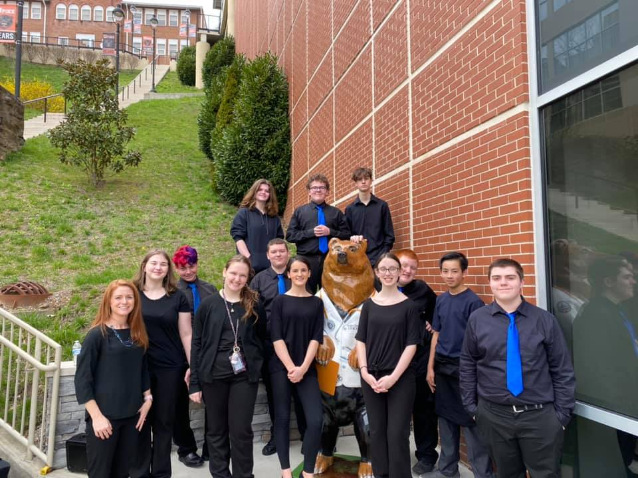
Paintsville band at upike for band assessment 2020

Slide 12
