Slide 1
By: Whitney NEvarez
FANTASTIC FLOORS
MSD K-8th
East Perry Elementary
Perry County

Slide 2
Project
I designed a sensory walk experience on our hallway floor to help calm students while transitioning in and out of the resource room.
I used 5 different sticker activities for the hallway.
We have 2 entrances to the hallway therefore I didn’t place the stickers all flowing in the same direction. As you enter the hallway on either side you are able to follow a path.

Slide 3
Reasons for my project
-Student behavior changes when they leave or return to the resource rooms. The behaviors and times vary from child to child. Students may miss general education classes, their lunch time, programs and assemblies due to behaviors that occur during transition.
Documented Behaviors during transitioning:
Running
Jumping
Screaming
refusing to walk
hitting others
hitting themselves
kicking walls

Slide 4
Did it work?
Students were thrilled with the sensory floors. Evidence shows that student participation increased and negative student behaviors decreased.
Not only did the floors provide a distraction during transition times, it also provided “brain breaks” during instruction.

Slide 5
Impact
Students spent MORE time engaged in instruction and LESS time having meltdowns.
Students were able to take breaks in the hallway in between instruction which caused fewer meltdowns.
Physical therapist and Occupational therapist were able to use the hallway to work with students on goals.
We saw SMILING faces when they entered our classrooms in the morning!!

Slide 6
What I learned…the data

Slide 7
Data description
Data was ONLY collected on students that are on my caseload. I have a total of 10 students with Functional Mental Disability.
Kindergarten – 1
2nd Grade-1
4th Grade-2
5th Grade- 1
6th Grade- 1
7th Grade- 2
8th Grade- 2
I collected data using a check sheet with the behaviors I witnessed the most.
Physical Behaviors
Running in the Resource Room hallway
Refusing to attend their general education classes with peers
Refusing to leave a desired area and transition back to the resource room
I collected the “Before Behaviors” during the months of October and November for a total of 30 school days. I collected the “After Behavior” in January, February, and part of March for a total of 30 schools days.

Slide 8
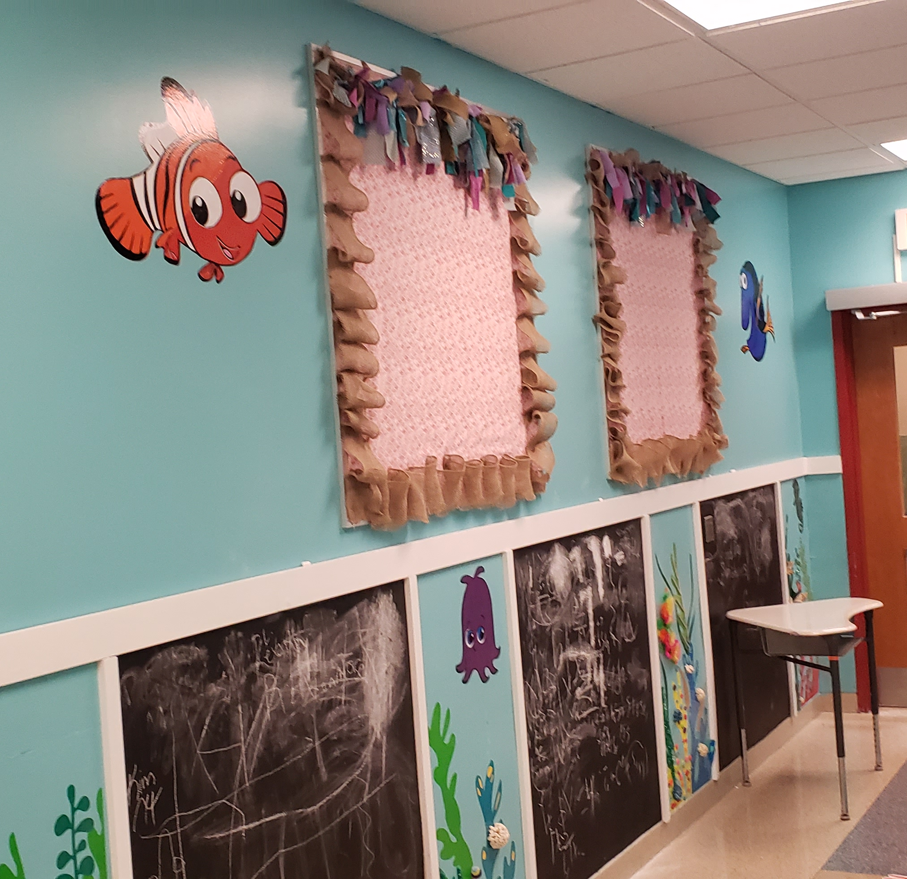
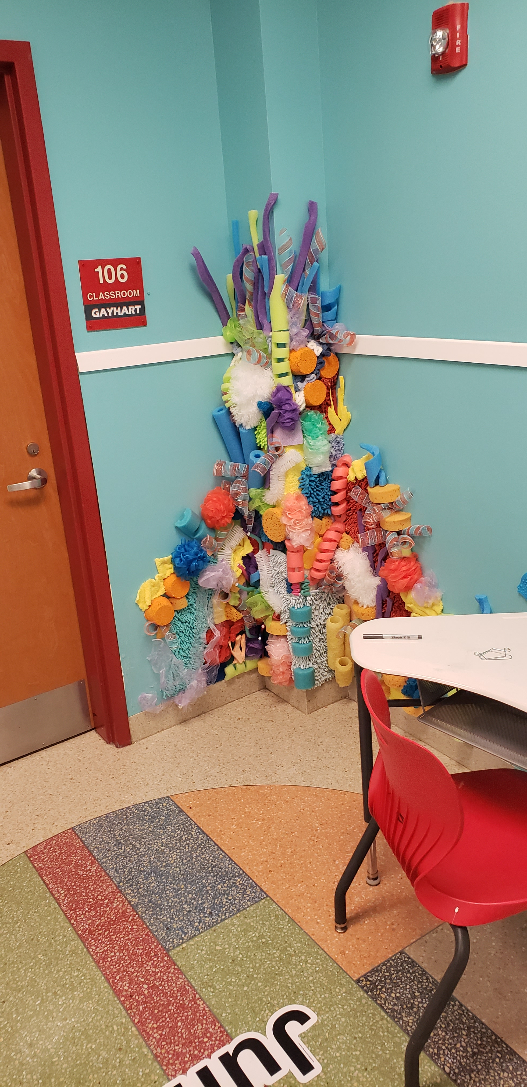
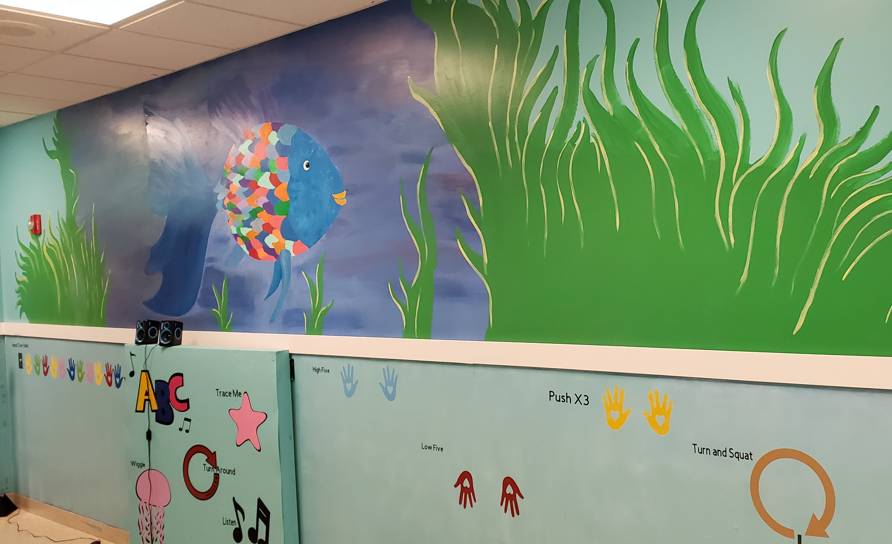
The ocean side

Slide 9
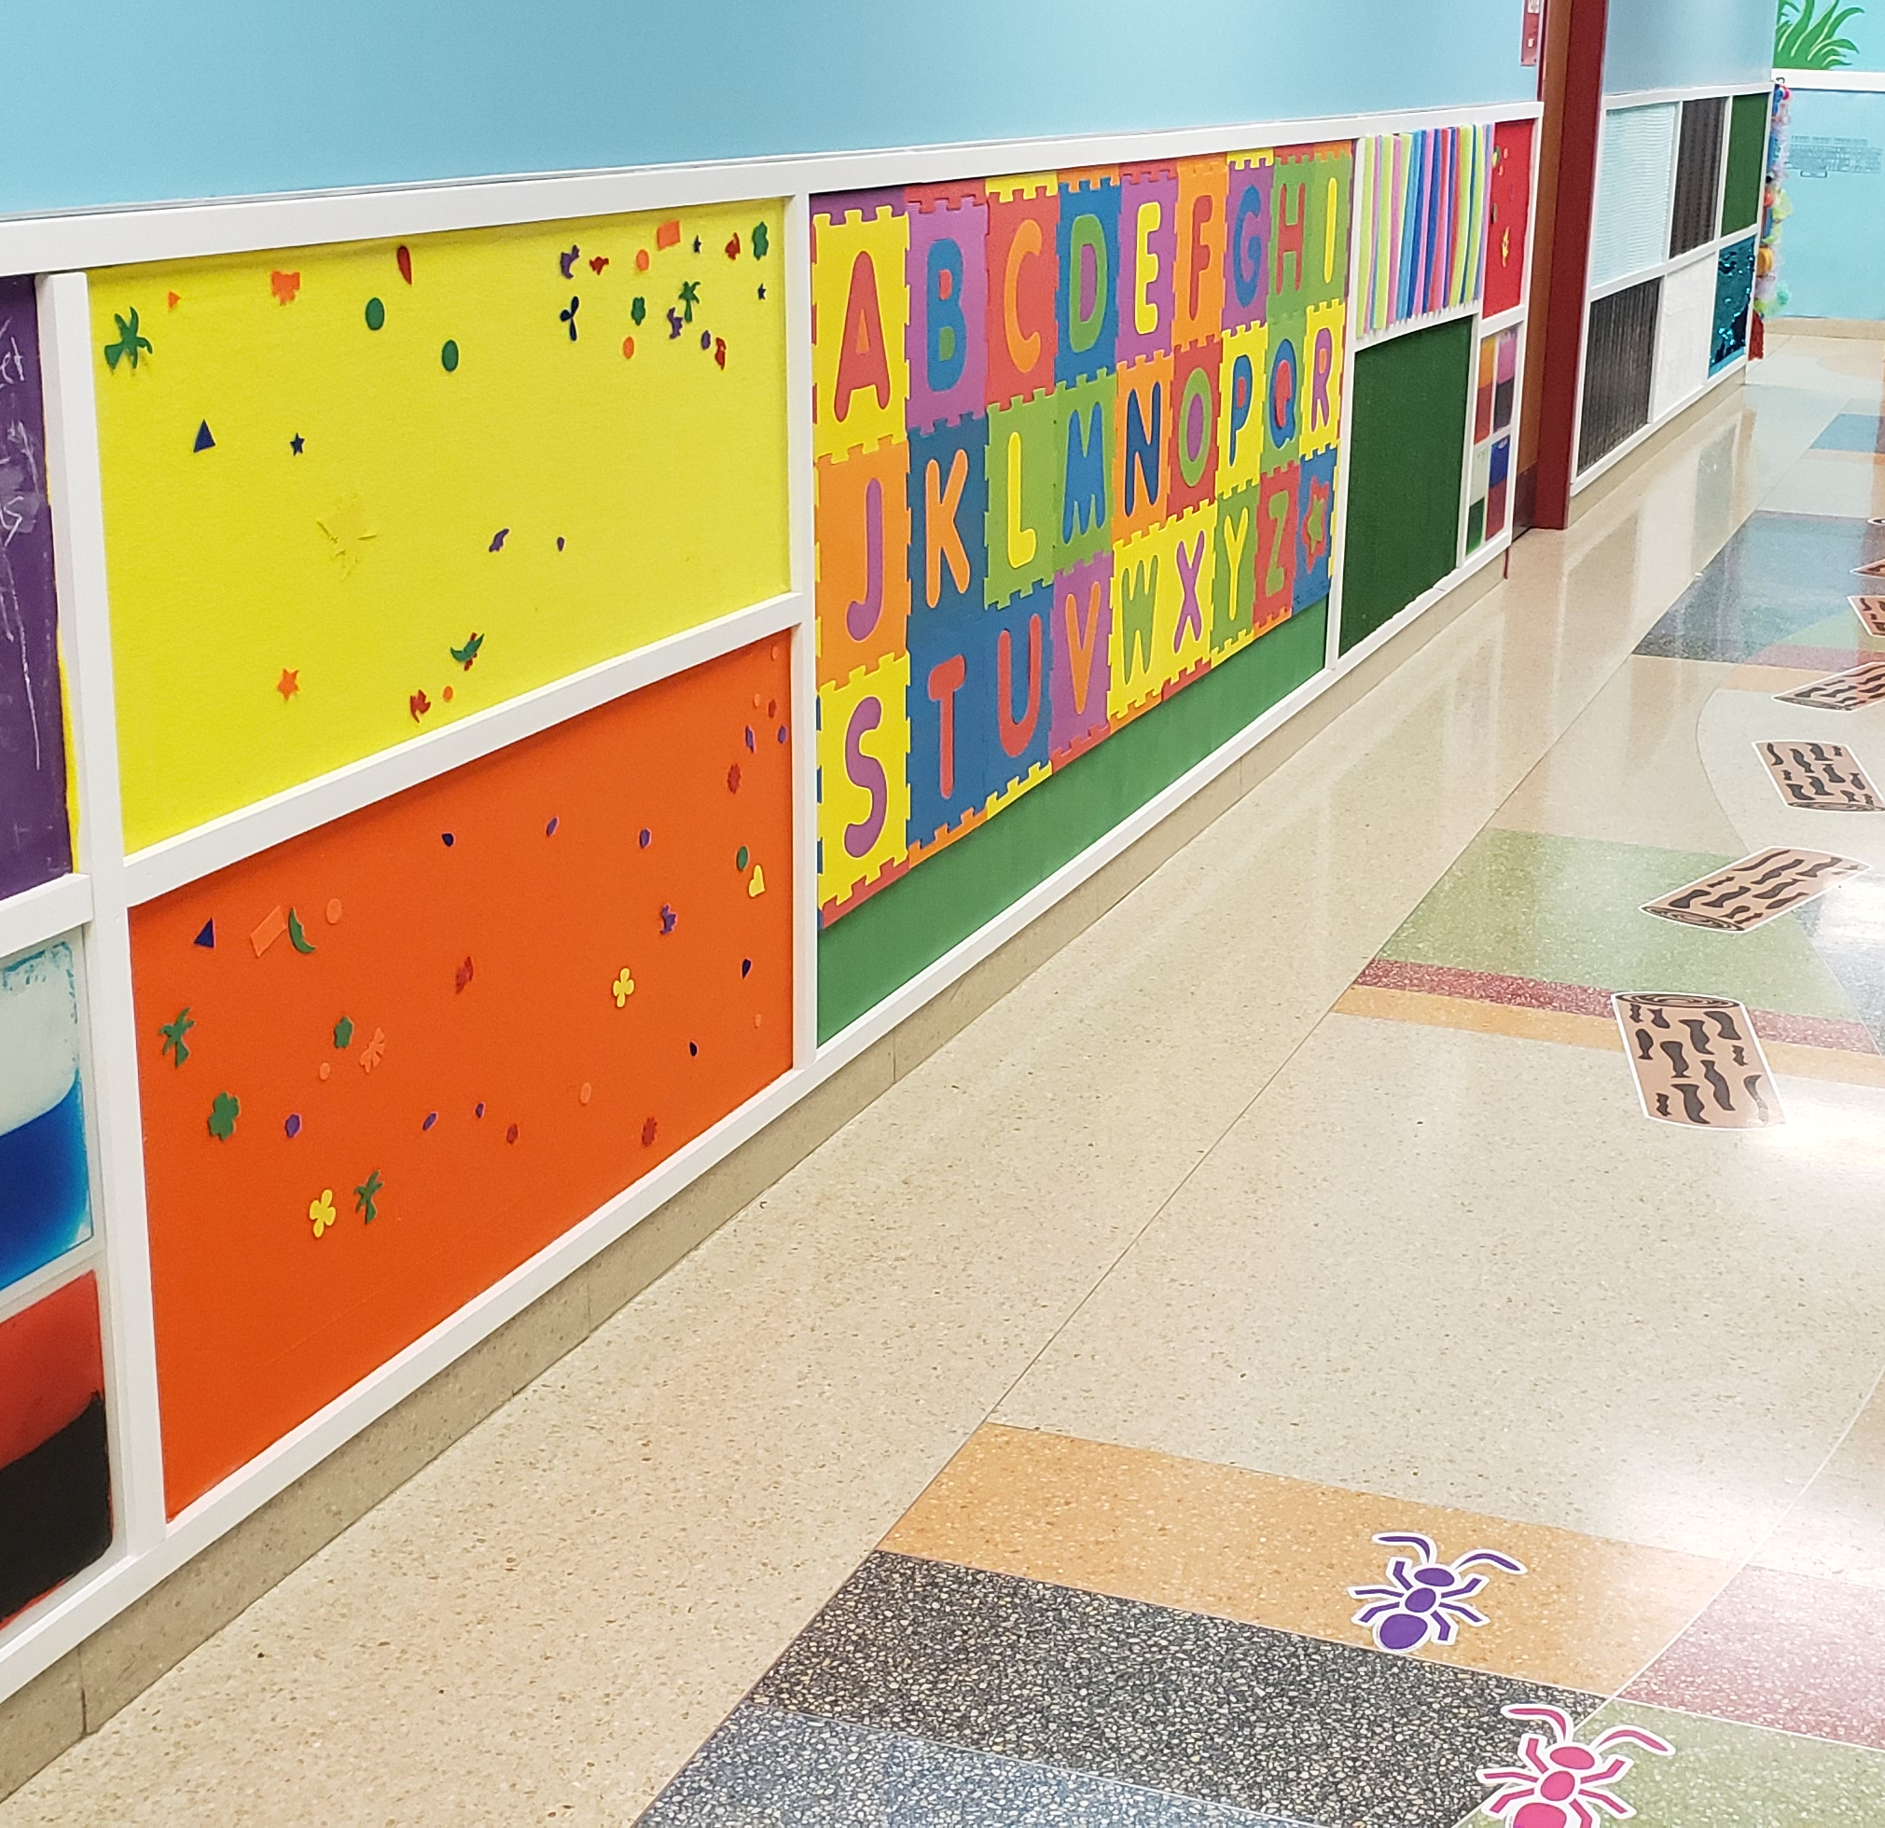
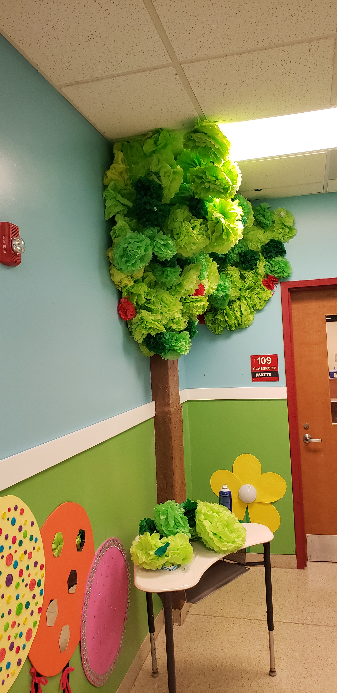
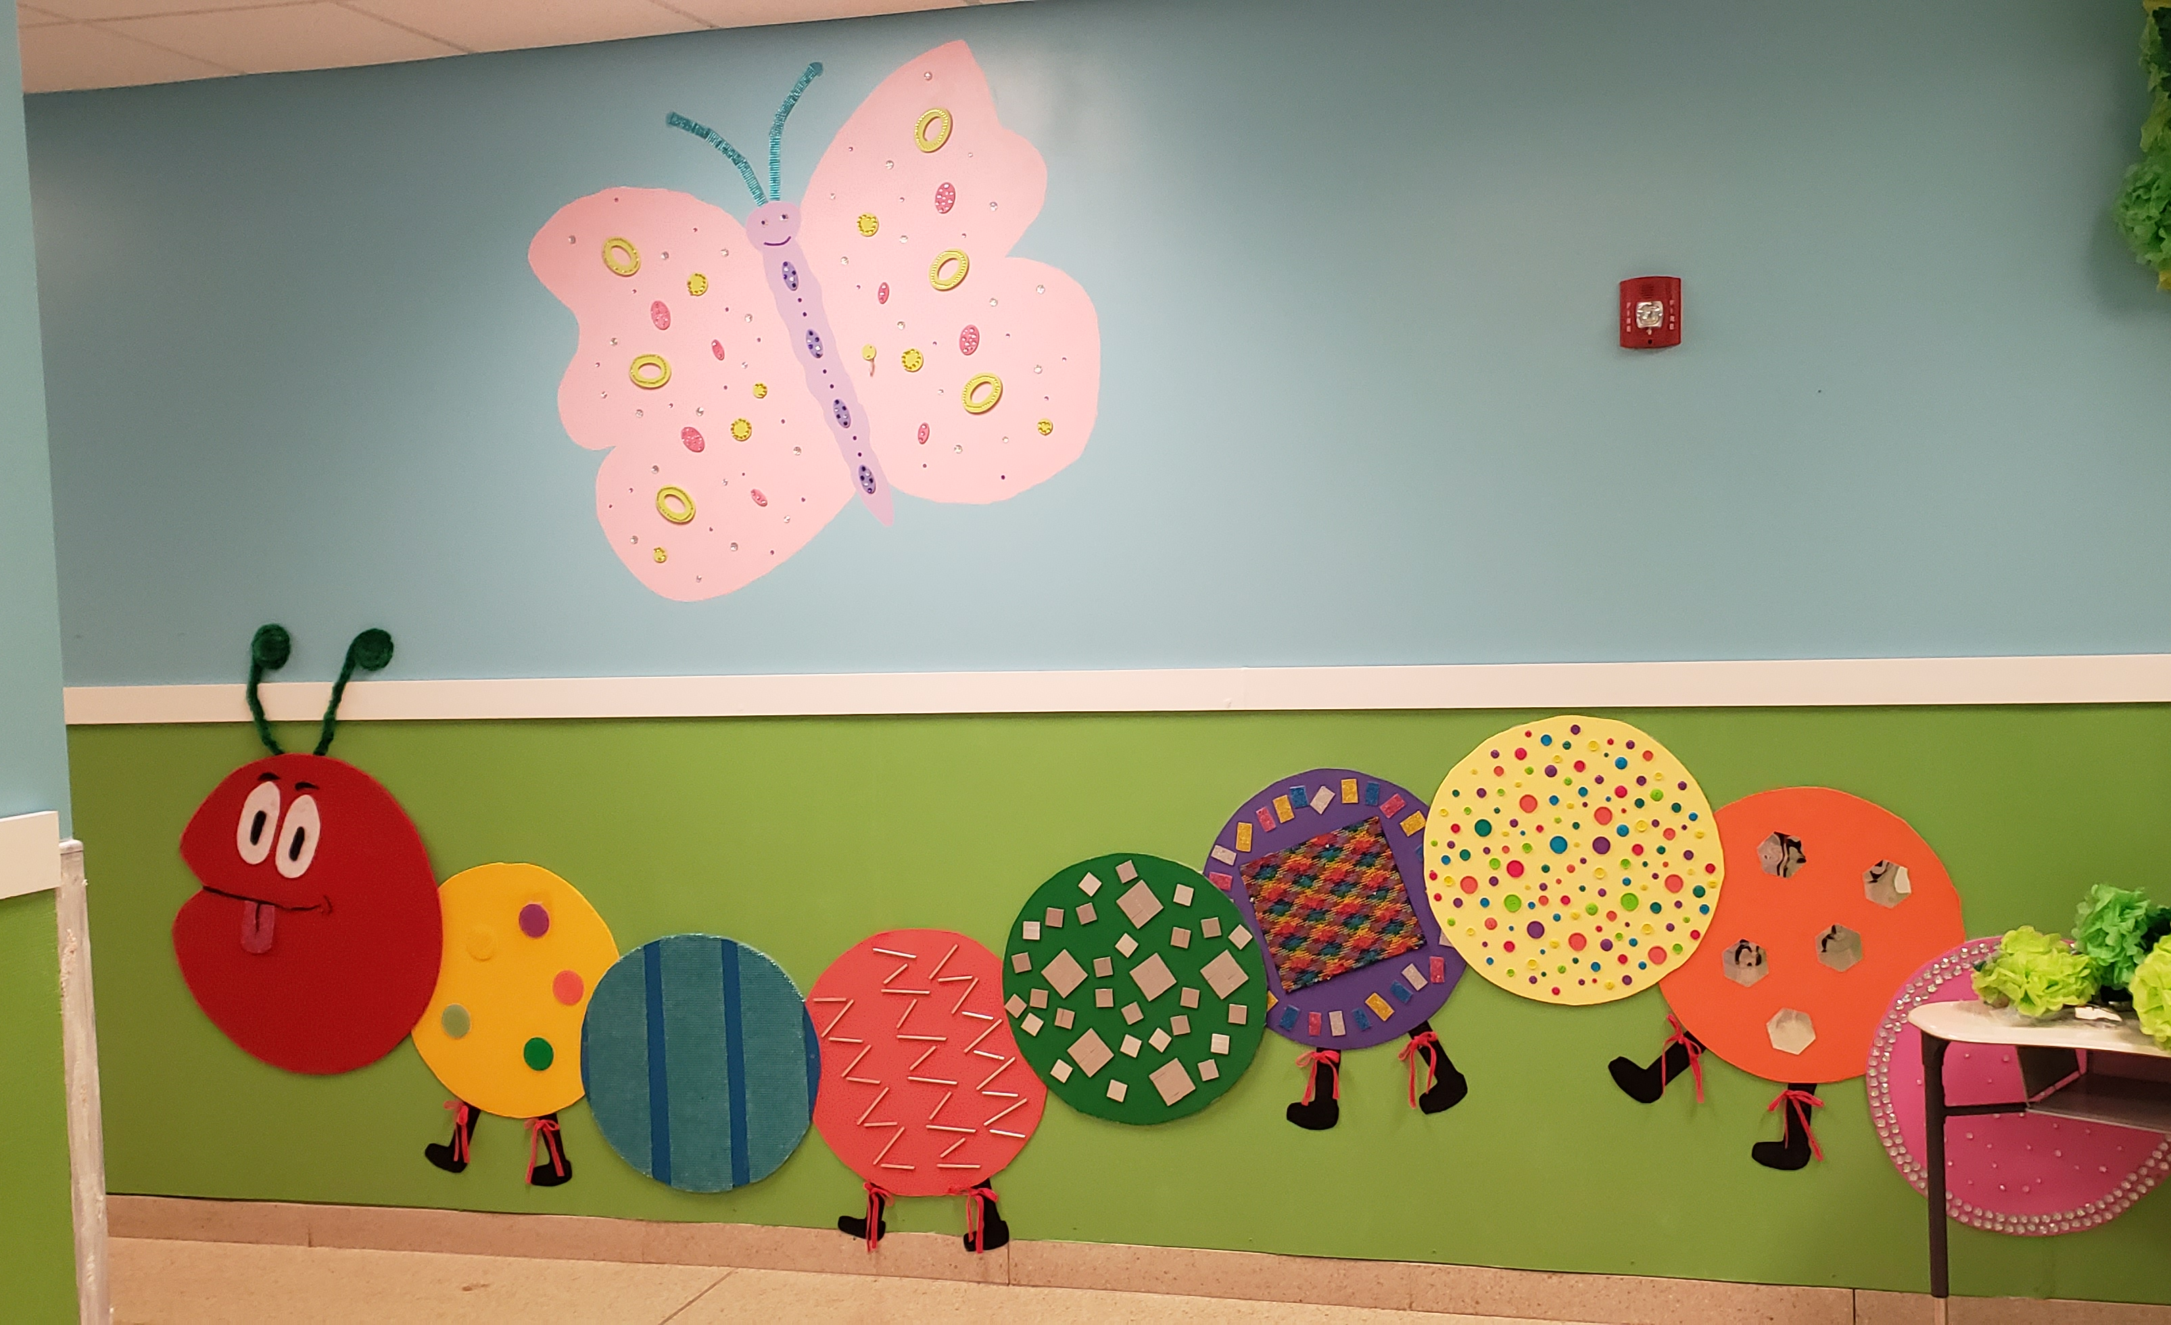
The land side

Slide 10
THANK YOU!
I Thank You, so very much for the opportunity to participate in this Learning Innovation. I have learned a lot and I feel that with the grant money I was provided, we were able to help students achieve in the classroom.
Thank you.

