Slide 1
Generation Z: Buddy Benches
SPECIAL EDUCATION TRANSITION INNOVATION GRANT
Letcher County Central High School
Julie Amburgey, Emily Kincer, and Joey Kincer

Slide 2
What is our project?
Looking at our school culture we saw the need to bring our youth together working beyond their digital screens and into the real life around them while also tying in their vocational trainings to create our school a safe space for inclusion and grow our empathy based knowledge as well as skills.
While doing this we wanted to incorporate a previous grant awarding of Personalized Digital Portfolios to allow our students to showcase their skills and specialties in a digital manner. We crafted the plan to construct buddy benches to be designed and built by our students, teach them empathy based skills to speak to peers, and have a ‘no tech zone’ to build there face to face abilities.

Slide 3
What was our Problem of Practice?
Will the utilization of digital portfolios (cohesive documentation of their individual skills through picture, video, displaying certificates earned, show job experience, utilize online resources, the HOLLER, ILP, IXL certificates, and more), empathetic lessons, and the implementation of Buddy Benches help guide students to develop skill sets that can bring them transitional success?

Slide 4
How did we know this was a problem?
With the transition component being a major area of focus for our special education population we often find ourselves looking for ways to tie it in to our everyday curriculum and through special outlets to insure we are meeting the needs of our students for the real world. Our area is often associated with the decline of the coal industry and families moving to find jobs to support them. From this we see the combination factor of youth following in the footsteps of family members and seeing the hints of success from others that have left our communities in addition to our youth being plagued by technology reducing their ability to have one on one conversations with individuals face to face.
By assisting students to acknowledge these attributes they have available they are then able to take these successes into a work setting to find success as well as see other opportunities for success.

Slide 5
How did we address the problem?
First component:
We worked with our youth on the empathetic training. Our focus on the training of our students on how to be empathetic listeners. Utilizing various free websites and resources teaching our student how to be empathetic listeners. With this they had to face real life scenarios to act out and find solutions to. The biggest value of this was all of these conversations had be done in a face to face setting.
Second component:
Our second focus was with the building of our Buddy Benches which is the main piece of our project. These benches will be planned, constructed, painted, installed, and utilized by our students.
Third component:
The Cougar Cares group. These students were be responsible for informing our students of the benches and their purpose then helping to facility their accurate usage. Cougar Cares are to wear matching shirts once a week. On these days they will be stationed at these benches between classes to facilitate any conversations with students sitting on these benches.

Slide 6
How did we evaluate ourselves?
To evaluate our selves we looked at key components in relation to transition services seeing if we were able to implement these to best fit the needs of our special education youth. By focusing on these components we were able to better facilitate the usage of the the implementation of their specially designed instruction and further their opportunities to showcase them. All of these components are key pieces to holding any type of position in the working field. As the project moved forward students will gain more independence and be in charge of the major pieces not require as close of monitoring. In addition, we have access to the student Digital Portfolios in order to track their abilities to showcase their skills.
Job readiness
Empathetic listening skills
Empathetic knowledge
Work skills utilized
Problem solving skills
Communication abilities

Slide 7
What resources and personnel did we utilize?
Resources included the lumber, hardware, tools, extension cords, local vendors, t-shirts, metal work, and larger tools for building purposes. All of these resources work together to allow for the success of the project in all aspects from the construction to the implementation.
Personnel utilized for this project were special education teacher, regular education teachers, vocational teachers, outside vendors, and students. All of these individuals were vital to the overall success and execution of the project as a whole.

Slide 8
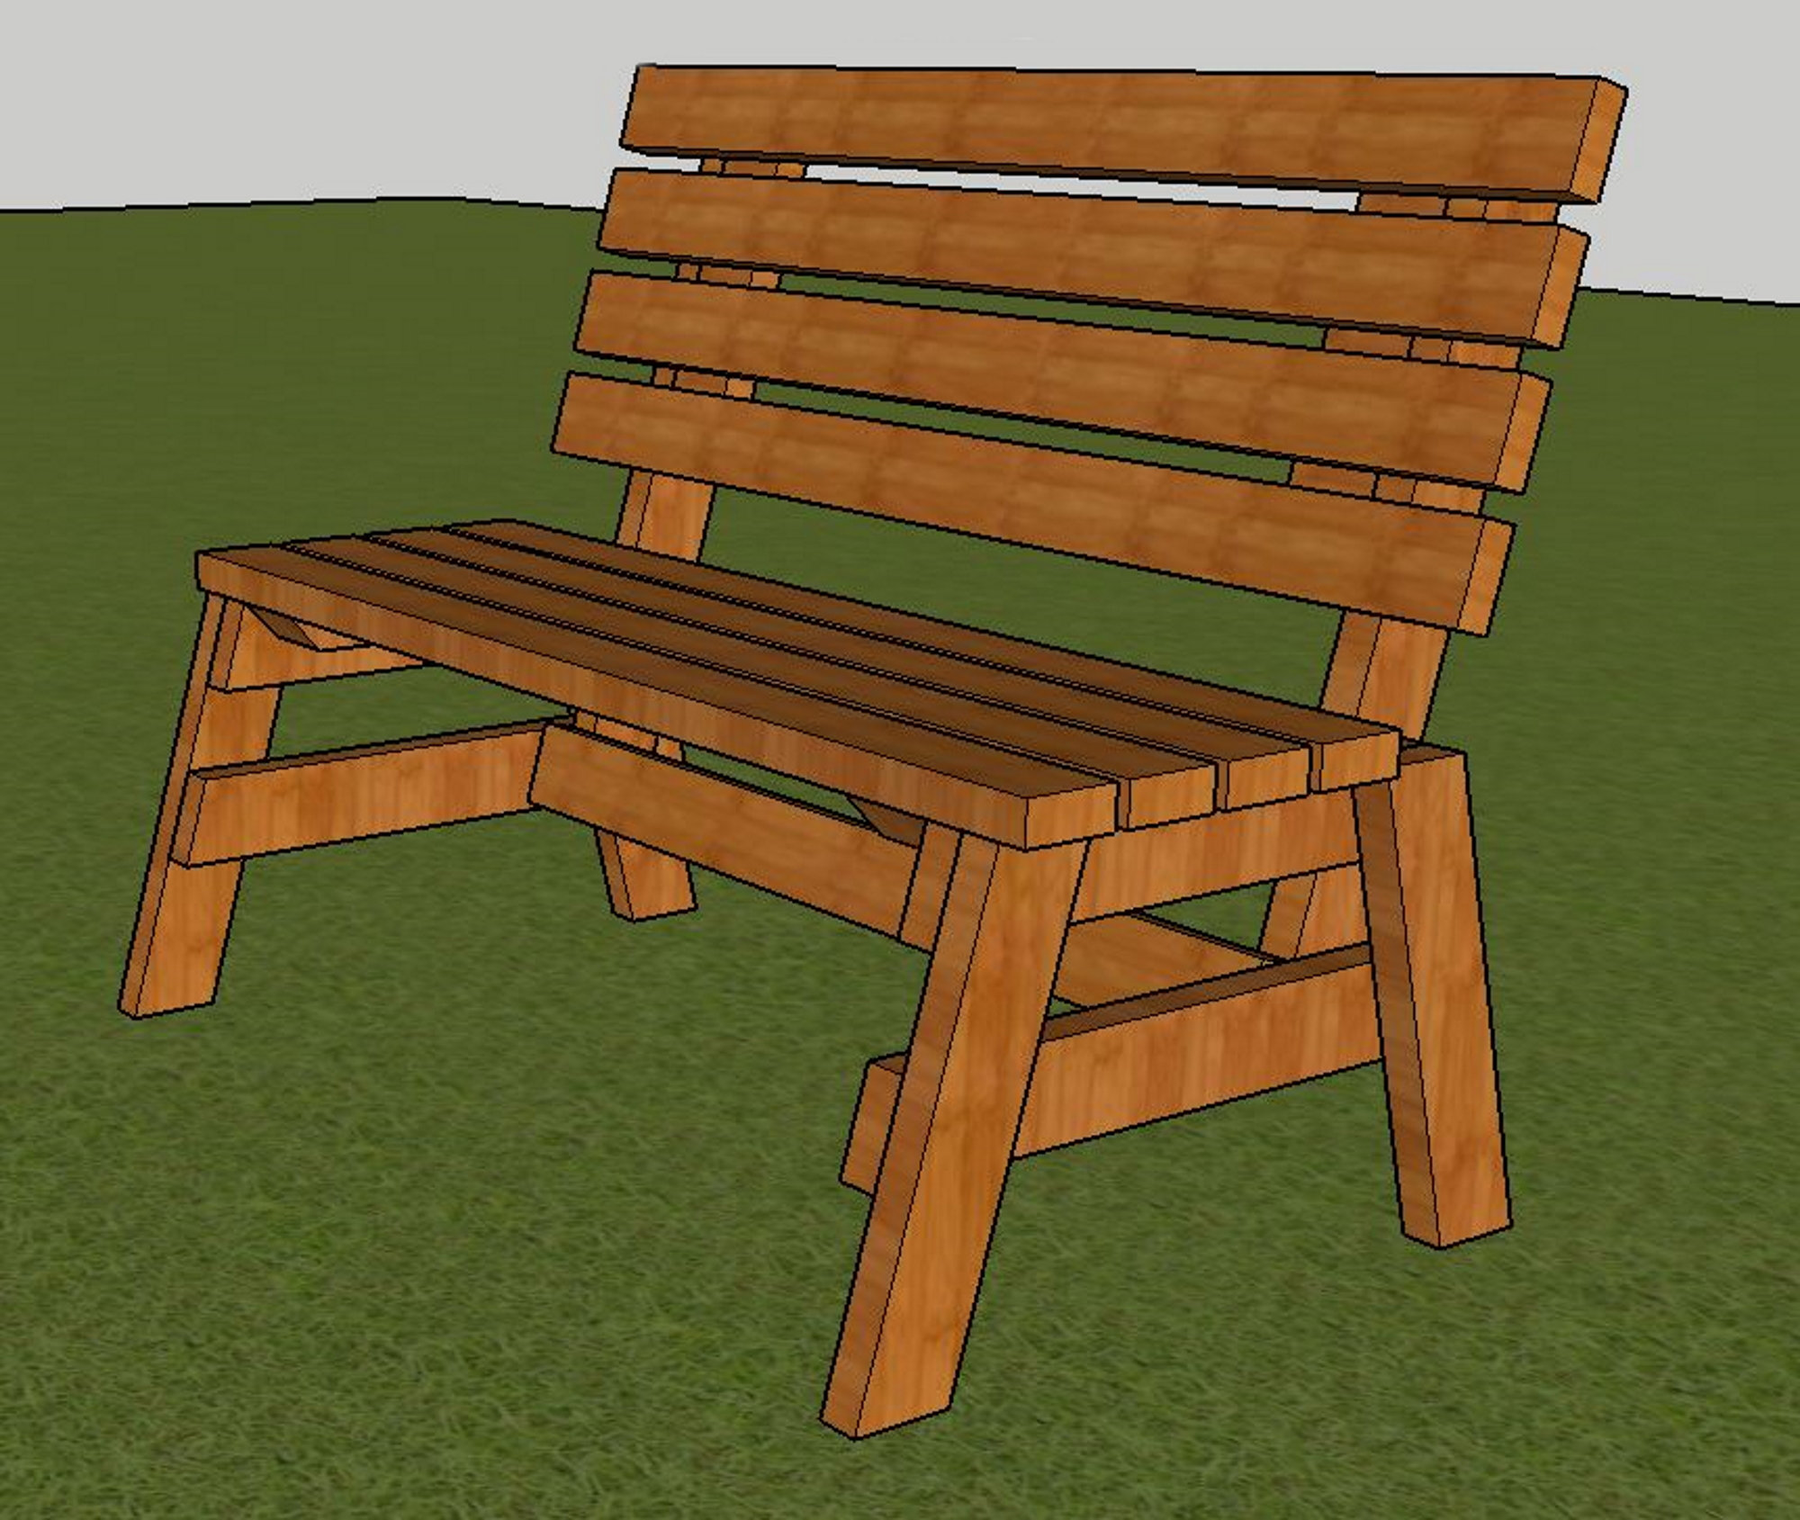
Bench Design
Our students are in the process of constructing our benches. They are currently at the end of the construction portion. We are having half of them stained and varnished and the other half painted to the students liking. They have big plans for the artistic design they will be implementing.

Slide 9

T-Shirt Design
These are the t-shirts selected by our Cougar Cares Team. When the bench are completed they will be wearing these as a unit once a week and working the benches to maintain them as a no tech zone encourage face to face conversations creating a safe space in our school.

Slide 10
What outcomes did our project yield?
Individually our students, each have a in progress digital portfolio displaying their individual skill sets that can be utilized to provide them opportunities. Students will update this portfolio as the year continues to have a cohesive representation of their abilities and skill sets that they already possessed as well as those they will be trained on.
As a whole, our students have successfully designed, built, and have implementation protocols in place on the Buddy Benches. They have been working as a unit throughout the process of constructing the benches and executing their implementation. By these youth have a multitude of resources they are better suited for their future and able to begin narrowing what type of future career they want to have.

Slide 11
How do we see our school culture improving?
From the buddy benches we are looking to see an increase in student interactions face to face. From the benches being set in high traffic areas at our school we will best see their usage by our students and the monitoring of our Cougar Cares team.
In addition, through the preparation and building of our benches we saw a great stake our teachers were placing in our project. They were interacting and investing time into seeing how the project is progressing. These systems put into place are vital to our school culture growing into a positive and productive safe space for our youth.
By seeing the buy in by all parties we are sure to have a strong basis of growth within our school not only building school spirit but also rapport.

Slide 12
Questions?
Julie.amburgey@letcher.kyschools.us
Emily.kincer@letcher.kyschools.us
Joey.kincer@letcher.kyschools.us

