Slide 1
Blended Transition: Putting Curriculum into Action
Cristen Pulliam, EdS and Jamey Sellars, M.A.
Ashland Independent Schools
Ashland, KY

Slide 2
WHAT IS BRIDGING THE GAP?
Essentially, at its minimal meaning, bridge the gap means to diminish the differences between two things. In this case, the transition process for exceptional students so that students can be gainfully employed, live independently, and achieve post-secondary education goals.
It also means building a bridge in curriculum for exceptional students so that students need match up with the direct services available.

Slide 3
The Project Focus
The purpose of this action research study is to investigate the implication of web based transitional learning curriculum to systematically study and address the gap between requisite skills and curriculum requirements for exceptional students whom have specialized needs in the area of transition. The curriculum will be the bridge between interest, knowledge, and performance skills necessary for post-secondary transition from high school to careers or educational settings.
This is important because a blended curriculum will help ensure that the transition planning and process for students with exceptionalities will be systematic, comprehensive and based on student interest and diverse needs.

Slide 4
Challenges
Delivery of content of the Oneder Computer Based Program was difficult to deliver as a whole group
Signing up new students to get log in info
If the internet is down then programs are not accessible
The program was just getting rolling with data collection when the COVID-19 interrupted the learning process for students; while students were able to log in and work from home, some of the parents struggled to get their student to participate

Slide 5
Success Stories
Students were interested in the Oneder Program and were able to apply real world skills and interests after working with the program
Explore new activities they might not have thought were interesting prior to the program
Students were able to use the Buddy Clock system to learn how to clock in/out and use time mangements skills
Students felt like a part of the community wearing their Ashland Staff shirts
A new class is being built out of this program and will intergrate the Oneder transition program with a NEW campus class with support from an Employment Specialist

Slide 6
Impact on Student Learning
How did it impact student learning?
Students showed interest in the computer based programming. It allowed students to focus on career options to pursue when they leave high school. The field experience would give them hands-on training that is not usually accessible during the school day. This was cut short due to Covid-19.
How will it impact student learning in the future?
Computer based programs will continue to draw interest from the students. The success of the program will lead to classes being developed to help exceptional student with specialized needs continue to pursue successful transition to life after high school. Community connections will continue to be made to allow more options for field experience.

Slide 7
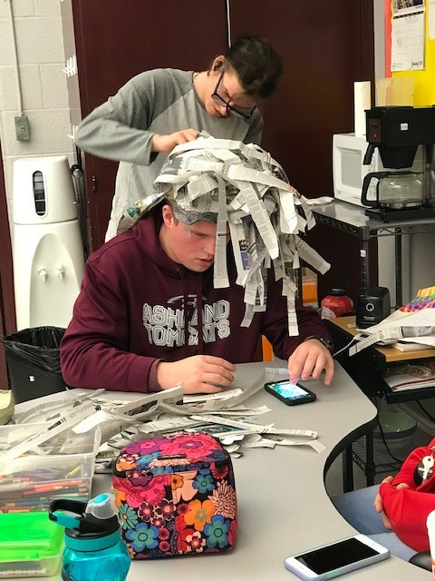
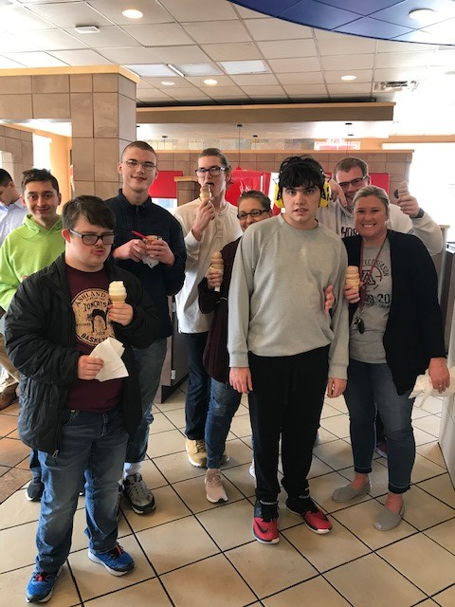
Pictures from the Program
Oneder Instruction, Visit to Dairy Queen, Learning how to Make Wigs out of newspaper

Slide 8
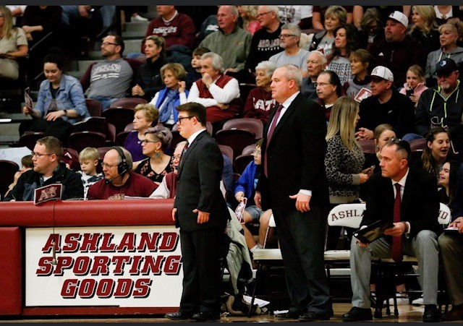
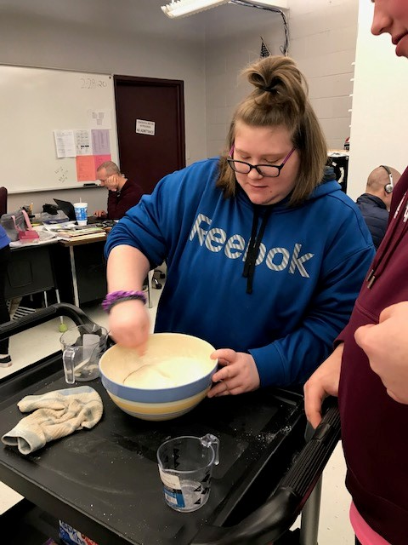
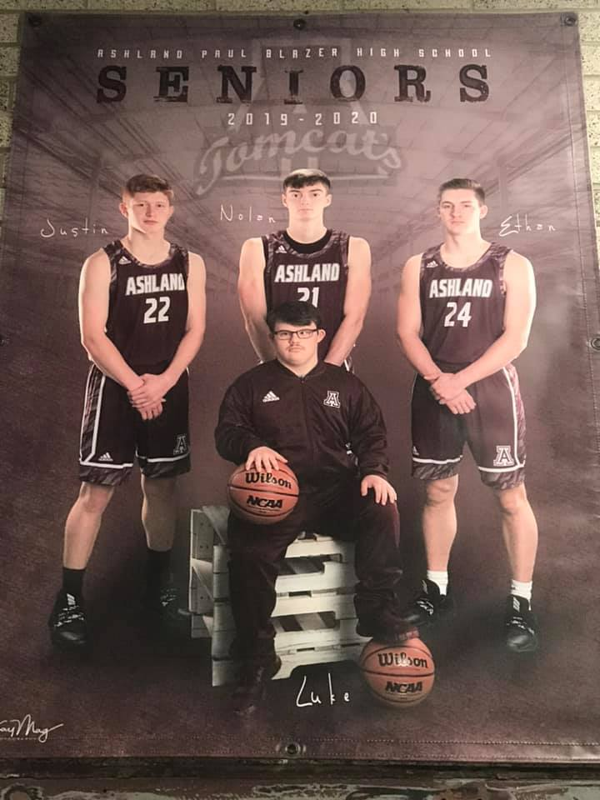
Inclusive in TomCat Basketball, one student helped coach and pump up the team
Life skills applications: Haircuts and making pancakes independently

Slide 9
Outcome of Project
Students were able to take the presurvey, but not the post survey.
Curriculum was implemented. The transitional learning curriculum of Oneder DID seem to positively impact the students and encouraged them to participate in more real world activities.
Does the transitional learning curriculum selected provide the necessary supports for exceptional students who are transitioning into post-secondary occupational and educational opportunities? This question was not able to be answered completely. It did help support the creation of a new class and support for an employment specialist for the district.

Slide 10
TOPIC IMPORTANCE: Background Information
School to Work Opportunity Act 1994
Addressed the connection of academic content to workplace skills to engage students interests and increase academic achievement
Students got mentors in the work place, pre-employment coaching, career exploring, vocational education
Taught students both life skills and on the job training

Slide 11
TOPIC IMPORTANCE
2007 NLTS-2 Study
55.1% had jobs, 20.5% community college
Increase do to funding for college and career programs
Students have more chances to explore career opportunities
Curriculum is limited

Slide 12
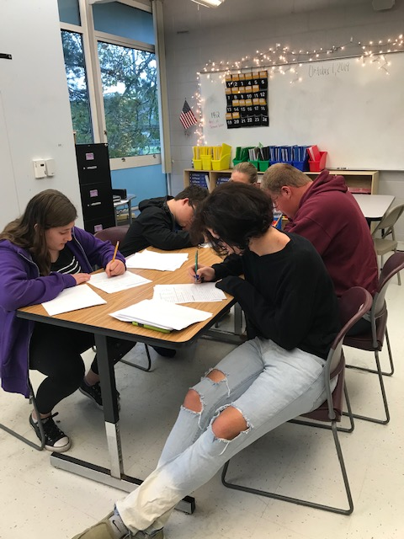
TOPIC IMPORTANCE
Transition Services - The term `transition services' means a coordinated set of activities for a child with a disability that- Designed to be within a results-oriented process, focused on improving the academic and functional achievement of the student with a disability to facilitate the student’s movement from school to post-school activities
Based on the individual student’s needs, taking into account their strengths, preferences and interests
(Individuals with Disabilities Act) IDEA 1990, IDEA 2004
Congress also made significant changes in the legal definition of "transition services" in IDEA 2004.

Slide 13
KDE 2014 Data
2014 KDE data
48% of exceptional students are not graduating high school
84% are not college or career ready
Vocational training is only planned for 40% of students
Supported employment is planned for fewer than 10% of students (includes VI and Autism)

Slide 14
TOPIC IMPORTANCE
Perkins Act 2019 (Perkins V)
Forces districts to provide job training and vocational support so students can make “meaningful progress”
Mandates that beginning in 9th grade students see if they are eligible for Vocational Rehabilitation Services
Schools also must have an Employment Specialist or be able to explain why the position is not funded
Big 5 for Perkins:
Funding amount(increased) $1.193 billion
Local / community focus
Guarantees against funding cuts
Increased “allowable reserve fund” for states
Strictly defined terminology

Slide 15
TOPIC IMPORTANCE
Indicator 13
What districts requirements are reflective of what should be in place for a quality education program for exceptional students
Student Focused Planning
Family Involvement
Student Development
Program Structures
Interagency Collaboration

Slide 16
INDICATOR 13…WHAT DOES IT SAY?
Percent of youth with IEPs aged 16 and above with an IEP that includes appropriate measurable postsecondary goals that are annually updated and based upon an age appropriate transition assessment, transition services, including courses of study, that will reasonably enable the student to meet those postsecondary goals, and annual IEP goals related to the student’s transition services needs. There also must be evidence that the student was invited to the IEP Team meeting where transition services are to be discussed and evidence that, if appropriate, a representative of any participating agency was invited to the IEP Team meeting with the prior consent of the parent or student who has reached the age of majority. (20 U.S.C. 1416(a)(3)(B))

Slide 17
Transition Planning Flow Chart
Collect Transition Assessments
Needs
Strengths
Preferences
Interests
Write Measurable Postsecondary Goals
Education/Training
Employment
Independent Living, as appropriate
Identify Transition Services
Instruction
Related Services
Community Experiences
Employment, Adult & Daily Living
Update the Course of Study
Write the Annual Goals
Coordinate Services with Adult Agencies
Notes:
Transition planning is a process that can lead to successful postsecondary outcomes for students with disabilities. Each sub-indicator is a vital component of effective transition planning that will ultimately contribute to a student’s college and career readiness.
We will begin with sub-indicator 49a, measurable postsecondary goals. Please notice the green section here on the flow chart depicting where this occurs in the process.

Slide 18
TRANSITION PLANNING
Indicator 13 and students aged 16 and older
Guiding the transition process
Plans often incomplete
38% do not include living goals
45% contain the words “not applicable”
Possible assessment
Formal (tests, interviews, standardized tests)
Informal (observation, interview)
Transition Services include:
Instruction
Related Services
Community Experiences
Employment
Other Post-School Adult Living Objectives
When appropriate, acquisition of daily living skills and provision of a functional vocational evaluation

Slide 19
WHAT DO TRANSITION SERVICES INCLUDE?
Instruction
Related Services
Community Experiences
Employment
Other Post-School Adult Living Objectives
When appropriate, acquisition of daily living skills and provision of a functional vocational evaluation
Develop linkages to adult agencies or providers
Transition Counseling
Referral to disability services to determine eligibility after high school
Referral to OVR to determine eligibility for services

Slide 20
FUNCTIONAL SKILLS and VOCATIONAL EDUCATION
Functional Skills “soft skills”
Preparing meals
Budgeting
Maintaining a residence
Paying bills
Raising a family
Caring for clothing
Personal grooming
Life skills and vocational education
A functional vocational evaluation is an assessment process that provides information about job or career interests, aptitudes, and skills
Information is gathered through situational assessments in the setting where the job is performed
Information gathered through a functional vocational assessment can be used to refine educational experiences, courses of study, and employment activities/strategies listed in the transition services in the IEP

Slide 21
GAPS in CURRICULUM
Limited information is available in the area of transition curriculum
Educators must modify, develop, or adapt curriculum to meet the needs of exceptional students
Must stay within compliance of federal, state, local laws
How do we solve these issues?
A blended curriculum
Provides students with opportunities to learn academics in applied situations, practice day to day skills in the natural environment, receive on the job training

Slide 22
GAPS IN CURRICULUM
Web Based Curriculums
Career Cruising (2015)
Lengthy, generic, poor interest inventory
Achievement in Career Educaution (ACE)
Promoted by KEDC, piloted in 2015, expensive ($12,000 yearly), does not comply with middle school transition requirements, limited data to support program
Naviance (2019)- piloted 2019, specific for MS and HS, curriculum path is more dedicated to college preparation and resume building
ONEDER Academy- (2019) meets the NEEDS of EXCEPTIONAL students
Blended curriculum with transition and social emotional learning

Slide 23
ONEDER Academy
Cost effective
Meets individual needs for students
Uses latest research to do lesson modules
Identifies strengths, develops interpersonal skills, sets personal goals, explores career options

Slide 24
OTHER COUNTIRES BLENDED CURRICULUM
Blended Curriculum is lacking for exceptional students in US
Nova Scotia and Phillippines are developing curriculum aimed at K-12th grades
Transition to school life
Post-secondary education
Entrepreneuship
Adult life
Functional life
Other countries are meeting the aspiration needs and empowering exceptional learners
Equals a higher set of learning outcome
Flexible curriculum
Transitioning after high school with a higher rate of success

Slide 25
FUTURE RESEARCH
Transition Grant
Blended Curriculum
Kentucky Valley Educational Cooperative (KVEC)
Does the implementation of a transitional learning curriculum impact the exceptional student’s attitude, positively or negatively, towards occupational and educational outcomes when transitioning to post-secondary real-world activities?
Does the transitional learning curriculum selected provide the necessary supports for exceptional students who are transitioning into post-secondary occupational and educational opportunities?
By using this curriculum, students will be able to self-monitor progress, prepare for post-secondary careers as andragogious learners, and focus on specific learning outcomes as related to Indicator 13 Transition Goals.
Find a curriculum that best works for exceptional students
Work together as a team process
Include different agencies
Focused team approach
Provide direct services to students

Slide 26
SUMMARY
Transition is a REQIRED portion of the IEP
Indicator 13: REQUIRED Post-Secondary Goals
Helps to increase employment, independent living, and post-secondary education if the right supports are in place for students
Use a focused team approach
Fill the gaps in curriculum for exceptional students
Find the right curriculum to meet the students need

Slide 27
KNOW YOUR WHY

