Slide 1
Breathitt Area Technology Center Tiny HOuse
2019-2020

Slide 2
The Challenge
Take $$18,890, 2 teachers, and a bunch of eager kids and build a fully-functional tiny house!

Slide 3
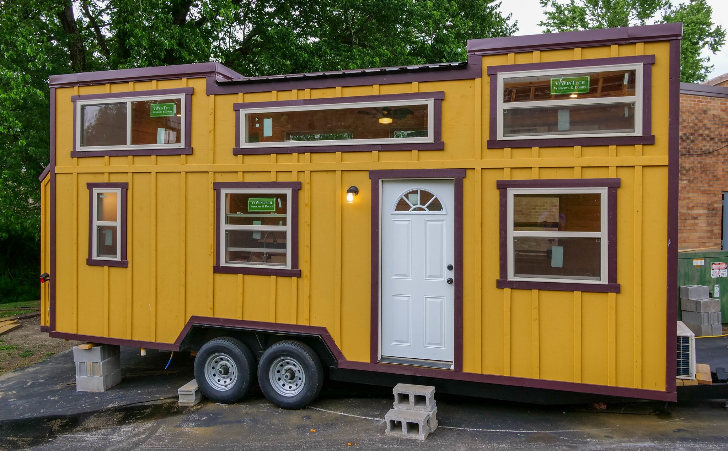
What to Build?
The first tiny house at the white pine D-Log siding
The second tiny house had a really neat layout and profile
We decided to combine the two designs
Tiny House #1
Tiny House #2

Slide 4
Lesson from Previous Tiny Houses
Completed much more of the framing, plumbing, and electrical work in the shop as compared to the first two.
Didn’t move it outside until roof was ready to go on
Go for quality and not quantity of features.

Slide 5
Very similar at the start to Tiny House #2
You’ll notice that the layout is almost identical to Tiny House #2.
Without the siding and different color trim, it is very hard to tell this is different.

Slide 6
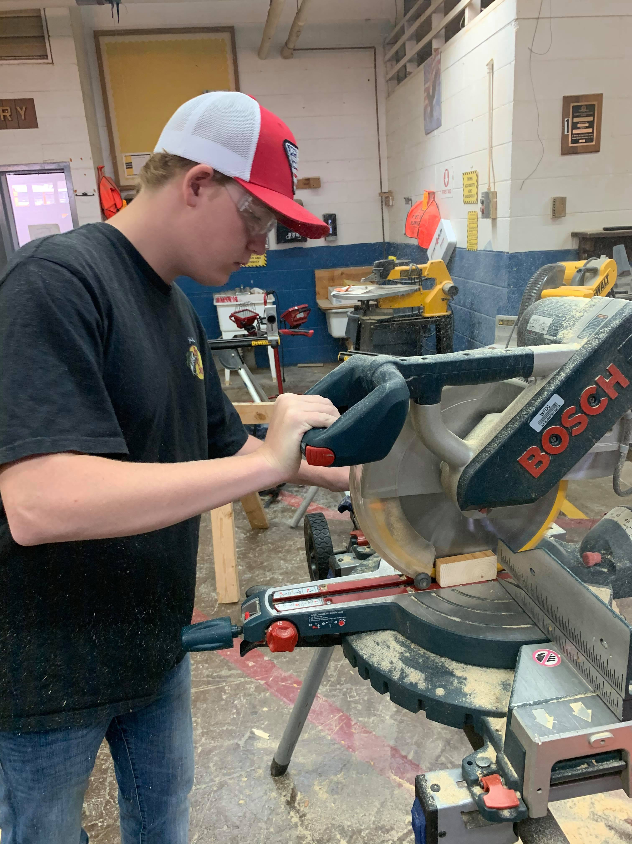

Slide 7
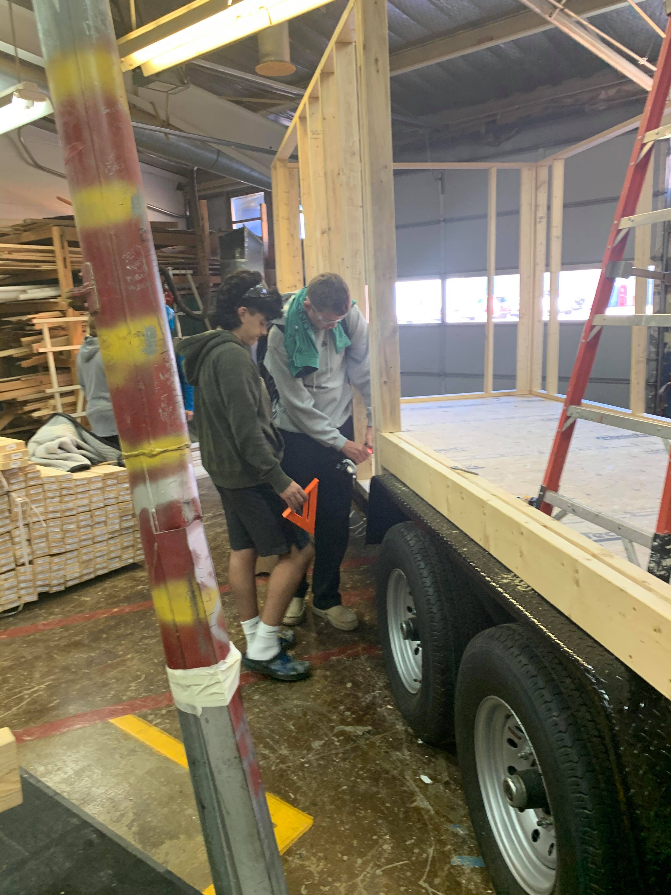

Slide 8
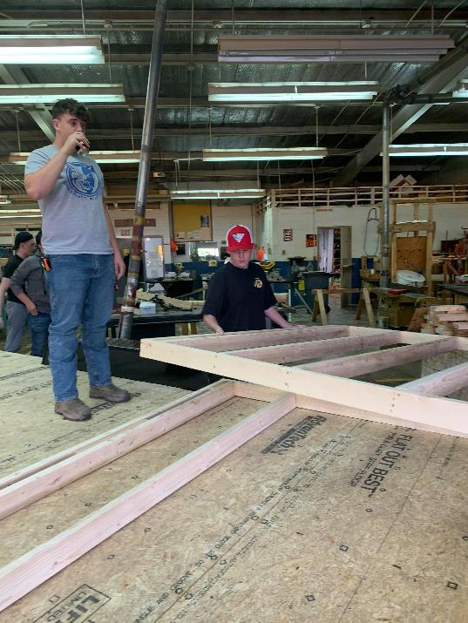
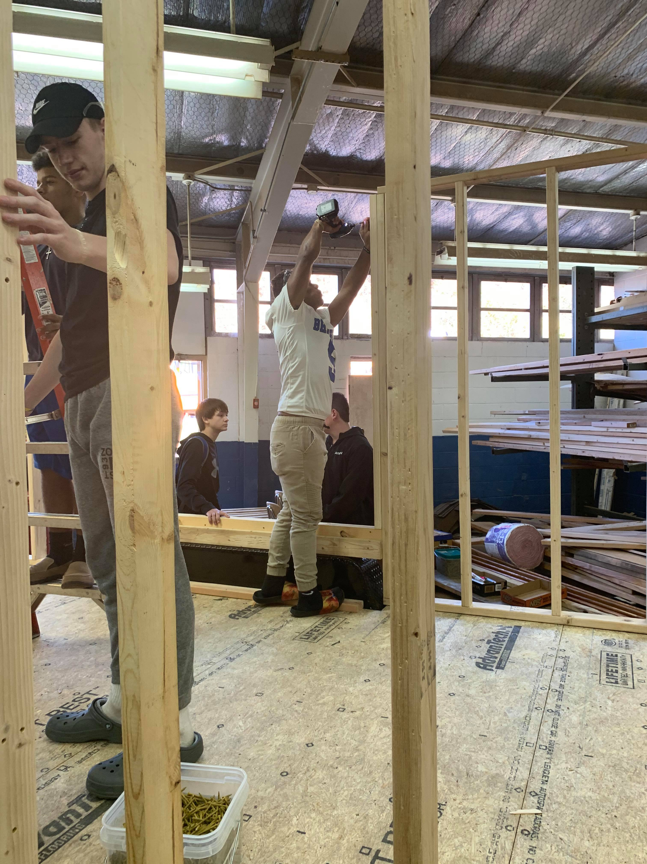

Slide 14
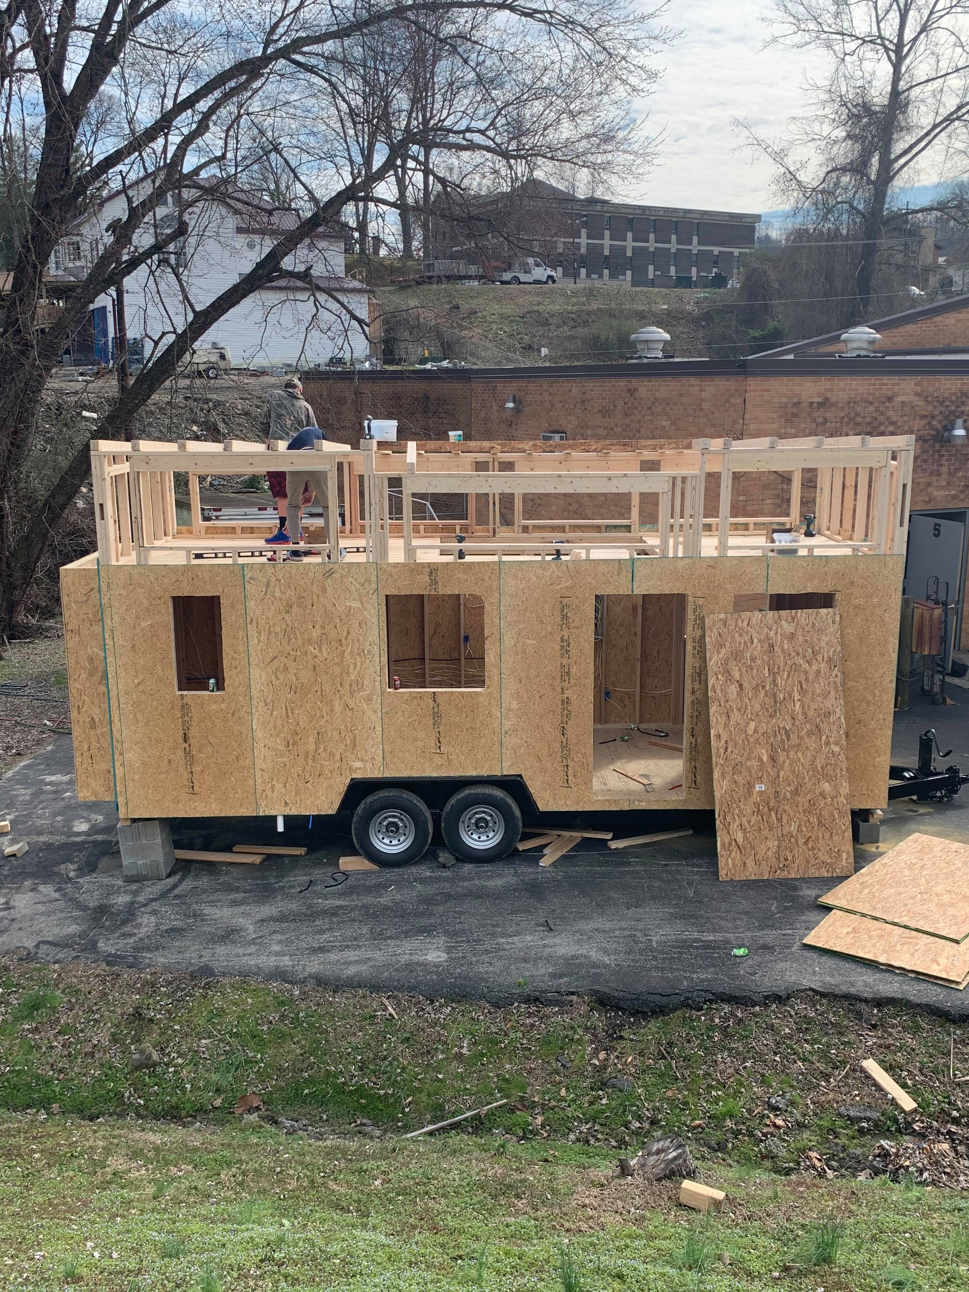

Slide 15
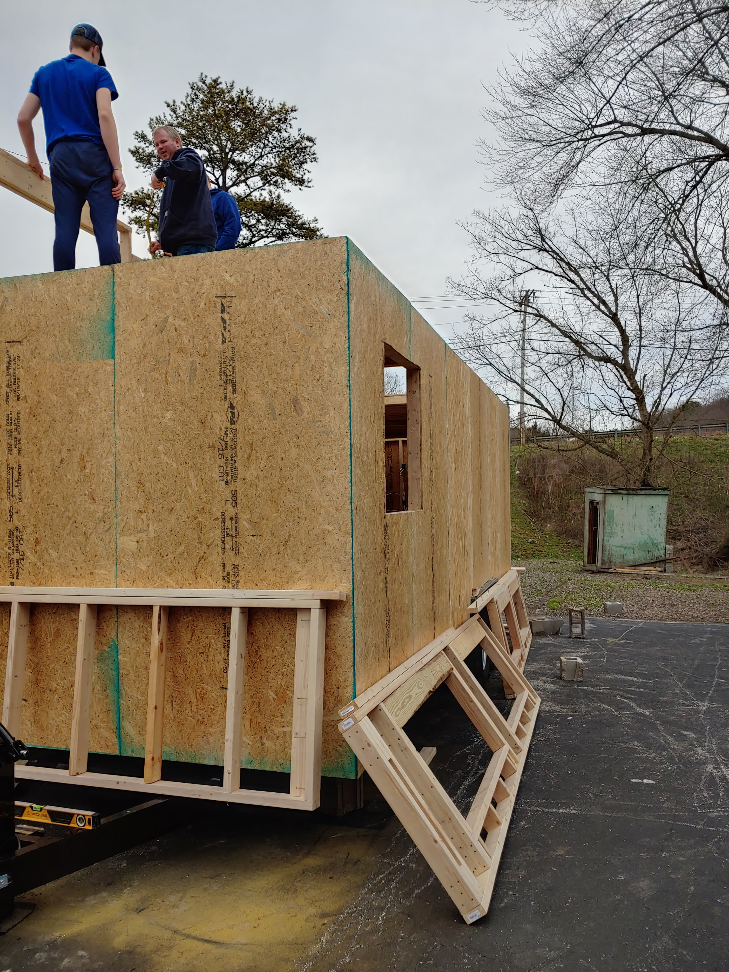
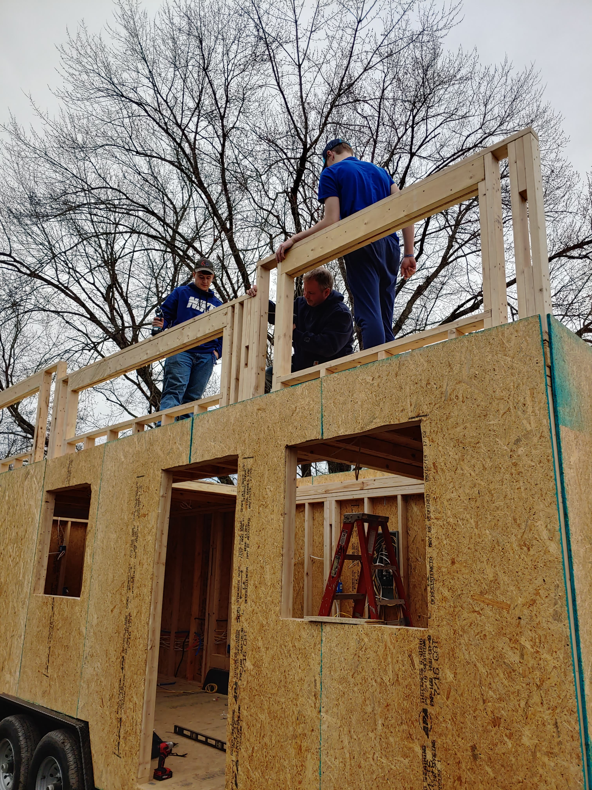

Slide 16
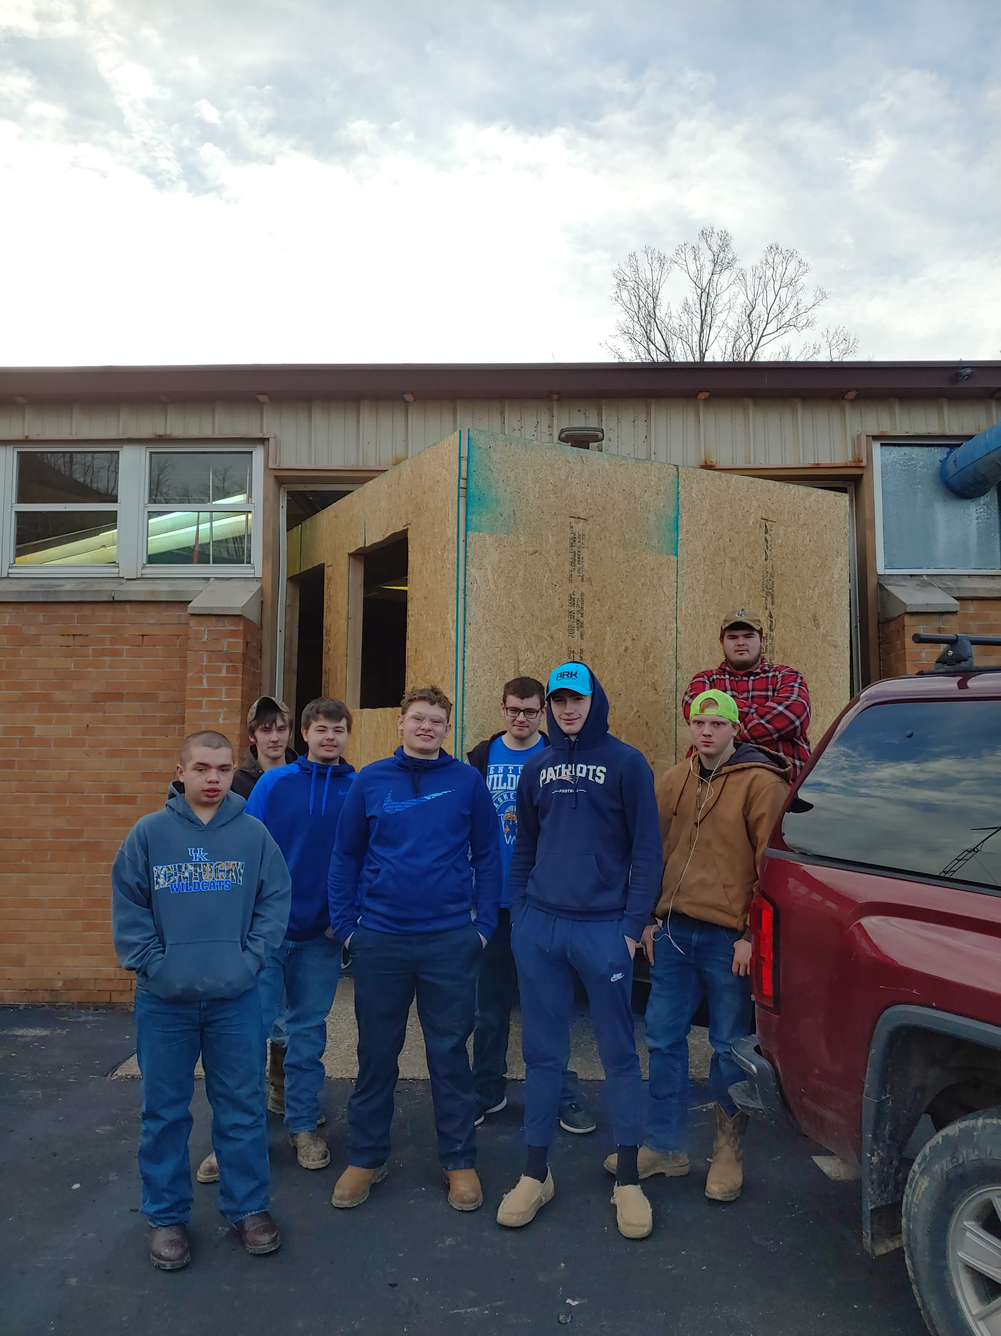
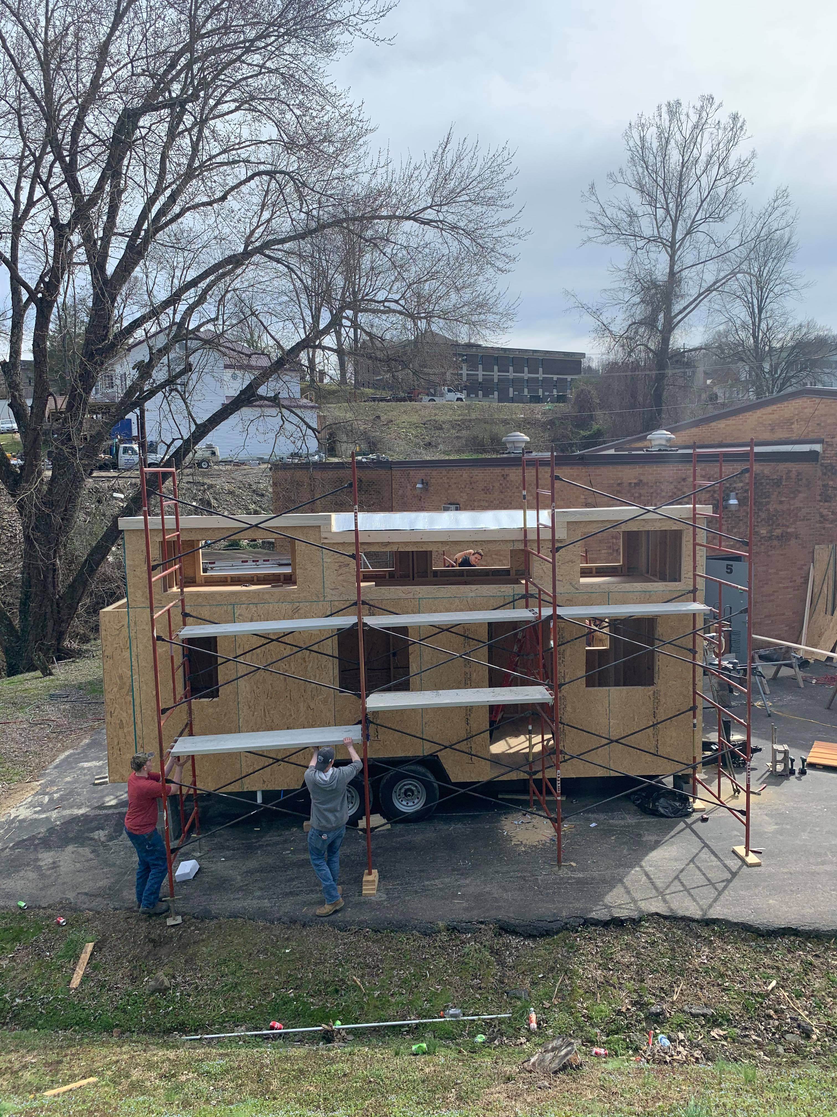

Slide 18
And then…
So, we’ll have to finish it when we can.

Slide 19
Major Budget purchases (so far)
Item | Cost
Structural Lumber | $3,382
Heat Pump | $489
Windows and Doors | $1,957
Roofing | $499
D-Log Siding | $3,500 (estimate)

