Slide 1
Construction of Biodigester an Alternate Inexpensive Energy Source
How this is Useful
Kristine Brucal, Zane Burchfield, Alexander Wolford and Alex Hatter
Department of Physical Sciences,
Belfry High School,
Belfry, KY 41514.

Slide 2
Construction of Biodigester an Alternate Inexpensive Energy Source
How this is Useful
Description of the Project
Students from Physics & STEAM Class initiative was:
Building a homemade inexpensive biodigestor in order to produce methane gas (CH4) and fertilizer.
Biodigestor resembles as a human stomach.
The process begins with organic material decomposed by bacteria.
The two products react to produce 2 products namely biogas and fertilizer.
*Students learned the techniques of design and construction.
*Understood the concepts of building different components in field of mechanical and chemical Engineering.
*Learned to trouble shoot the assembly and calibrate all components for building an efficient device.
*Researched to find the amount and components of materials to be used to produce enough gas to create efficient energy source.
*Knowledge students gathered enabled them to equip them to enter a work force that leads them to bring back industries to this region.
*

Slide 3
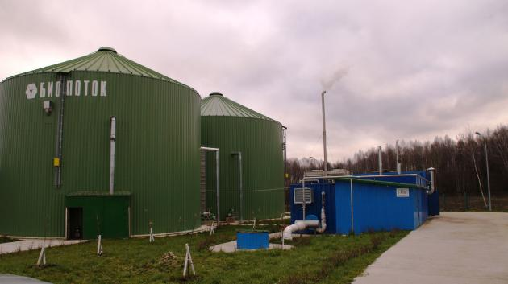
Construction of Biodigester an Alternate Inexpensive Energy Source
How this is Useful
Large Scale Anaerobic Digestion
Disadvantages
Advantages
Combined treatment of different organic waste and wastewaters
High reduction of the volume of waste
Generation of a renewable energy (biogas)
Potential for greenhouse gas emission reduction (collection of methane; green energy production)
Remaining sludge could be used as fertilizer
Experts are required for the design, construction, operation and maintenance
High technical and organizational complexity (complexity normally rises with scale)
High sensitivity of methanogenic bacteria to a large number of chemical compounds
Figure 1: A vertical continuously stirred tank reactor (CSTR) – an example of a large scale biodigestor tank in Europe

Slide 4
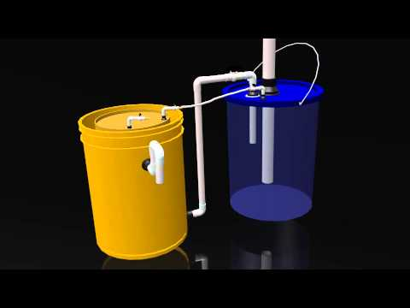
Construction of Biodigester an Alternate Inexpensive Energy Source
How this is Useful
What is Anerobic Digestion?
An aerobic digestion is a sequence of processes by which microorganisms break down biodegradable material in the absence of oxygen. The process is used for industrial or domestic purposes to manage waste or to produce fuels.
Figure 1: Shown an illustration of the final prototype. The prototype consists of two buckets that have different inputs/outputs with different functions The objective of the model is to produce methane and fertilizer from the reactants.

Slide 5
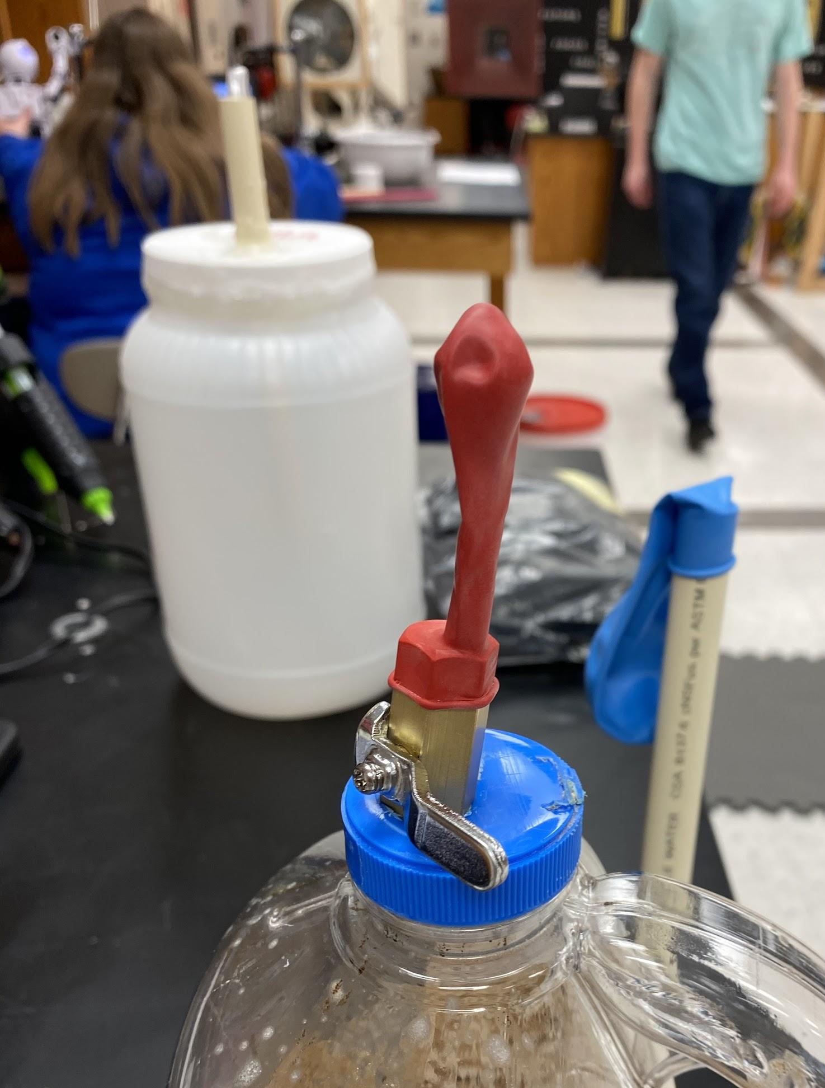
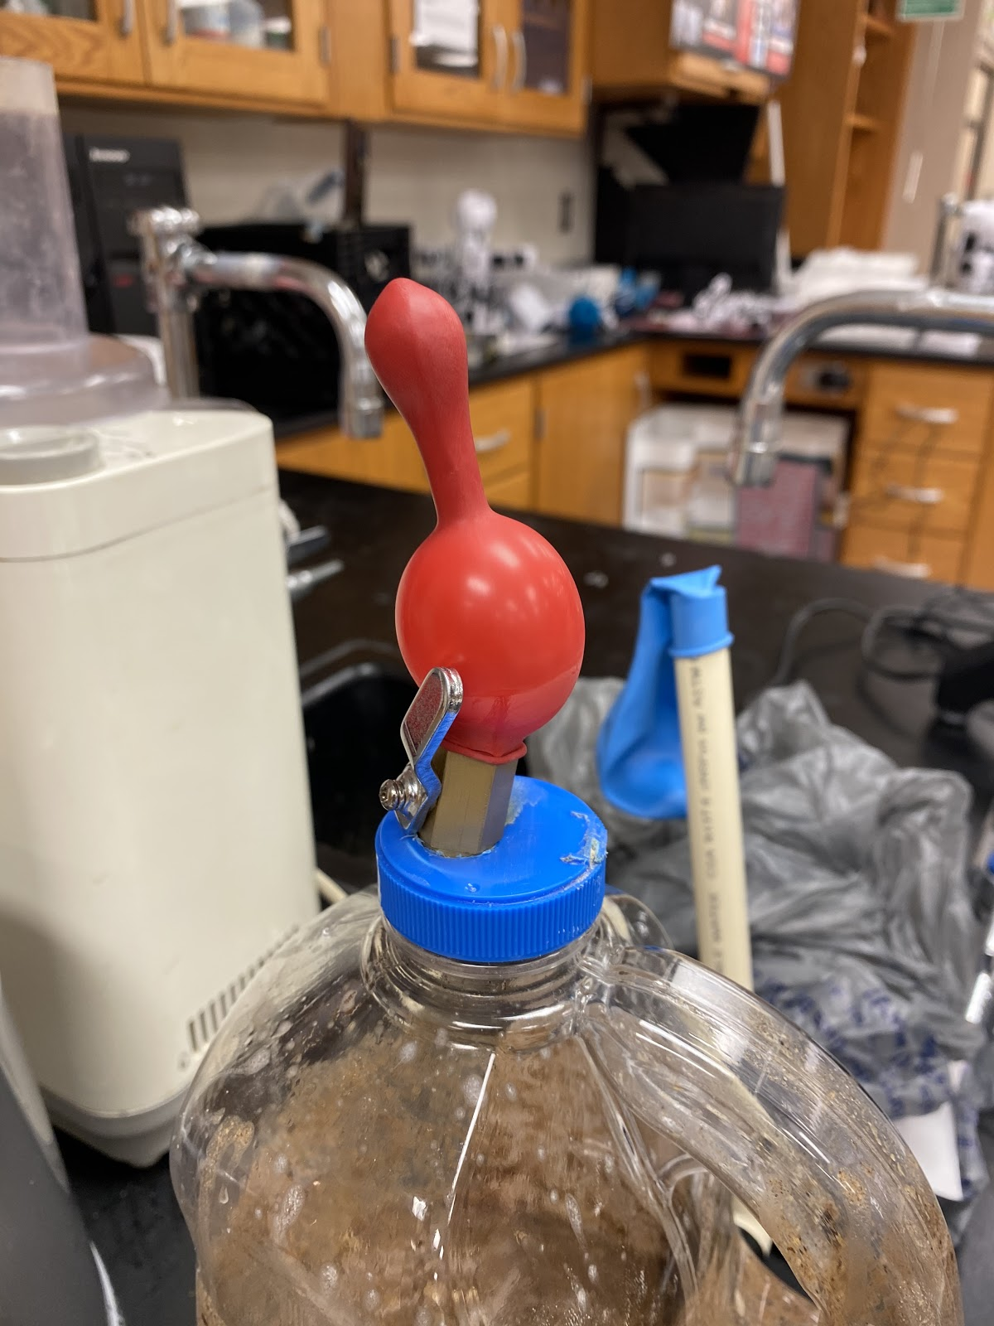
Construction of Biodigester an Alternate Inexpensive Energy Source
How this is Useful
Prototype of the Biodigestor
Left Fig shows 5 days after digestion
Right Fig shows 10 days after digestion.
Manure/ Compost | Water | Food Waste
4 cups | 4 cups | 4 cups
Days | Gas (ppm)
5 | 11
10 | 15
Shown above are photographs of our prototype. We utilized a used hand soap bottle as the container, and we drilled holes to serve as inputs and outputs. We placed the contents inside. After 2 weeks, a gas was generated.

Slide 6
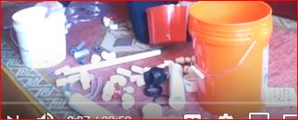
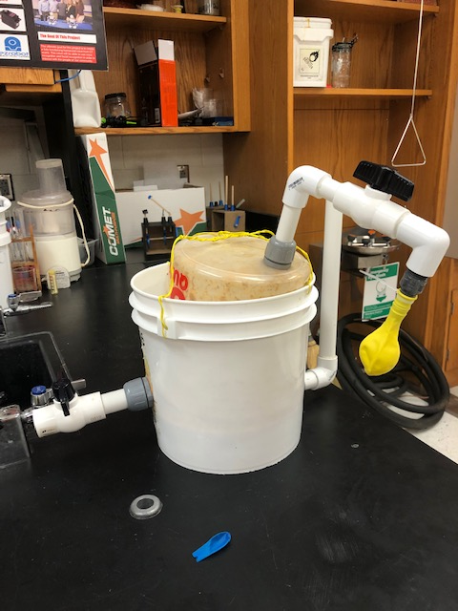
Construction of Biodigester an Alternate Inexpensive Energy Source
How this is Useful
Materials Used
All the materials for this project was obtained from Lowes.
Completed Telescopic Biodigestor is shown in the above Figurre.

Slide 7
Construction of Biodigester an Alternate Inexpensive Energy Source
How this is Useful
Uses of Methane in Households
Environmental Benefits
Organic materials can be separated from the municipal solid waste (MSW) stream and processed in an anaerobic digestor.
When organic materials are anaerobically digested, biogas is created. Biogas is a renewable source of energy.
Anaerobic digestion produces digestate, a nutrient-rich slurry. Digestate can be applied to agricultural land as a fertilizer and/or soil amendment to improve soil health.
Methane is created when organic materials decompose in oxygen-free environments like landfills and manure lagoons.
Anaerobic digestion systems capture methane and allow us to use that methane in a beneficial way.
Third world countries utilize these small scale biodigestors in order to produce methane to power furnaces, water heaters, stoves, and fireplaces.

Slide 8
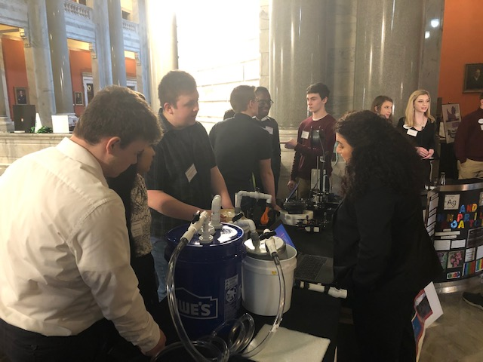
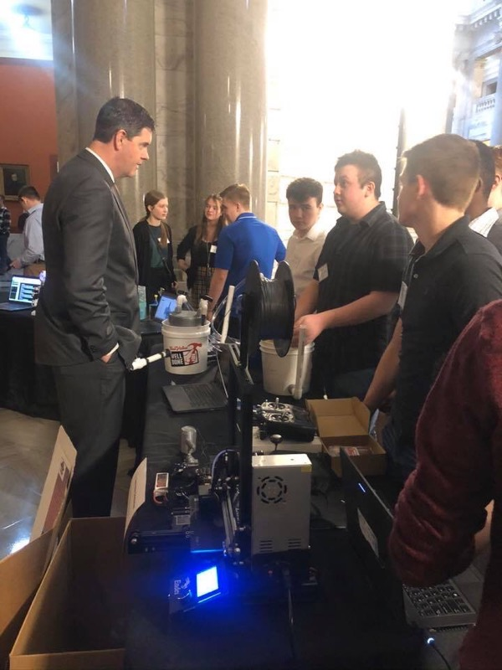
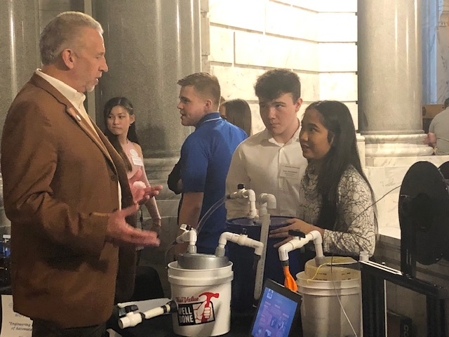
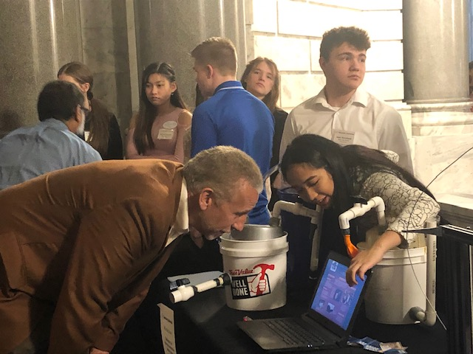
Construction of Biodigester an Alternate Inexpensive Energy Source
How this is Useful
Students Presented this project at the Innovation Celebration at the Capitol, Frankfort, Kentucky
On March 10th, 2020
State Representatives
Mrs. Angie Hatton
&
Chris Harris
KDE Associate Commissioner
Mr. David Couch

Slide 9
Construction of Biodigester an Alternate Inexpensive Energy Source
How this is Useful
Acknowledgments
We would like to acknowledge
Belfry High School Administration to use the facility
Mr. Will Edward for helping to get materials for the project.
Mr. Don Collins for helping to get certain materials from Lowes to build the Biodigestor.
Members of the Kentucky Valley Education Co-Op (KVEC) providing us funding through ARI grant to carry out this project

