Slide 1
OWSLEY COUNTY HIGH SCHOOL TRANSITION INNOVATION GRANT
AGRICULTURAL AWARENESS

Slide 2
THREE COMPONENTS OF THE ACTION PLAN
HIGH SCHOOL/ELEMENTARY SCHOOL COLLABORATION
SMALL ANIMAL PROJECT
THE GOAL OF THIS COMPONENT IS TO INCREASE AGRICULTURAL AWARENESS OF ELEMENTARY STUDENTS.
WE WORKED WITH ELEMENTARY STUDENTS TO GROW A LETTUCE BED THAT THEY COULD USE AS A PART OF A MEAL FOR THEIR PARENTS.
THE GOAL OF THIS COMPONENT IS TO RAISE HIGH SCHOOL AWARENESS OF THE WORK INVOLVED IN RAISING SMALL ANIMALS
WE STARTED CONSTRUCTION OF A SMALL ANIMAL SHELTER AND FENCED IN PASTURE FOR A SMALL HERD OF GOATS.

Slide 3
THREE COMPONENTS OF THE ACTION PLAN
THE FINAL COMPONENT OF THE ACTION PLAN INVOLVES AWARENESS OF STEPS TO ESTABLISH AN AGRIBUSINESS.
WE STARTED A SMALL BUSINESS WHICH WILL PRODUCE AND MARKET SORGHUM AS A BUSINESS.
WEATHER AND COVID-19 COMBINED TO CAUSE DELAYS IN COMPLETING THE WORK. WE HOPE TO FINISH ALL WORK BY THE END OF FIRST SEMESTER NEXT SCHOOL YEAR. FOLLOWING ARE SOME EXAMPLES OF THE WORK COMPLETED TO THIS POINT. A PORTION OF THE WORK WAS COMPLETED FIRST SEMESTER.

Slide 4
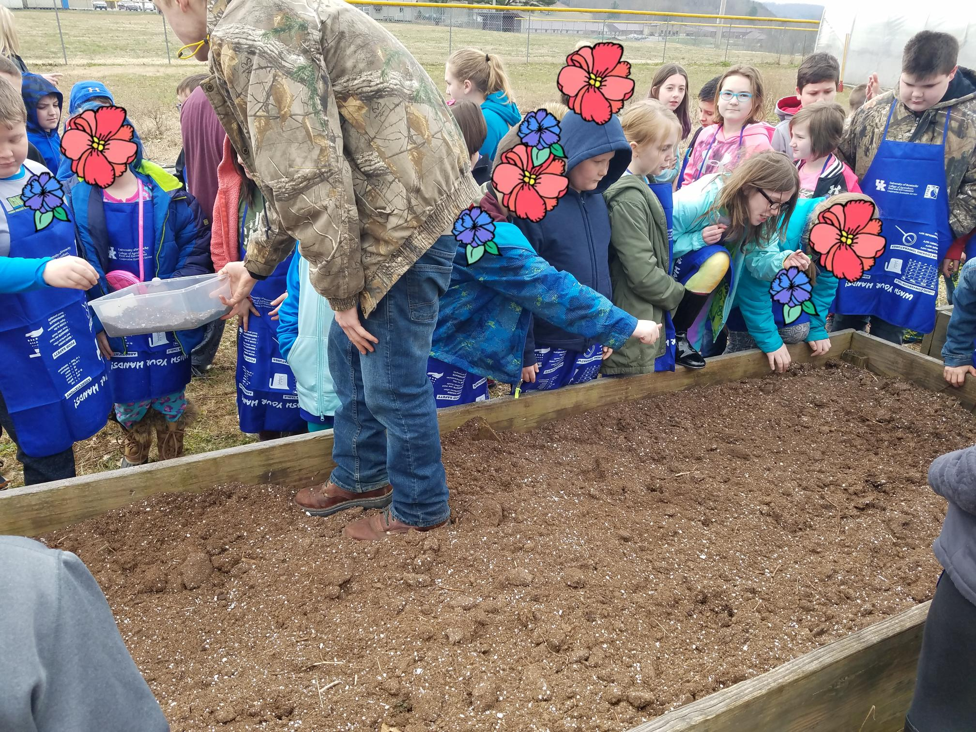
SEEDING THE LETTUCE BED
ONE OF THE SPECIAL ED HIGH SCHOOL STUDENTS IS SHOWING THE ELEMENTARY STUDENTS HOW TO SEED LETTUCE AND HELPING THEM TO SEED THEIR OWN LETTUCE.

Slide 5
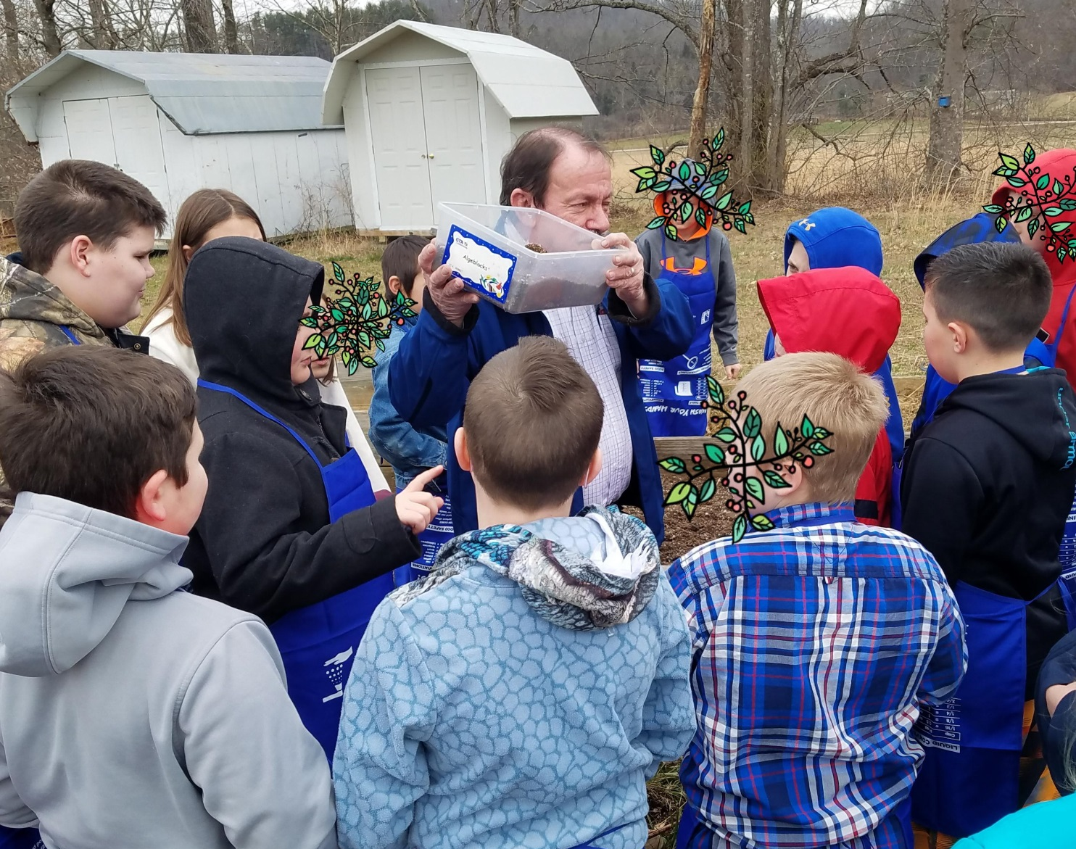
INSTRUCTION PRIOR TO SEEDING THE LETTUCE
ELEMENTARY STUDENTS, INCLUDING SEVERAL SPECIAL ED STUDENTS, ARE BEING GIVEN A SHORT LESSON ON THE NUTRITIONAL QUALITIES OF LETTUCE.

Slide 6
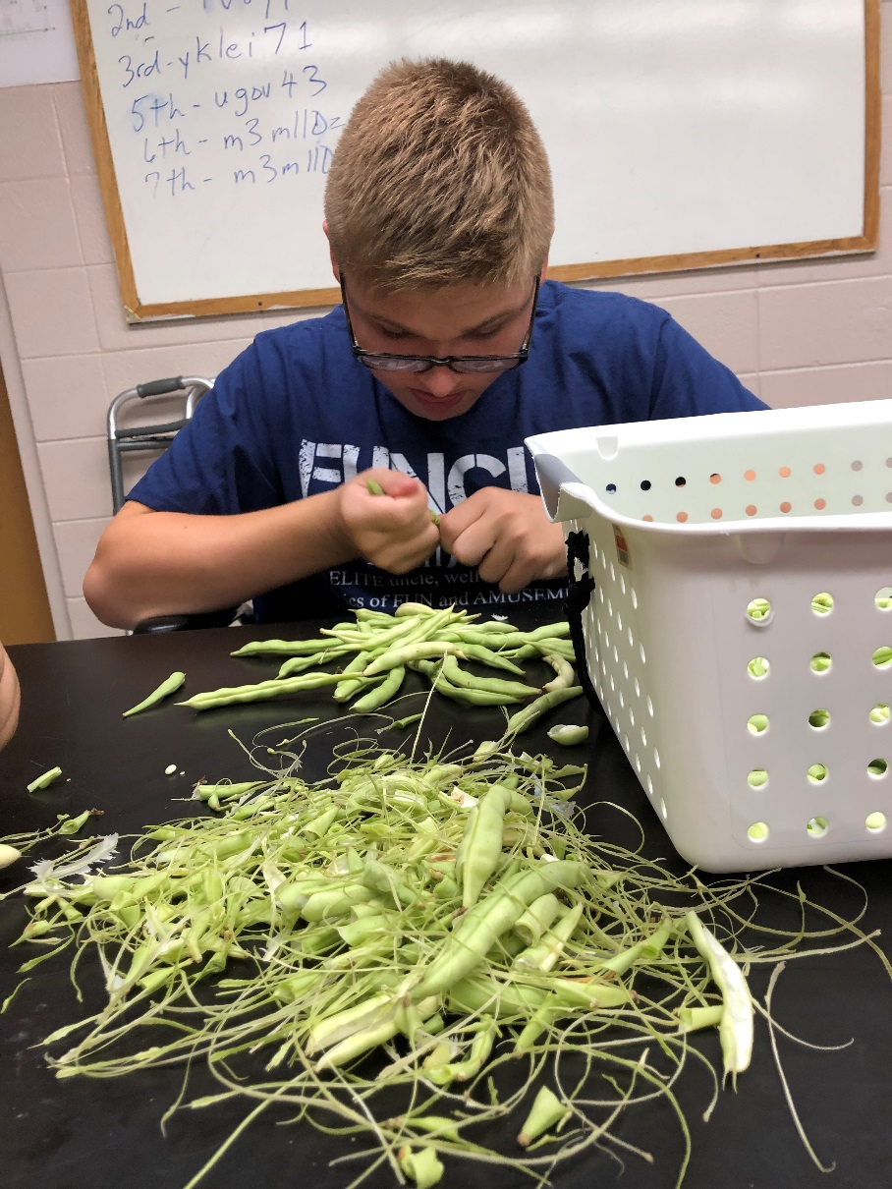
PREPARING BEAN FOR COOKING
THIS YOUNG MAN IS STRINGING AND BREAKING BEANS THAT HE HELPED TO PRODUCE AND HARVEST ON THE SCHOOL FARM.

Slide 7
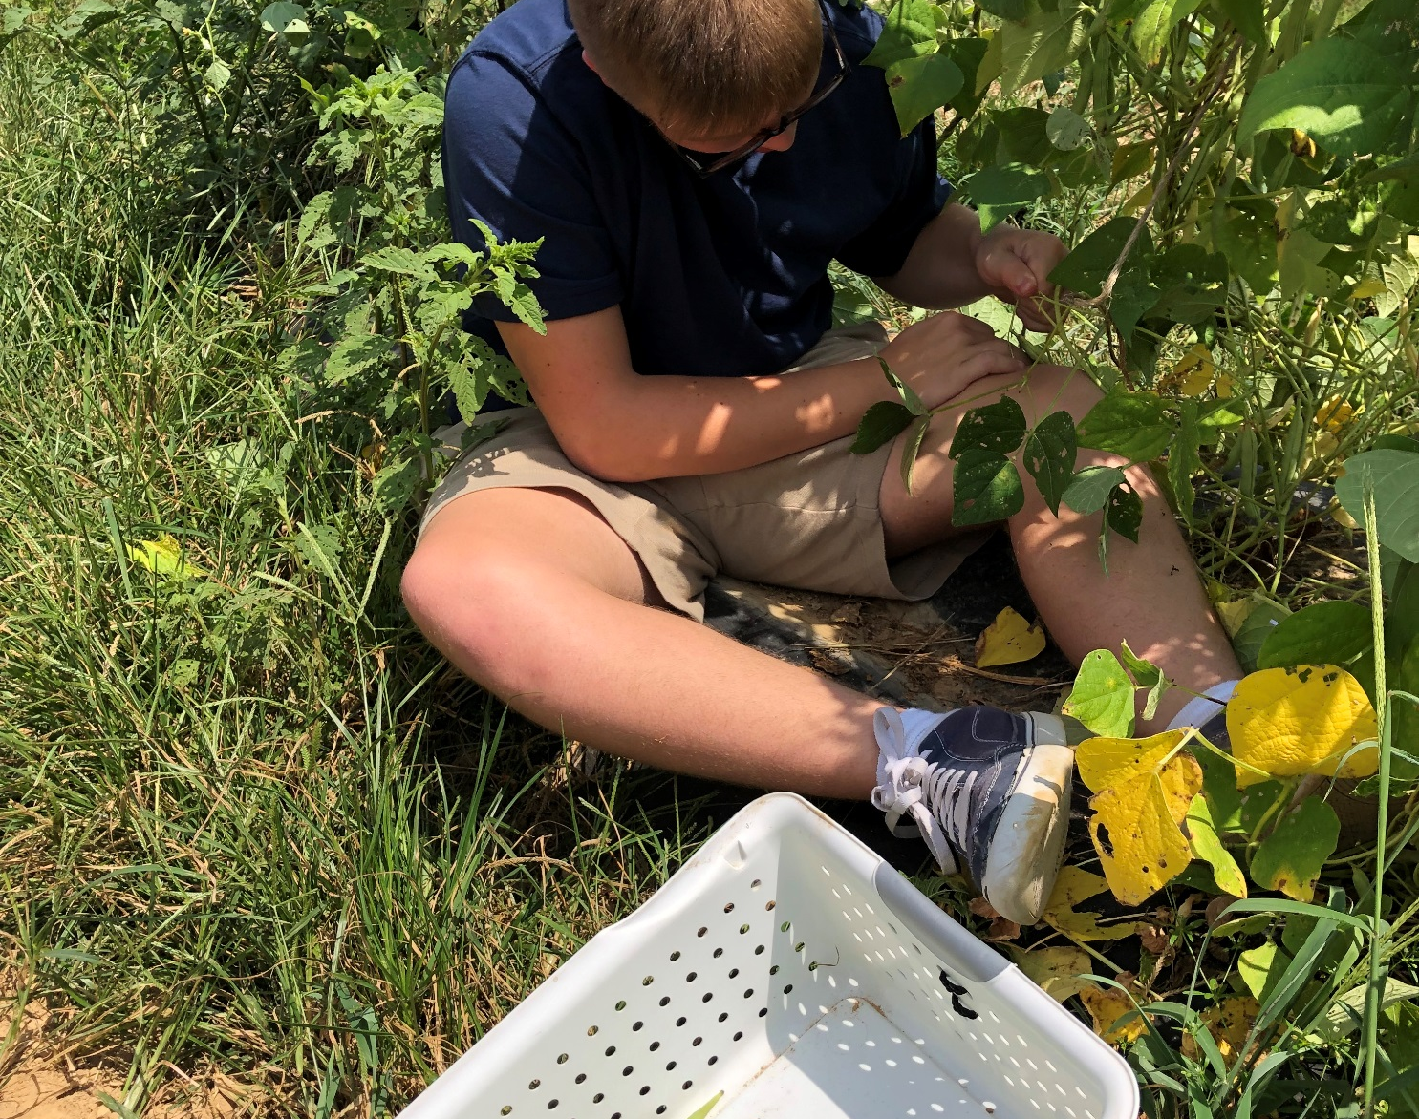
HARVESTING BEANS
THIS PICTURE SHOWS THE YOUNG MAN FROM THE PREVIOUS SLIDE HARVESTING BEANS ON THE SCHOOL FARM.

Slide 8
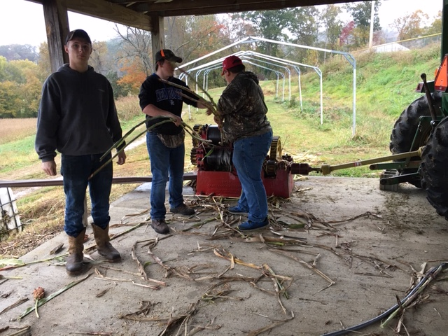
PROCESSING SORGHUM
THIS PICTURE SHOWS SOME OF OUR STUDENTS GRINDING SORGHUM CANE TO PROCESS INTO SORGHUM. THEY GREW THIS CANE ON THE SCHOOL FARM.

Slide 9
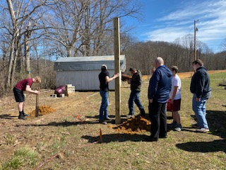
CONSTRUCTING THE SMALL ANIMAL SHELTER
THESE STUDENTS ARE BEGINNING TO SET THE POSTS THAT WILL BE PART OF THE SMALL ANIMAL SHELTER. THEY HAVE ALREADY SQUARED THE BUILDING SITE AND MARKED THE SPOTS FOR EACH OF THE POSTS TO BE PLACED. THEY LEARNED HOW TO SQUARE AN AREA BY USING DIAGONAL MEASUREMENT DURING THIS TASK.

Slide 10
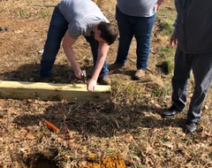
CONSTRUCTING THE BUILDING
BRANDON IS DRIVING A NAIL INTO THE PART OF THE POST THAT WILL BE UNDERGROUND. THIS NAIL WILL ACT AS AN ANCHOR FOR THE POST WHEN CONCRETE IS POURED AROUND IT.

Slide 11
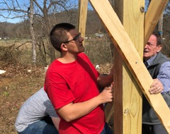
CONSTRUCTING THE BUILDING
SAM IS USING A LEVEL TO ADUST THE POST SO THAT IT IS PERFECTLY PLUMB, OR STRAIGHT UP.

Slide 12
DID WE REACH OUR GOAL?
WE PARTIALLY COMPLETED OUR STATED GOAL OF INCREASING AGRICULTURAL AWARENESS AMONG STUDENTS.
THE UNSTATED GOALS OF ENHANCING MATH SKILLS, TEAMWORKING SKILLS, AND COOPERATION AMONG SPECIAL EDUCATION STUDENTS WAS REACHED.
THE UNSTATED GOAL OF INCREASING SELF CONFIDENCE AND SELF RESPECT IN THE SPECIAL EDUCATION STUDENTS IS DIFFICULT TO MEASURE, BUT BOTH SEEM TO HAVE INCREASED, BASED ON GENERAL OBSERVATION OF THE STUDENTS.

