Slide 1
ALEXA - Can You Hear Me Now?
Alonzo Fugate
Breathitt County Schools
Marie Roberts - Caney Elementary School

Slide 2
Alonzo Fugate
Breathitt County Schools
Marie Roberts-Caney Elementary

Slide 3
What did I do?
I used the Echo Show in my classroom in order to facilitate learning with current information, news, and the “voice” of Alexa in order to answer student questions, quiz students on material being learned in the classroom, and allow students to investigate current world/weather situations.

Slide 4
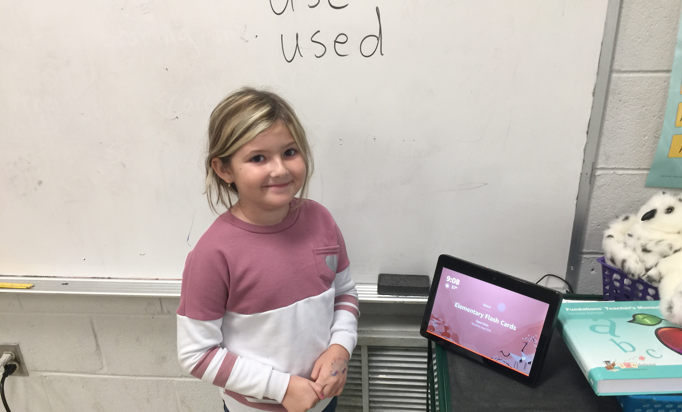
Easy to Use
Even a child can use it!

Slide 5
What else?
In order for all of the students to easily hear the information, I used a bluetooth wireless speaker connected to the Echo Show so that the sound could easily be heard throughout the classroom.

Slide 6
Why did I do it?
Students today live in the information age. We can easily and instantly access information. However, when teaching, it is very easy to just ask Alexa a question instead of having to stop teaching, go to a computer, and look up the information. Also, with elementary students, it was easier for them to orally ask a question instead of typing it into a computer or tablet.

Slide 7
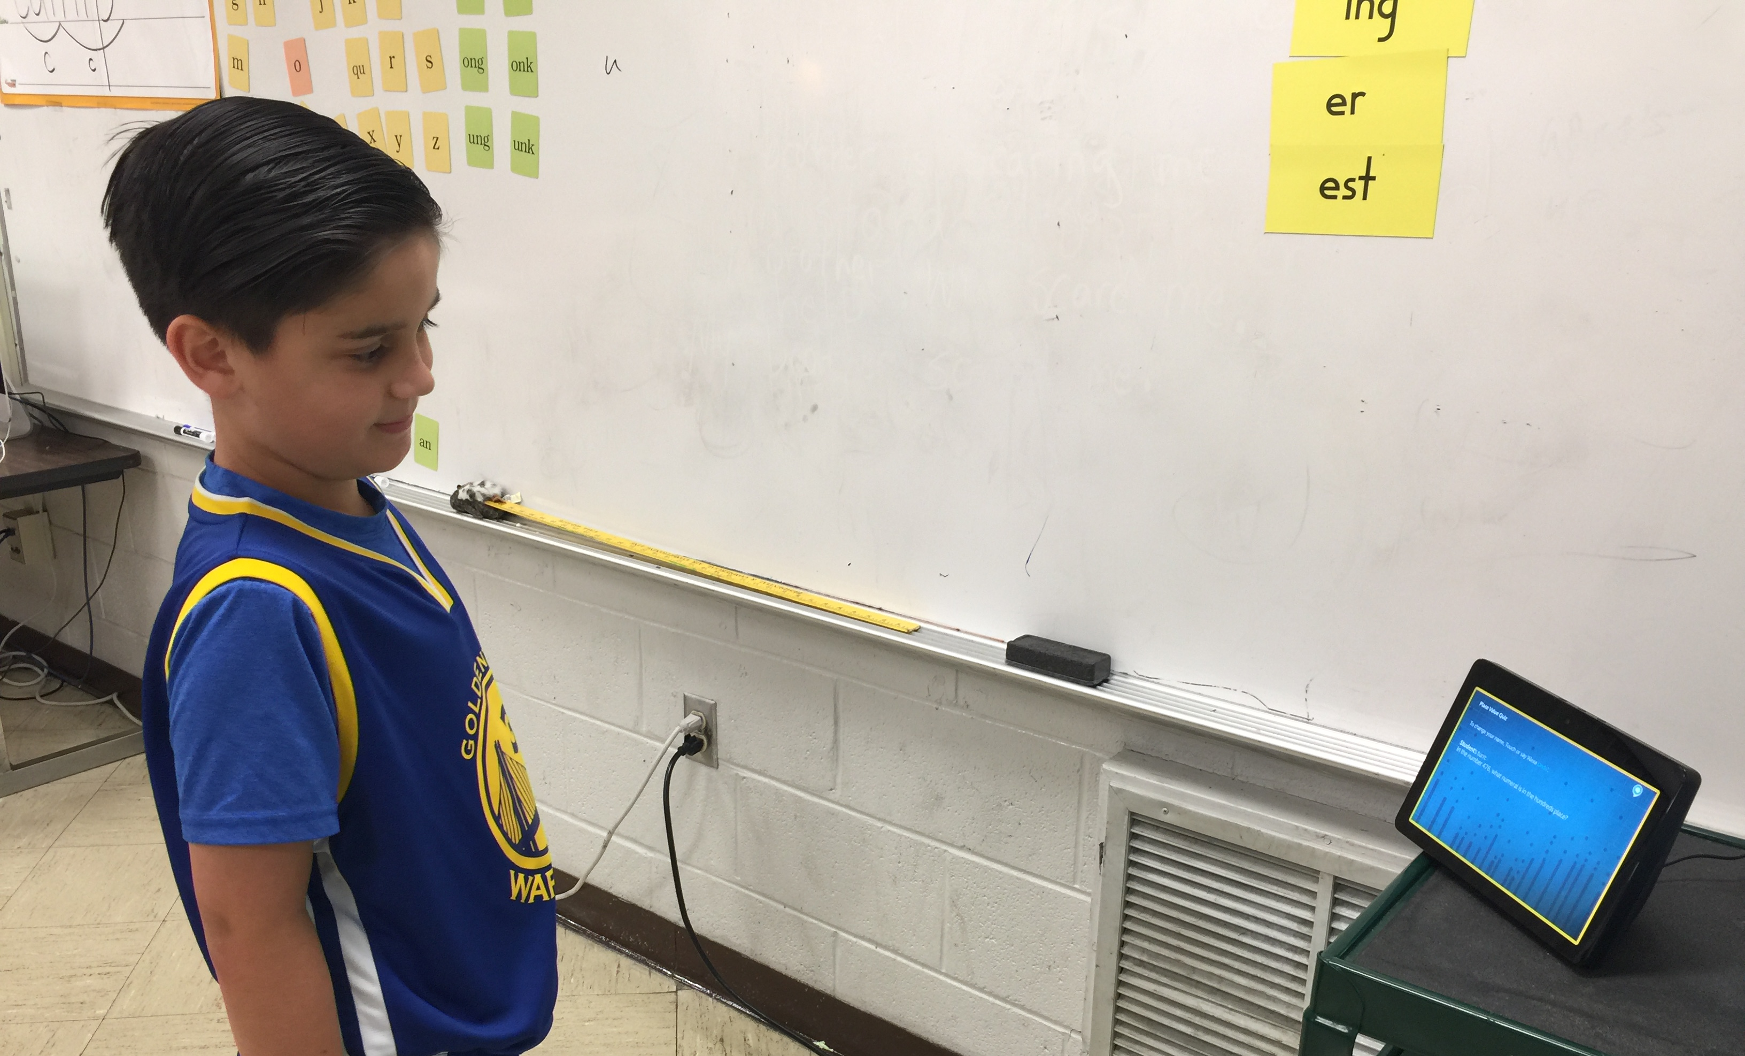
Asking a question
Easier for younger students to use

Slide 8
How Did it Work?
Each day, students used the Echo Show in various ways. We used it every day in order to investigate current weather conditions (with illustrations!) during calendar time.

Slide 9
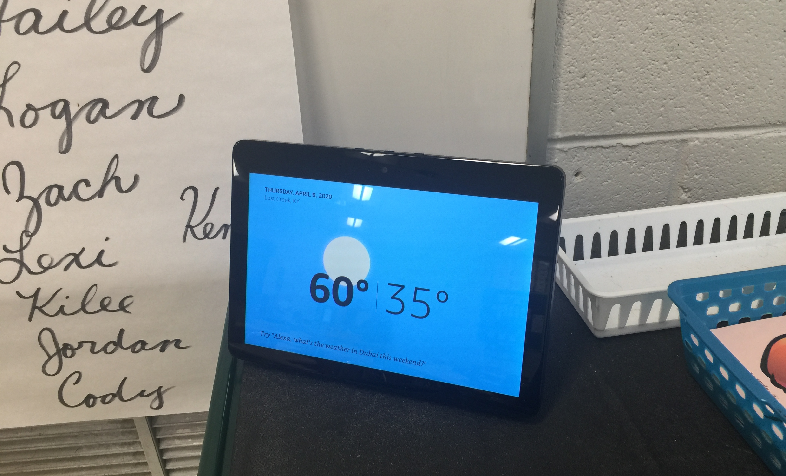
Daily Weather
With illustrations!

Slide 10
How Did it Work?
Students would use the Echo Show to help them study their “trick” words from our phonics program and their Sight Words from our 2nd grade list.

Slide 11
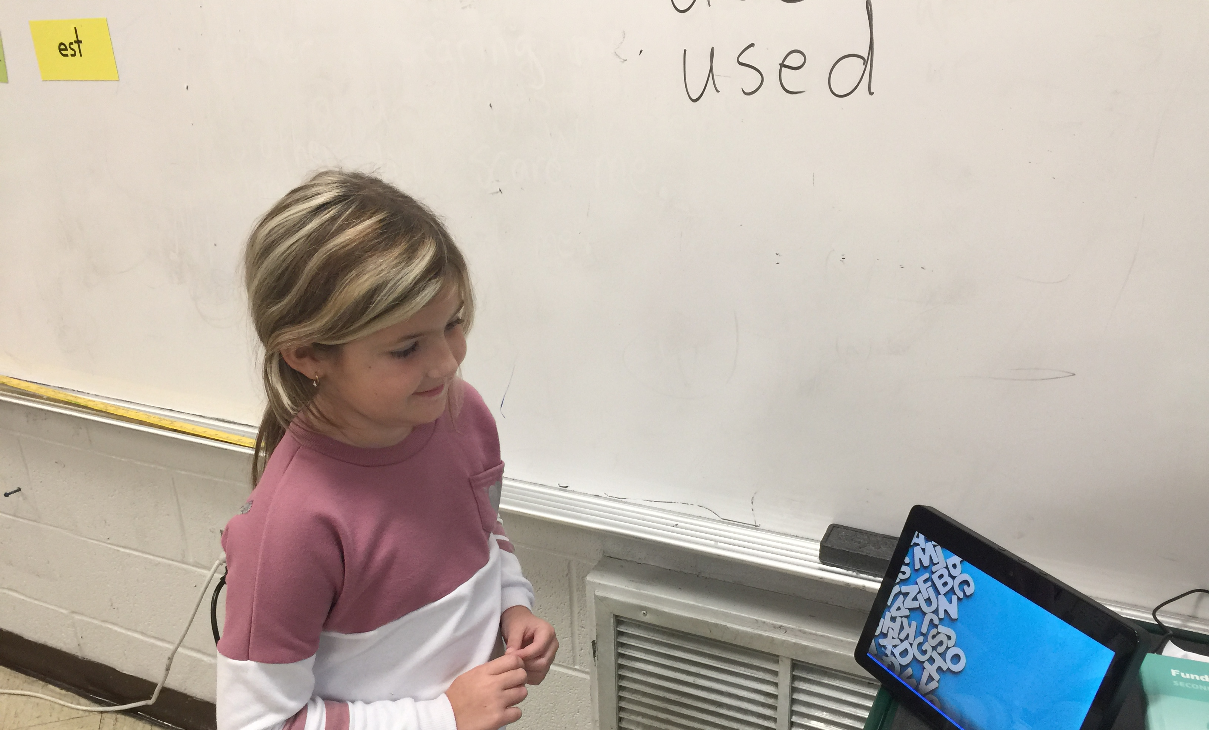
Sight Word Jumble
Studying Sight Words and Increasing Reading Skills

Slide 12
How Did it Work?
Students would use the Echo Show in order to easily bring up pictures and information about people and topics we were studying in class. For example, while reading about Ruby Bridges, one of the students was able to ask to see a picture of Ruby Bridges. It was brought up on the screen.

Slide 13
How Did it Work?
One example was when the students were reading about Abraham Lincoln in class. A students was able to ask Alexa to show the class a picture of Abraham Lincoln. The picture appeared on the screen for all to see. Alexa also gave the class a brief biography.

Slide 14
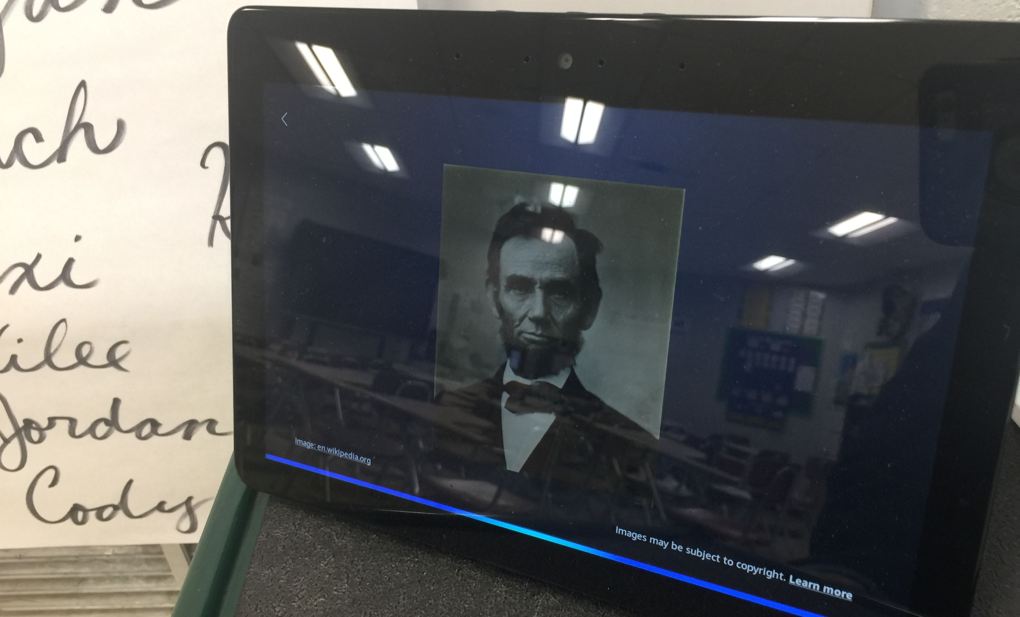
And Alexa Does!
With a biography!

Slide 15
How Did it Work?
Older students on the Academic Team used the Echo Show in order to study material for Governor’s Cup competitions.

Slide 16
How Did it Work?
With various Alexa apps, students were able to listen to stories and answer comprehension questions. Some of these were made by me using the Alexa Skills program.

Slide 17
All Students Were Engaged
They LOVED Using the Echo Show and Talking to ALEXA!

Slide 18
How did it impact student learning?
Students scores have improved from the beginning of the year in reading and math. I have had several students move up a level (or two!) from Tier II and III.

Slide 19
How did it impact student learning?
Students were more engaged in the classroom. They loved using the Alexa Echo Show in order to learn more about the world in which they live.

Slide 20
How did it impact student learning?
Students used the Echo Buttons to play the educational skills games that are available with the Echo Show. These buttons were used quite a bit with the Academic Team in order to practice content. They placed THIRD in the REGION and FIRST at DISTRICT!

Slide 21
What did I learn?
Students were very much at ease when using the technology. They are used to using equipment with voice-recognition.

Slide 22
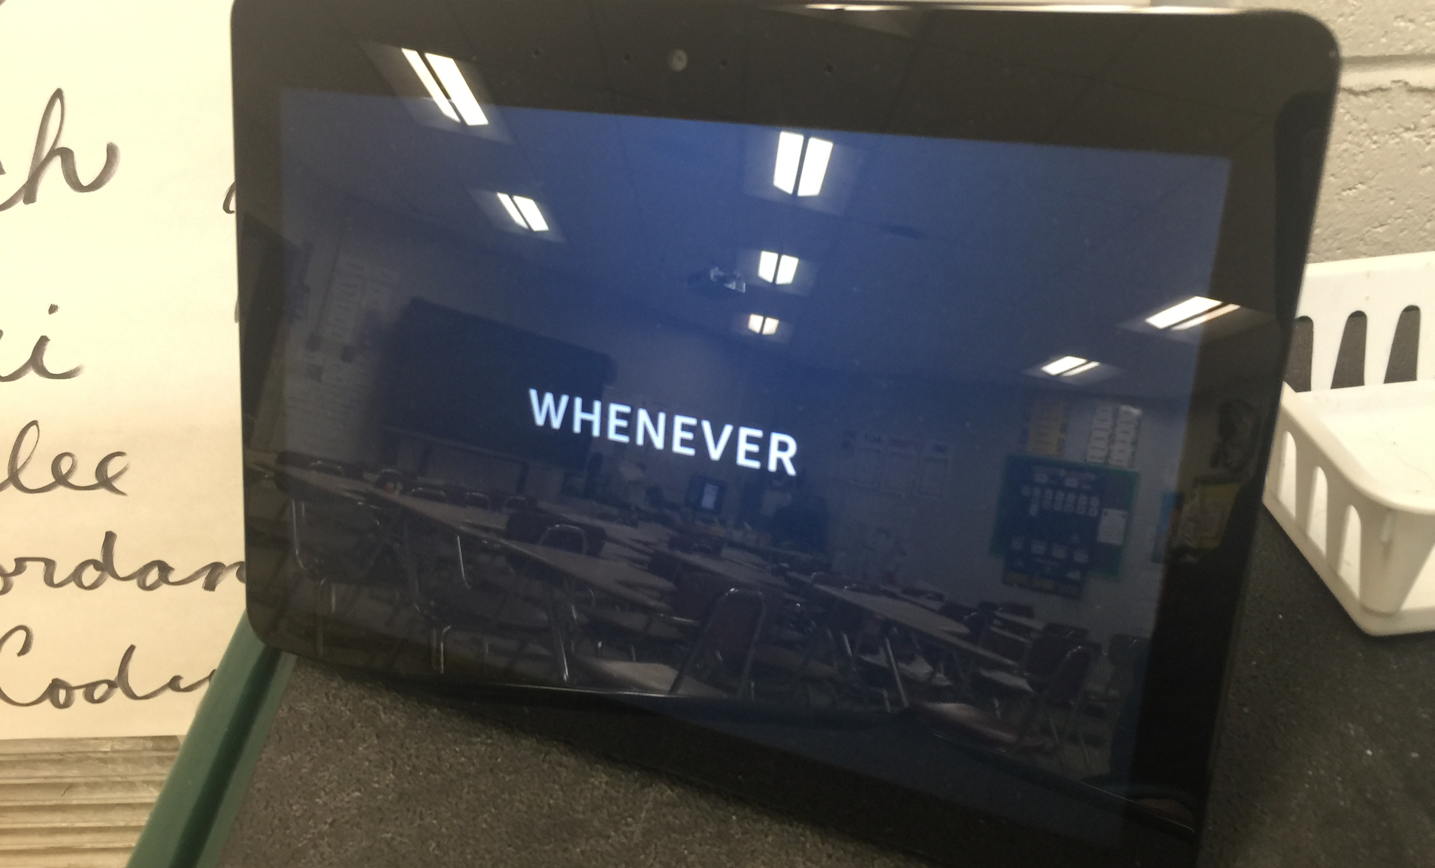
Even the teacher can ask how to spell words!
Hey…you never know!

Slide 23
What did I learn?
Students are engaged when using this technology. It helps them add to their own INDEPENDENT learning styles.

Slide 24
What did I learn?
Students were able to find another way to practice and learn skills in reading and math. Some of these students were struggling with other types of intervention. This was another tool that helped these students learn.

Slide 25
Results?
Students were engaged
Students used ALEXA for various purposes
Reading and Math scores increased for MAP testing
Reading scores have improved as seen in Running Records
Students who were shy seemed more at ease speaking to ALEXA

Slide 26
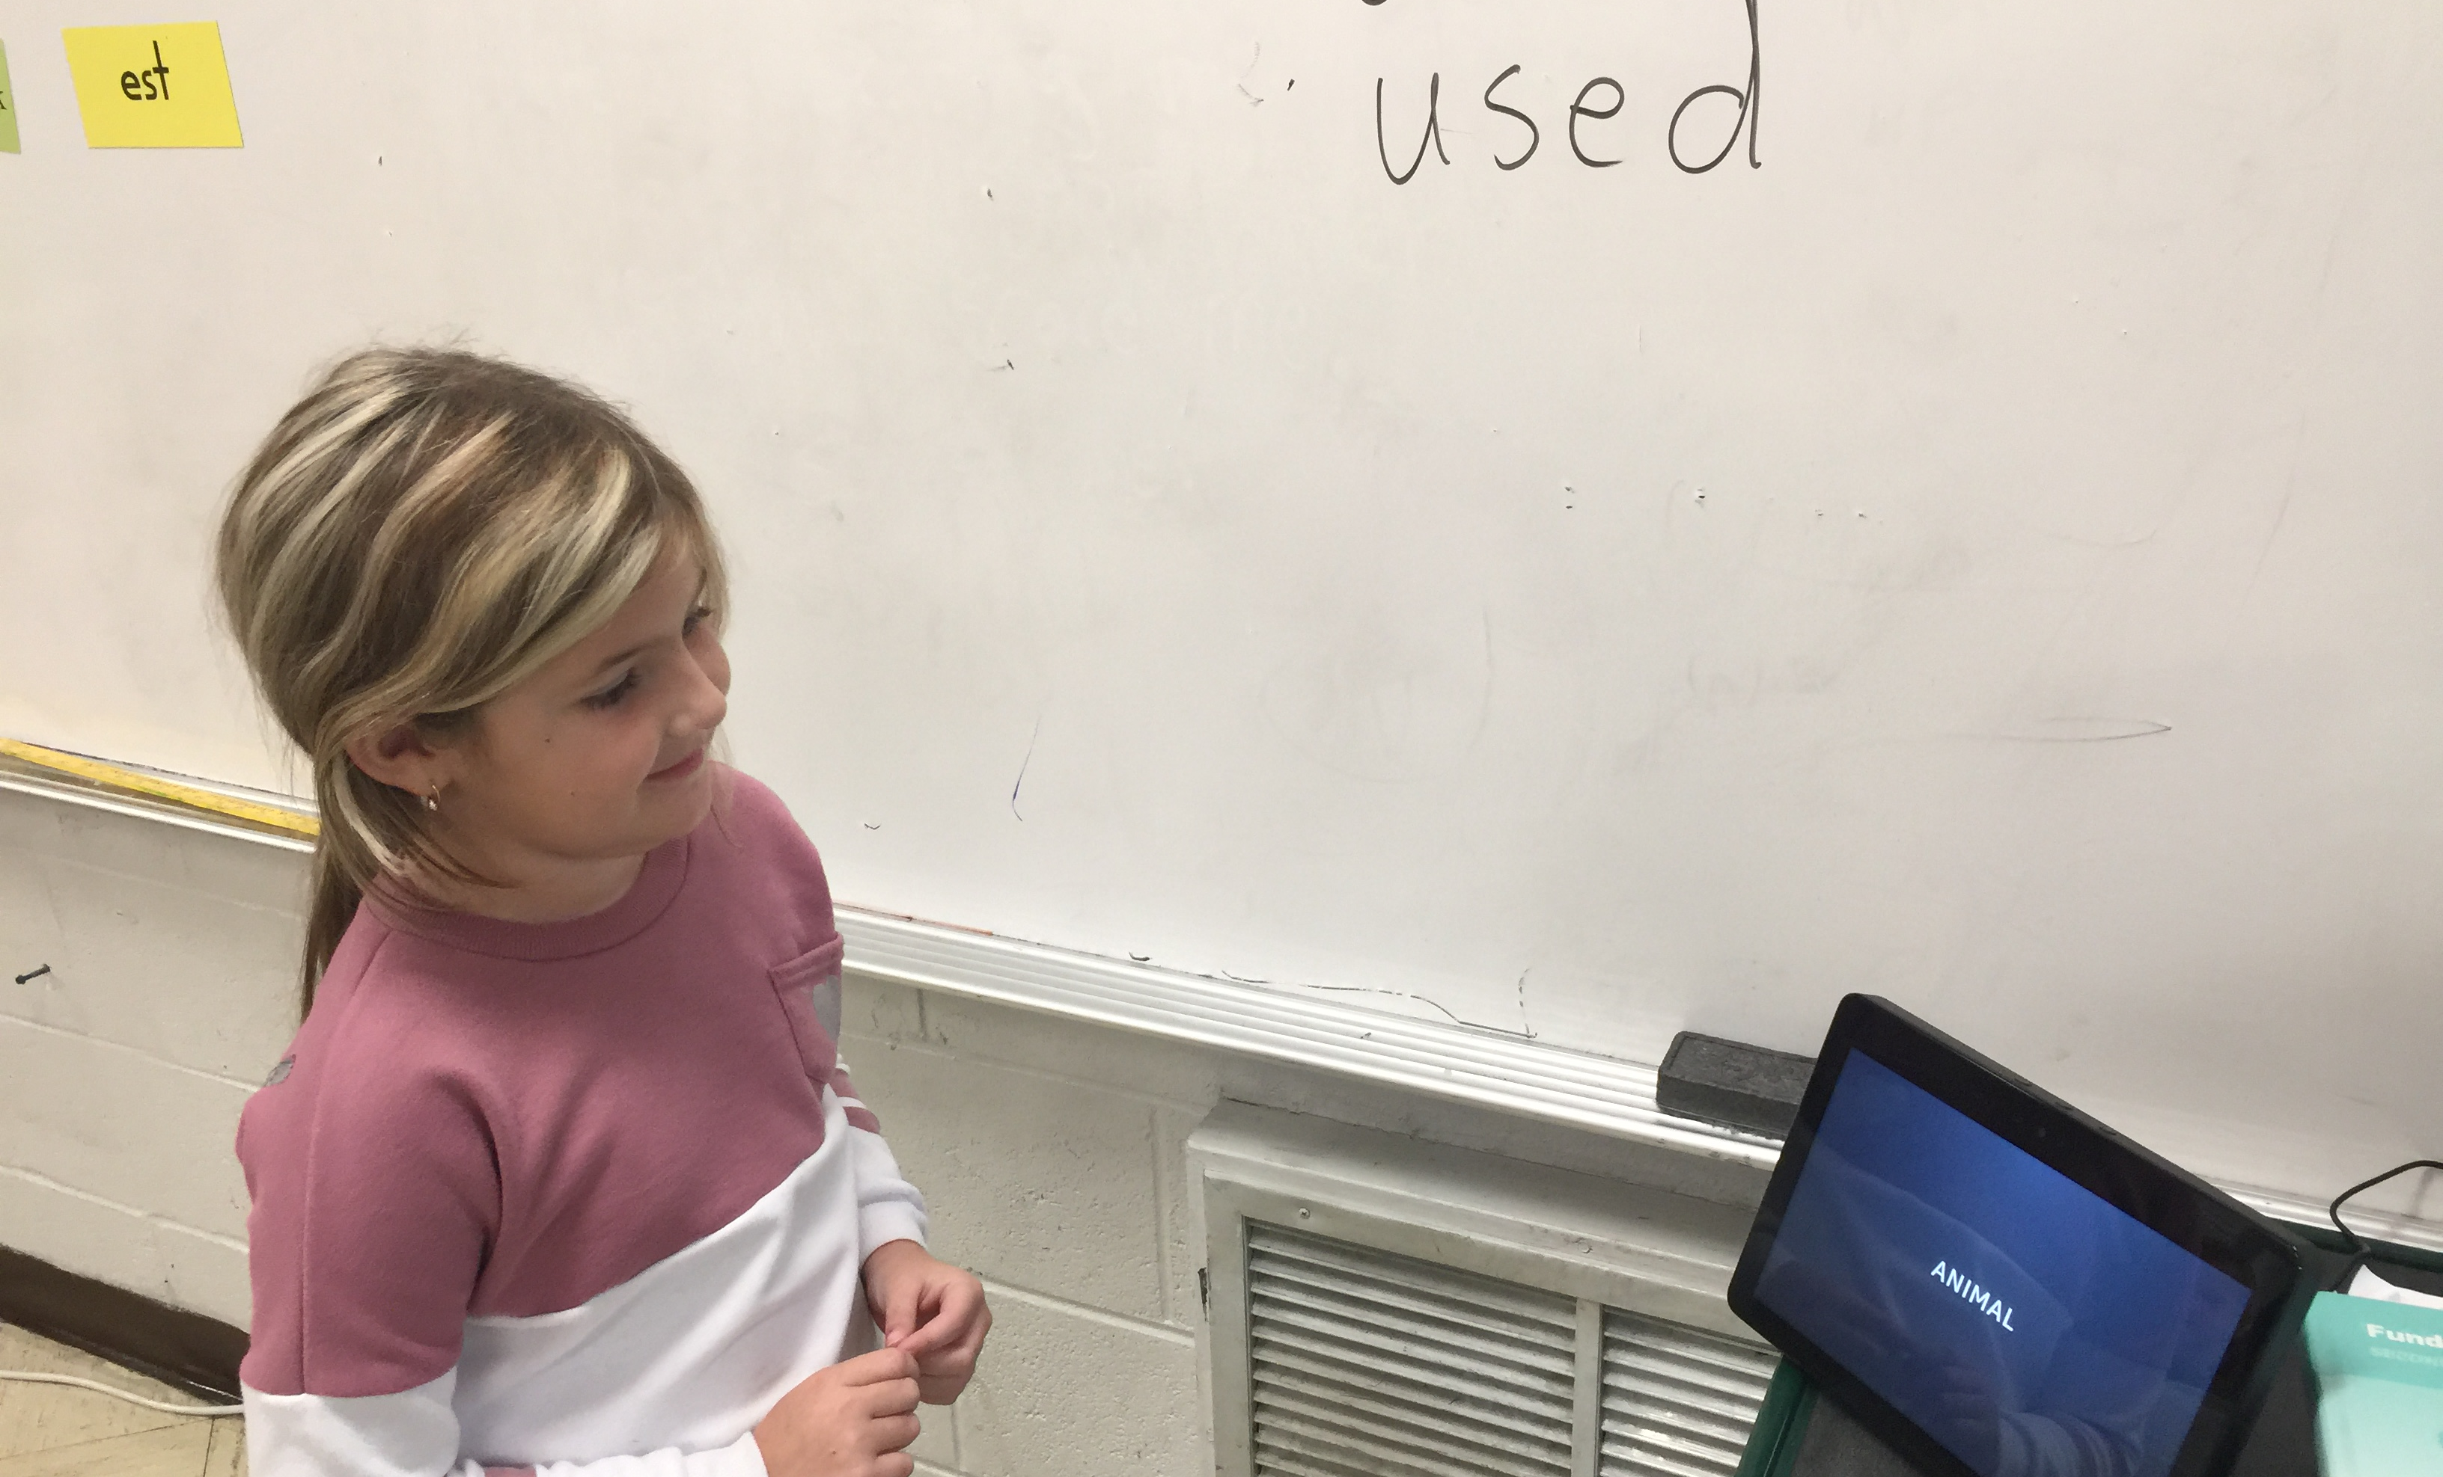
Worth It?
DEFINITELY!

