Slide 1
Piling Up Stones Documentary Project
Rebecca J Potter

Slide 2
ARI Grant Expectations
Innovate
to begin something new (Webster’s II)
traditionally journalism class was printed form of media
videography took my students out of their comfort zone
Address a challenge in education
learning how to manipulate the equipment, both audio and video
learning how to use the video editing program
Active learning process
watched many, many tutorials
shot and reshot video to get it right
used resources from KVEC (Willa Johnson)

Slide 3
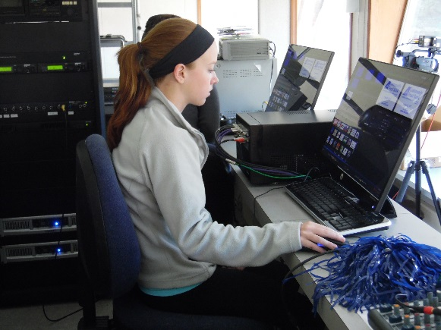
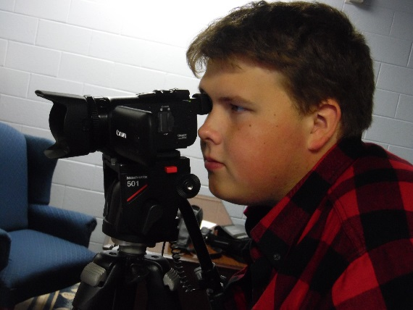
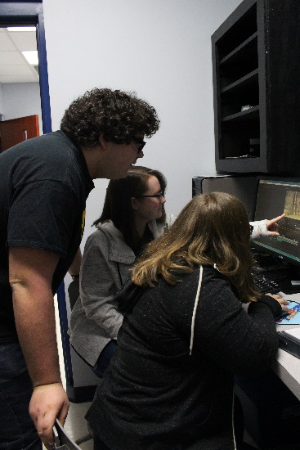
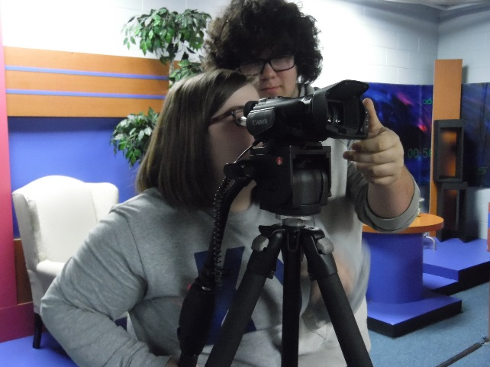
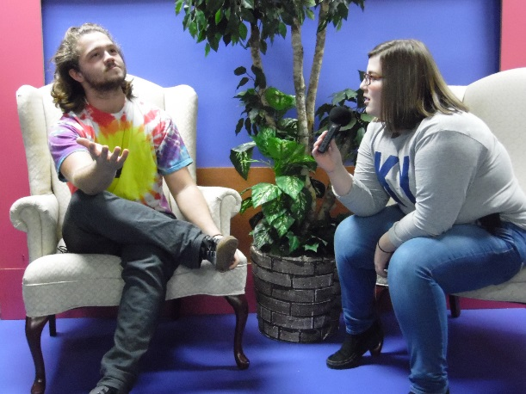
The Beginning

Slide 4
Content Taught
This grant project taught students to:
Use the vocabulary of the industry
Use features of various cameras and audio equipment
Set up camera angles for videos
Use proper interviewing skills
Use specific audio equipment (Rode microphone and Zoom audio recorder)
Download video clips
Use editing software (Adobe Premiere Pro)

Slide 5
Benefits of Participation
This grant not only gave the students specific audio and video skills, it also taught them:
Interpersonal skills
Professionalism
The importance of Appalachian culture in their lives
21st century skills that can be used in any media/digital career

Slide 6
Materials
Canon Rebel T5i
Rode microphone
59” Pro Series Photo and video tripod
G-Technology 1 TB Hard Drive
Sony 256 GB SD Memory Card

Slide 7
Piling Up Stones- Segment 1: Childhood

