Slide 1
Virtual Hands on Science Learning
Chrome Book

Slide 2
Research for TCT Learning
In order to be successful on the 4th grade TCT students needed to be familiar with specific science vocabulary.
Some important words were:
gestation period
life span
physical traits

Slide 3
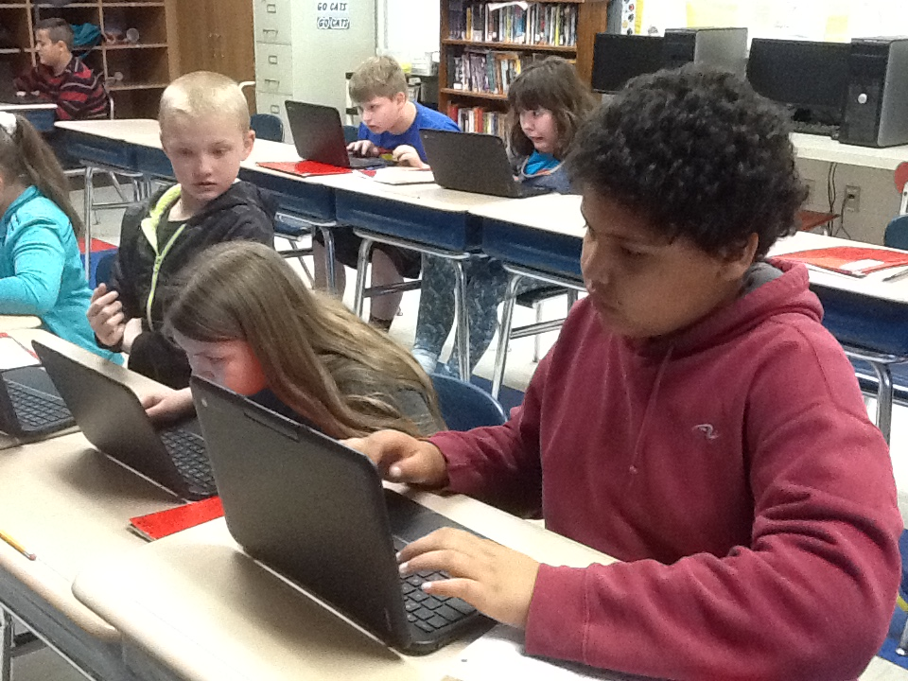
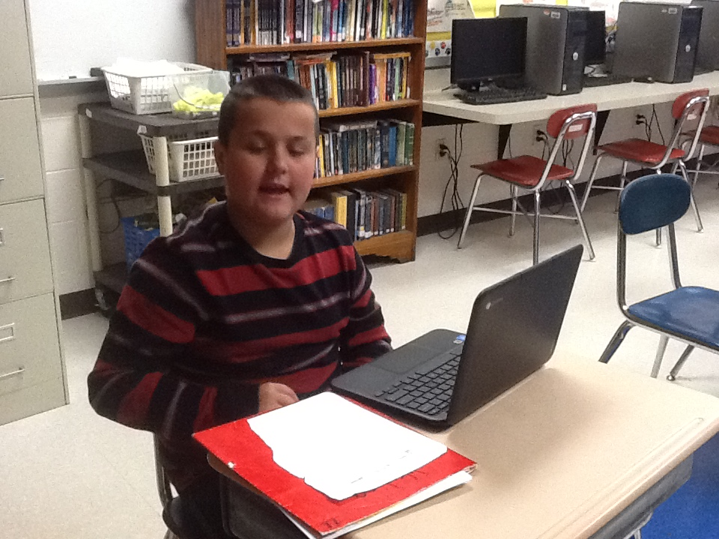
The Chrome Books made this learning much more interesting.

Slide 4
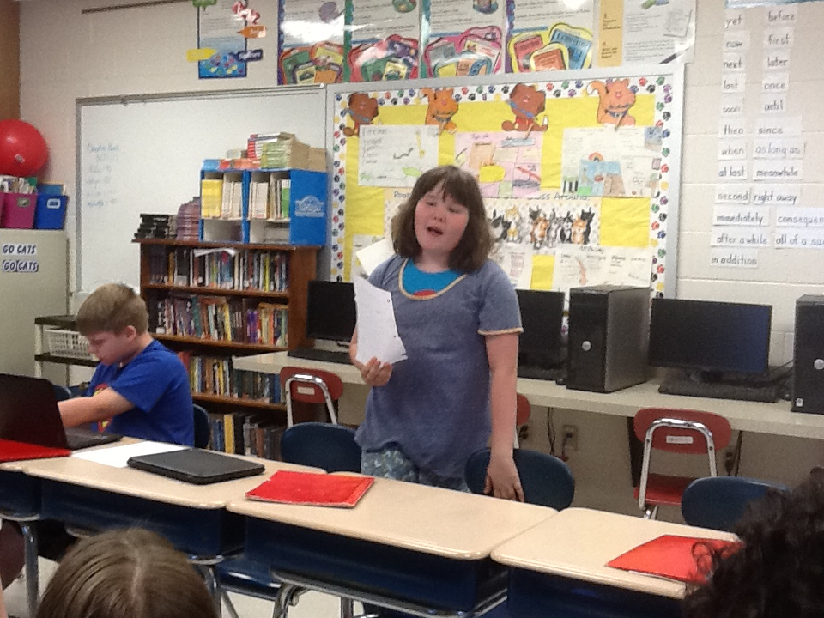
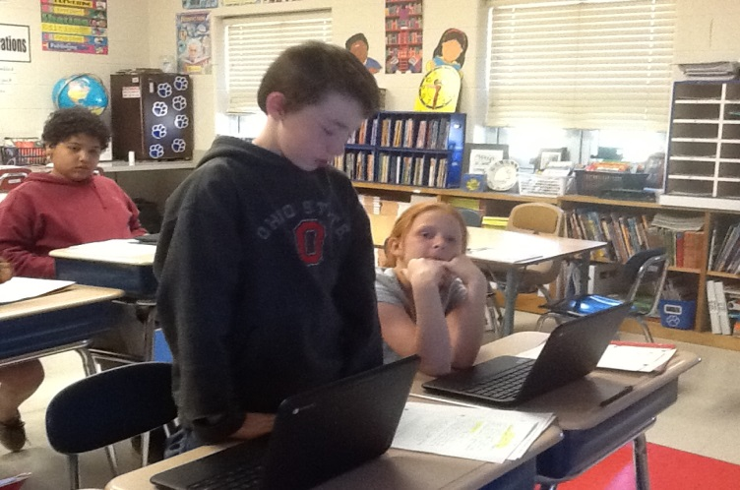
Daily Question and Answer Sessions
Students shared out in small and large group settings throughout the course
of their research. If a reporter couldn’t answer a posed question,
their standard response was, “I don’t know, but I will find out!”

Slide 5
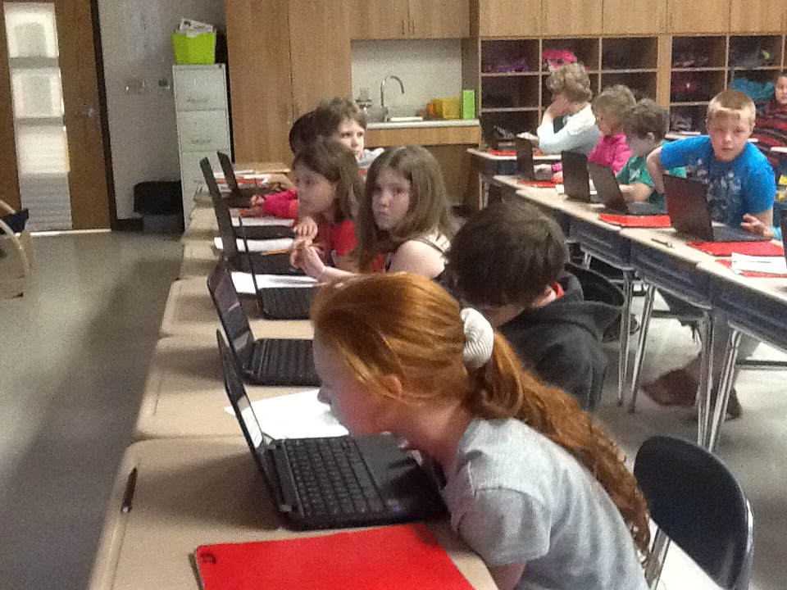
All learners were excited about using this technology for research!

Slide 6
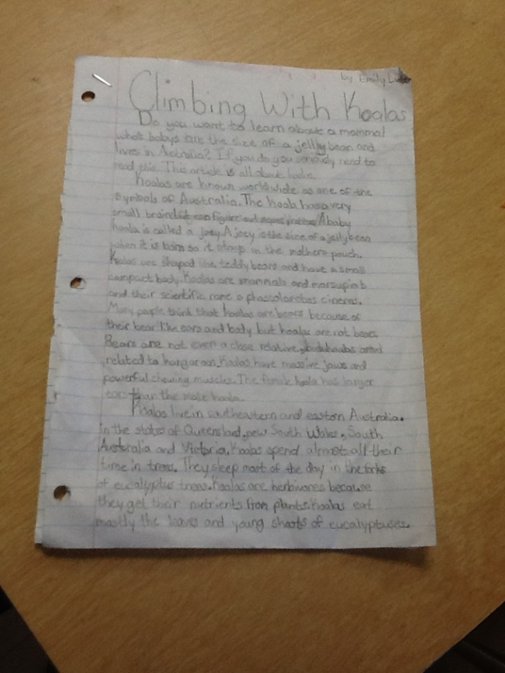
A Final Product
SAMPLE OF STUDENT RESEARCH
Students used the language presented in these lessons throughout their research. Our team found that this increased their understanding of the vocabulary presented in TCT and decreased some of the anticipated anxiety.

Slide 7
Chrome Books are also being used to differentiate instruction.
Learning Farm/Science
Mystery Science
BrainPop and BrainPopJr.
This sites can be viewed as many times as a student needs in order to be successful in the classroom.

