Slide 1
Boogie Boards
Rebecca Morrison

Slide 2
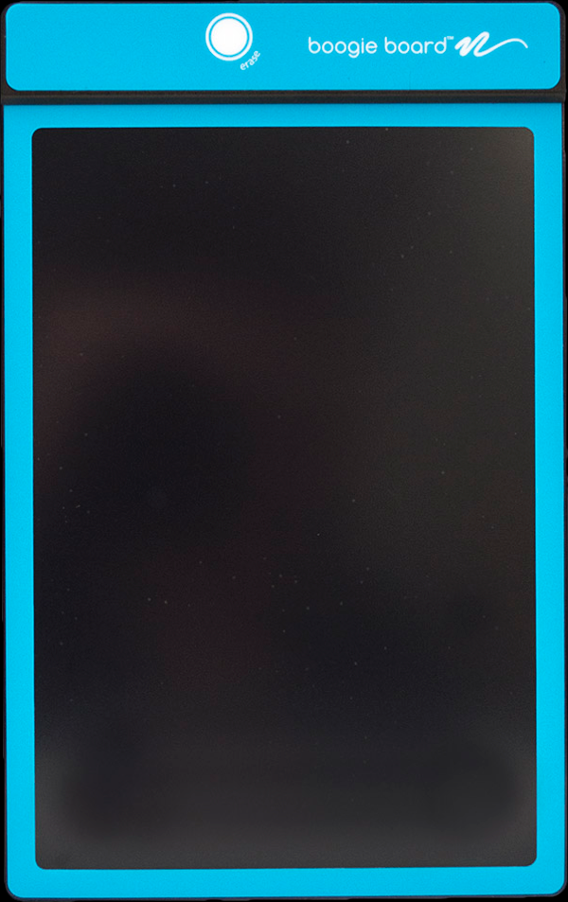

2x + 4 = 12

Slide 3
ARI Grant – Boogie Boards
My grant was for Boogie Boards to see if going paperless in the classroom helped make a difference on student engagement and student achievement.

Slide 4
What I found was that the Boogie Boards did have a positive impact on my students’ achievement and engagement in my classroom.
Students were excited to use the boards to do math.

Slide 5
How I Used Them In My Classroom
I had students complete their problems on the boards one at a time and hold them up. Everyone was on problem 1 at the same time. As a class we helped each other learn and achieve. The students who got number 1 correct helped a student who did not get number 1 correct.

Slide 6
Then, we would continue on to number 2, etc. This allowed me to catch problems immediately rather than after a whole page of problems were completed.

Slide 7
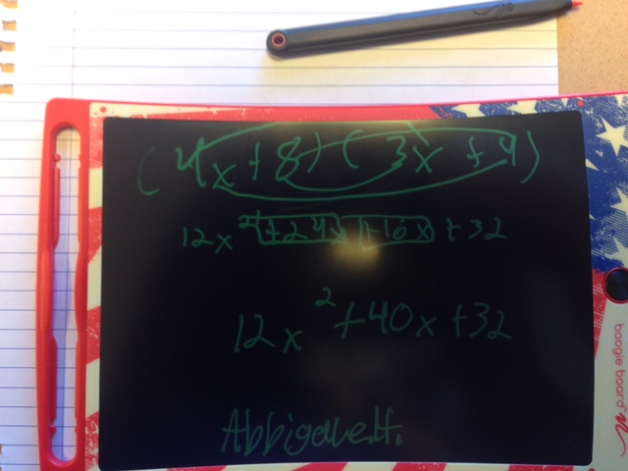

Slide 8
“Love them!”
- Tiana
“I like them 10x better than working on paper, and they’re fun!” - Grace
“I really do love them, and they make it easier to learn.” - Lyndsay

