Slide 1
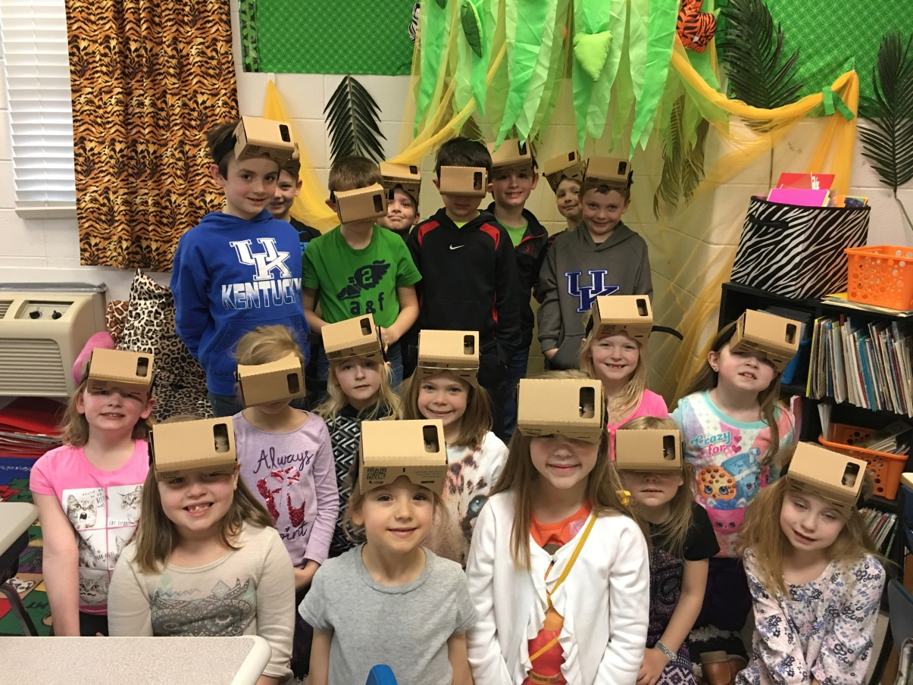
Project: The Places We Will go!
By Tammie Matijasic

Slide 2
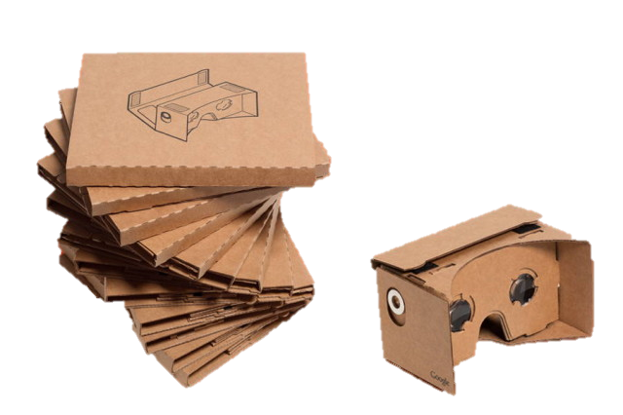
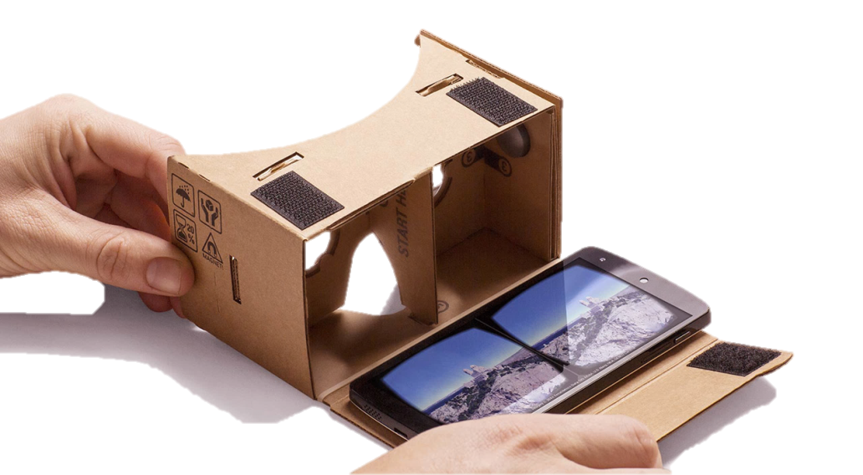
Action plan: My innovative plan for my grant was to take my students on several field trips without leaving the classroom using virtual reality headsets.

Slide 3
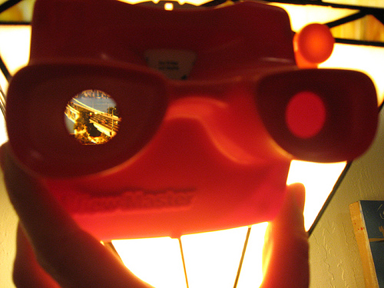
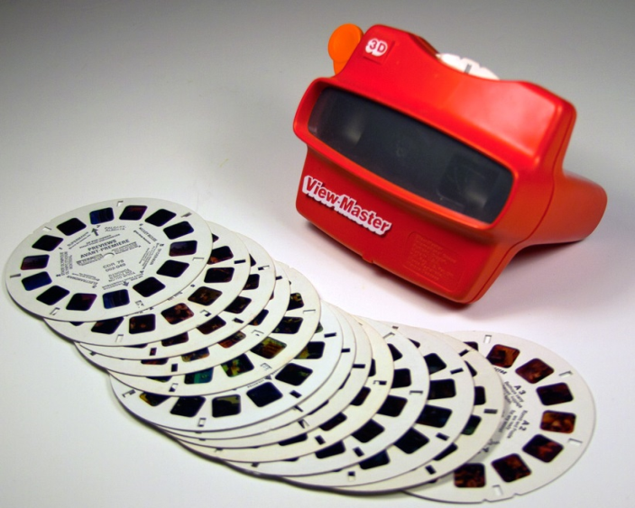
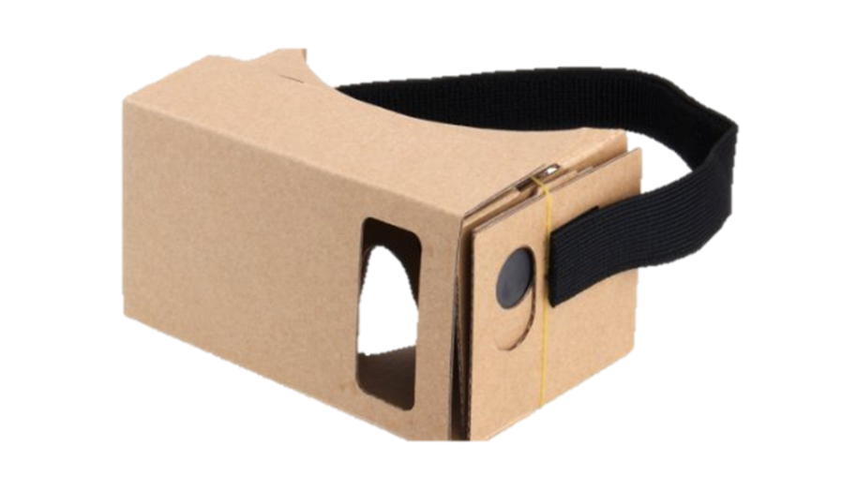
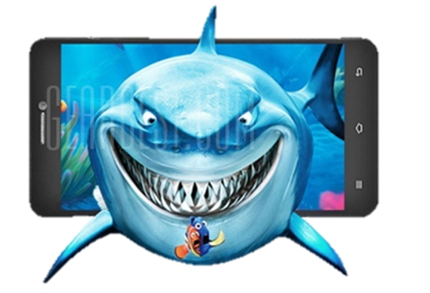
“VR” Blast from the Past
Viewmaster
Out with the old and in with the new!
This is 21st
century learning.

Slide 4
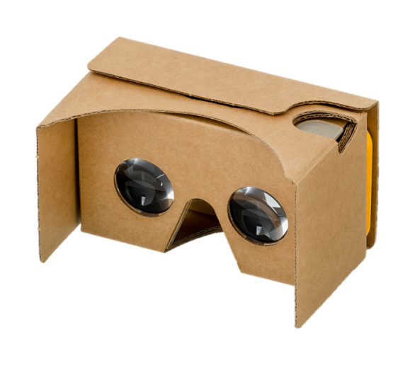
My project allowed me to transport my entire classroom to different places and different times – Museum of Arts, 3D roller coaster rides through different places and swimming under the water – with the click of a button!
By using virtual reality in the classroom, these immersive learning experiences
are now just a small sample of what's possible with VR today

Slide 5
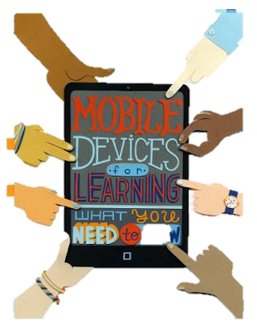
It seems the students remember longer, learn faster and decide better when are actively engaged they .

Slide 6
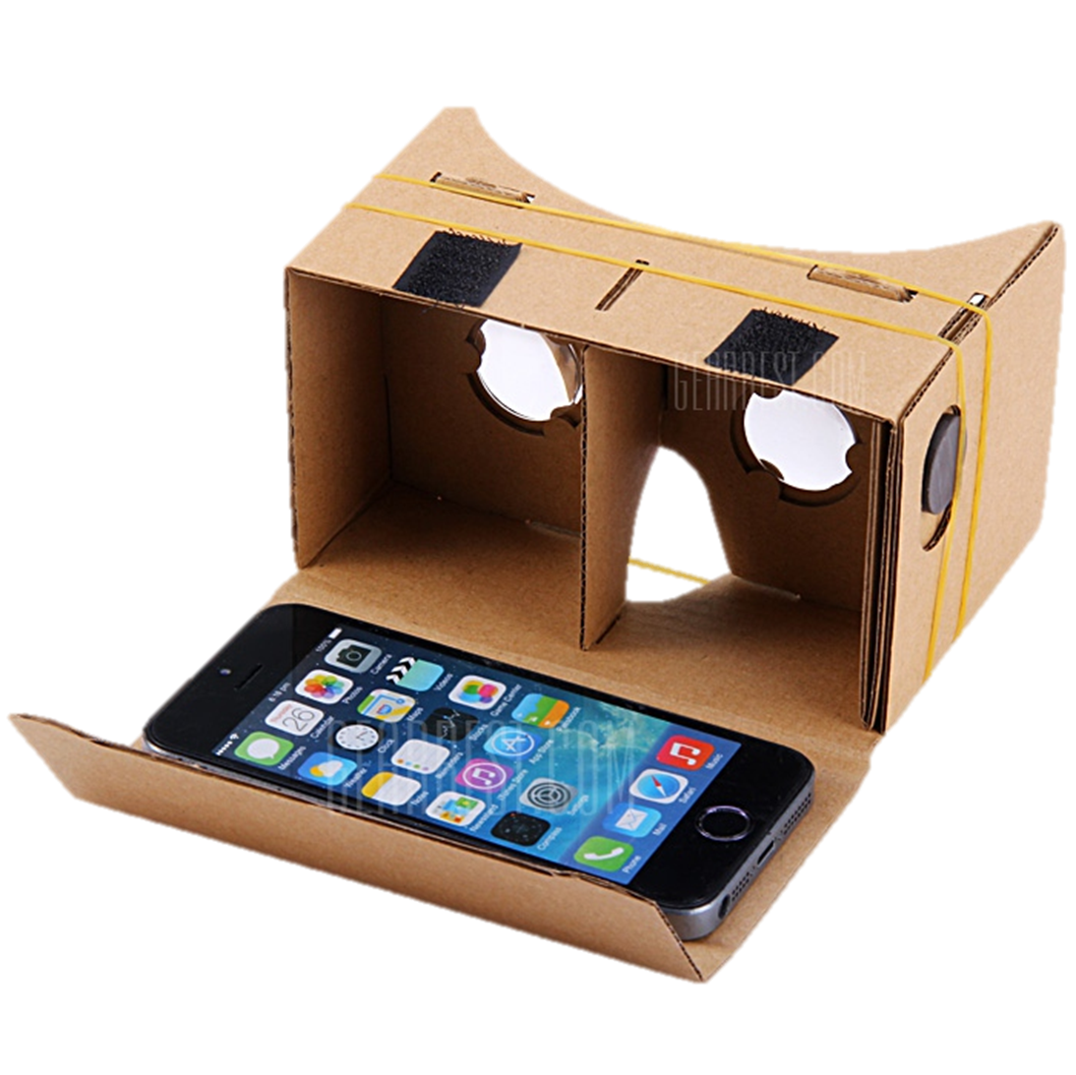
What I learned about the headsets
Pros: inexpensive, buttons or magnets
Cons: not very durable, not easy to learn.

Slide 7
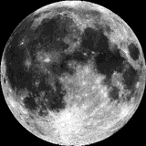
Response to the question:
If you could go anywhere, where would you go?
The moon
California
Disney World
Africa
Scuba diving in the ocean
Grand Canyon

Slide 8
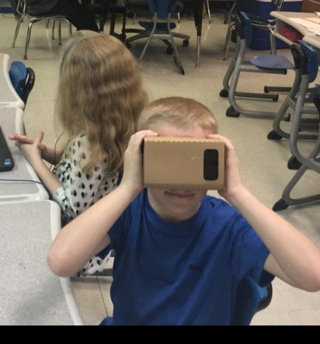
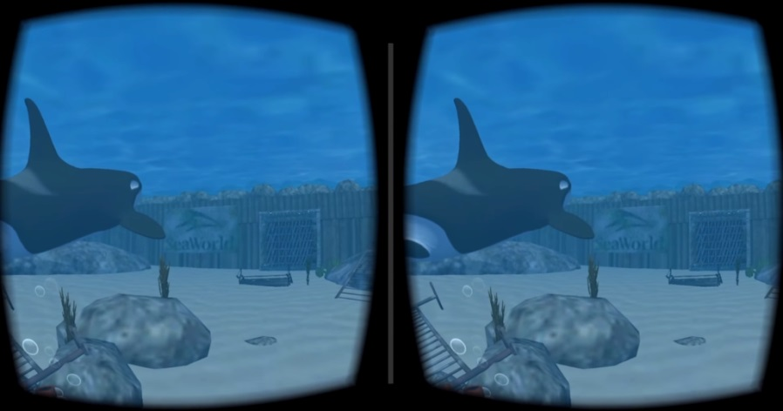
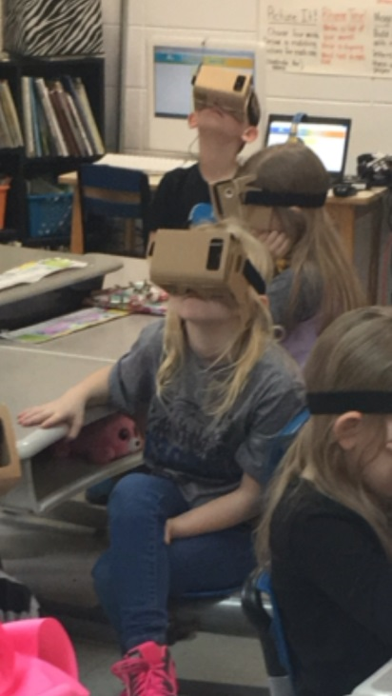
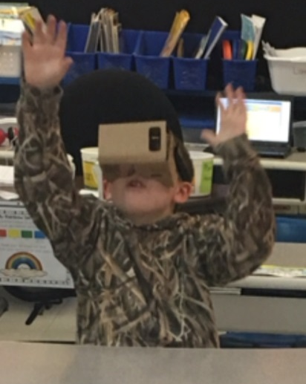
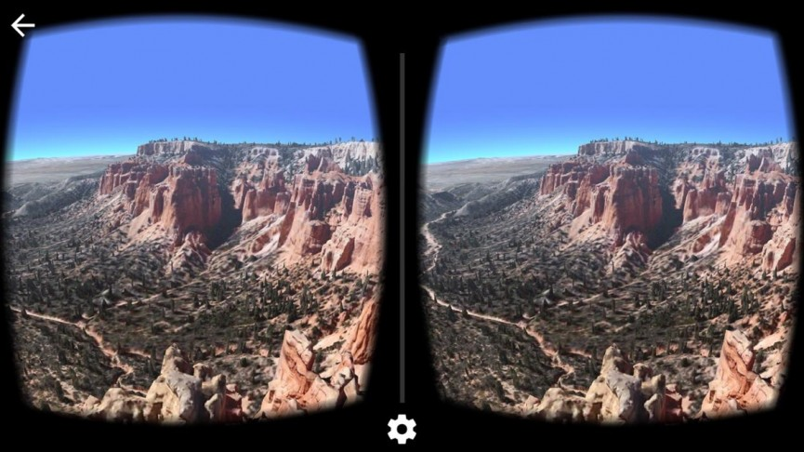
So much richer than showing them a picture or having them read about it.

Slide 9
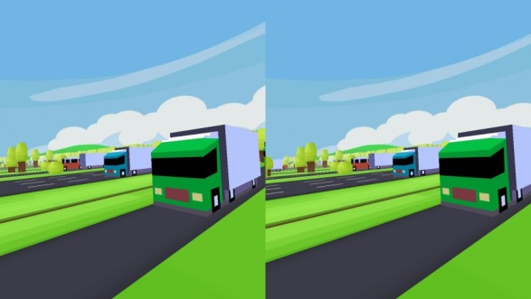
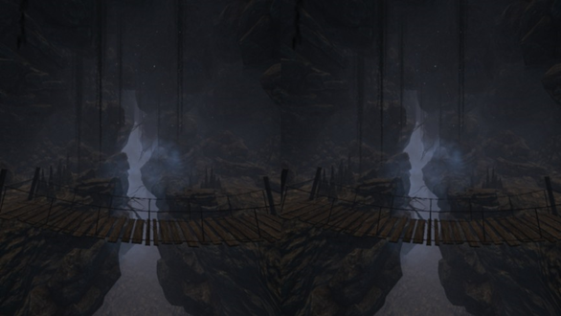
Google Apps
Cardboard (cardboard camera)
Street view, Expeditions
Arts and culture
Youtube: 360 Channels (Pete’s the Dragon)
VR Crossy Road
VR Cave

Slide 10
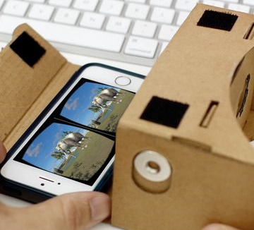
Elementary
AR flash cards , shapes, space addition
Crayola color Alive and Chromeville
PBS games
Wizar
Popar Toys
Field trips: Museum of Natural History
Guided tours of national parks
Zoos
Star Wars VR

Slide 11
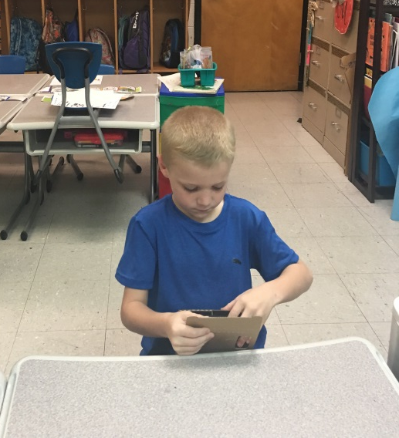
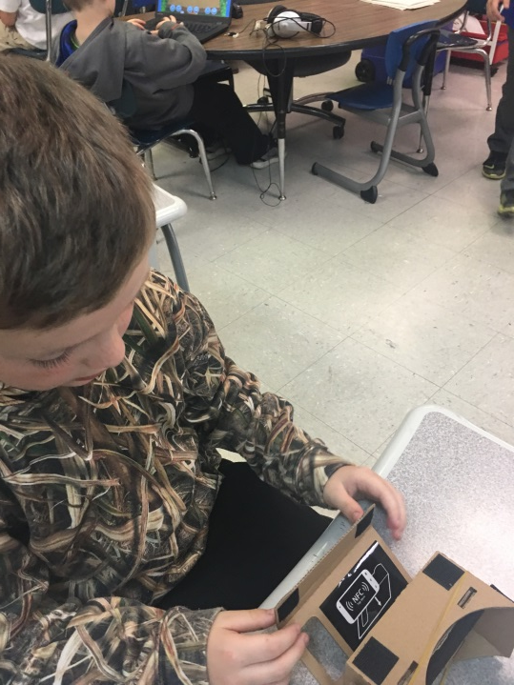
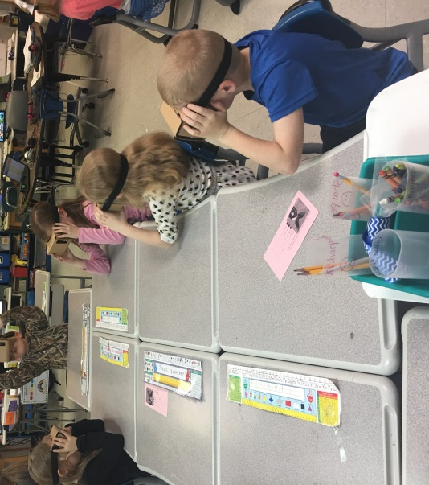
Expeditions:
Took my students to places a school bus couldn't.

Slide 12
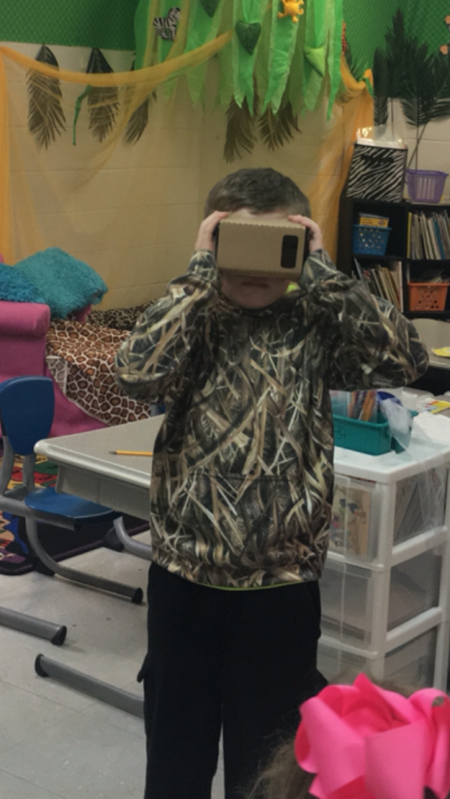
We LOVED Virtual Field Trips and
all from the comfort of your classroom we scuba dived with sharks in the ocean, visited various zoos and visited National Parks.
The VR experience was so amazing that students literally could not stay seated.
Responses heard:
What is that?
I see a shark.
Whoa!

Slide 13
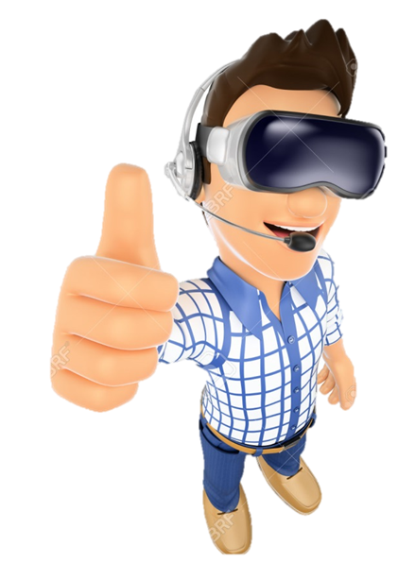
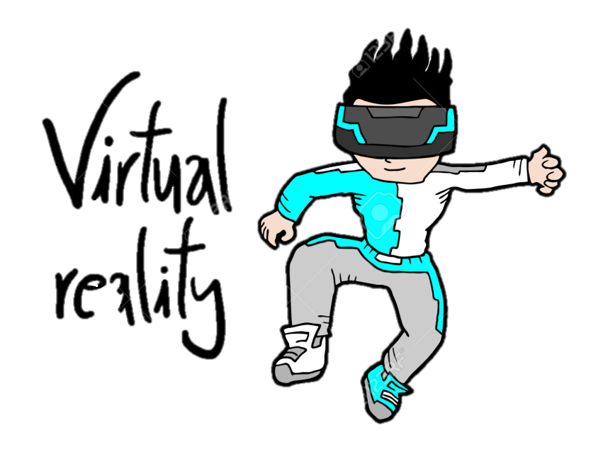
I feel the outcome was greater than expected with
student involvement, increased excitement about
learning and exposure to variety of experiences.

Slide 14
THANKS!
Any questions?

