Slide 1
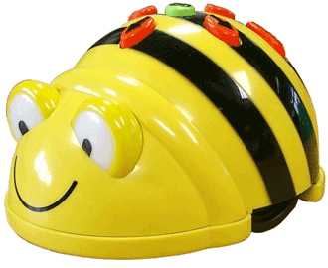
Megan Hudson
3rd Grade Teacher
Highland Turner Elementary

Slide 2
Area of Focus
Using technology for learning: Can primary students problem solve and learn basic reading and math skills using Bee Bots.

Slide 3
How They Help with Problem Solving
Bee bots help build critical thinking skills as students move through a series of challenges by directing the Bee bot through various routes through a mapping process.

Slide 4
How They Help with Problem Solving
Students develop an understanding of coding/programming, as well as learning to make predictions about where the bots should go, evaluate their decisions as they their bee bot is maneuvering throughout the course

Slide 5
How They Help with Problem Solving
Bee Bots help build and increase learning by using robot technology to support and cultivate vital skills for student achievement.

Slide 6
Hands-on Learning
Student engagement was increased with the use of the Bee Bots.
Students enjoyed learning where there wasn’t a given answer
Even though students had to make predictions and think about how to get the Bee Bot from one place to another, they found it to be a rewarding challenge.

Slide 7
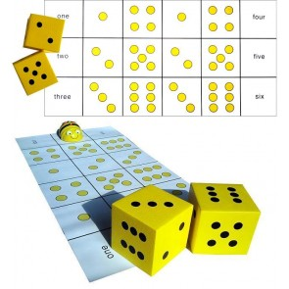
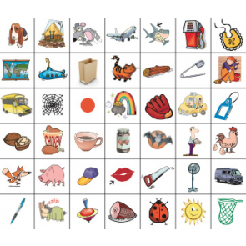
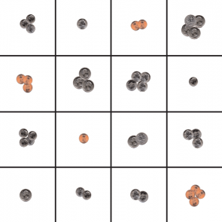
Bee Bot Mats
Through our grant we purchased
*U.S. Coin mat
*Dice mat
*CVC phonics mat

Slide 8
Dice Mats
Skip counting
Build number skills
Multiplication skills

Slide 9
CVC Mat
Work on consonant sounds
Work on vowel sounds
Picture recognition

Slide 10
Coin Mat
Recognize coins
Count coins

Slide 11
Programming
Like the Bee Bots, my students wanted more and found that working on studio.code.org provided them with more challenging forms of programming.
My students found that they could use the programming strategies/techniques from Bee Bots to program angry bird characters as well as programming to spell words.

Slide 12
Evaluation
Students have made correlations with the process of using the Bee Bots to that of solving problems in the classroom.
Students have to learn to think for themselves, try their answer and see the results, and they may have to try and try again until they get it right.
This was/has been a struggle for most students

Slide 13
Evaluation
I have found that even when presented with a challenge, students who can start out with a simple task and can have success, will welcome more difficult challenges as the stages progress especially when they experience success at each stage.

Slide 14
Evidence
Students working with the Bee Bots
Students are eager to try to program the Bee Bots and are willing to try to new ways to solve the same problem (getting to the same area, but going different routes).

Slide 15
Evidence
Problem Solving
Working with peers

Slide 16
Overview
My students have enjoyed using the different programming techniques. They love working with the Bee Bots and programming them to get to their destination. My student’s have improved on their problem solving skills and their critical thinking skills.
I highly recommend the Bee Bots and other programming technology to other teachers.

