Slide 1
The Eagle’s Nest News: An Augmented Reality Newspaper Written For and By Students
Rachel Holbrook, Ed.D.
Johnson County Middle School – Johnson County
7th Grade Language Arts

Slide 2
Area of Focus:
the acquisition and refinement of advanced writing skills for 7th grade students through the marriage of technology innovation with the production and distribution of authentic writing.

Slide 3

Research Question:
What impact will incorporating augmented reality technology in newspaper production have on students’ perception of school produced newspapers?

Slide 4
Action Plan
Students in my language arts enrichment class will design, research, produce, and distribute a student created newspaper featuring augmented reality and interactive QR codes
Students will use Chromebooks and Google Apps to research and create the content for newspaper articles
Students will use an iPad Pro equipped with the Aurasma App and a QR Code Generator

Slide 5
Project Evaluation
A pre and post survey was administered to students in my team using Google Forms.
I evaluated the perception students had toward the school’s current newspaper.
Then, after students created their own newspapers featuring augmented reality and QR codes, another survey was given to see if their perceptions had changed.

Slide 6
How It Worked
26 students in an enrichment class
Class met weekly for approximately 40 minutes
Students chose partners and journalism topics
Students used Google Classroom and Google Slides to create newspapers

Slide 7
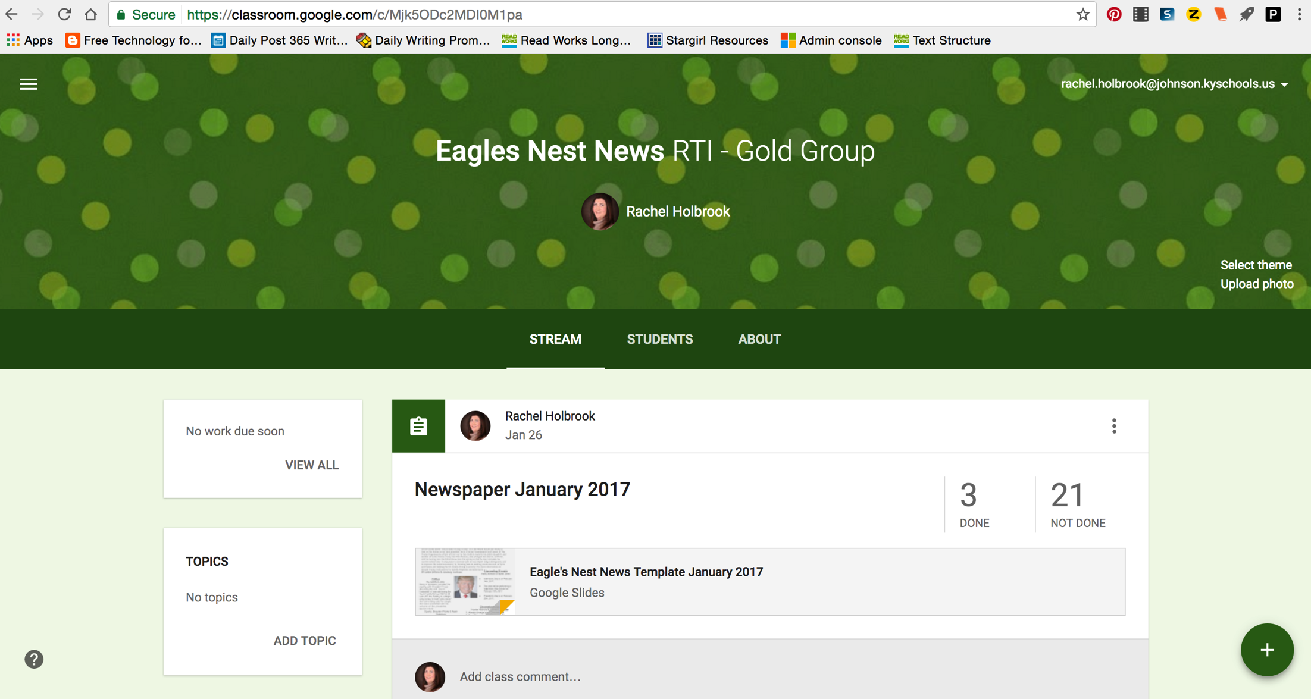

Slide 8
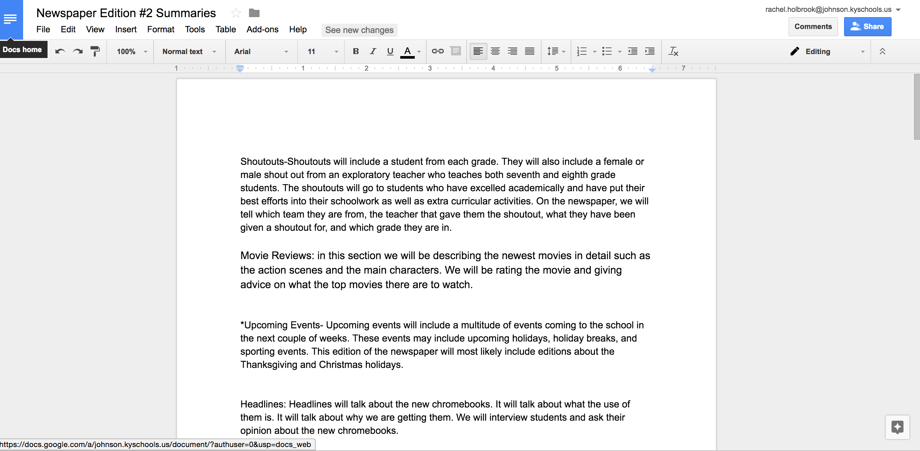

Slide 10

Aurasma

Slide 11
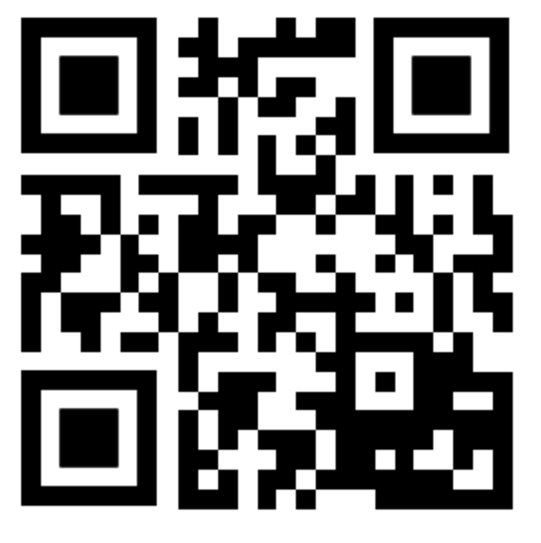
QR Code

Slide 12
Pros
Authentic writing (purpose & audience)
Student created
Engaging
Appropriate enrichment opportunity for students that do not need interventions

Slide 13
Cons
Aurasma App was difficult for students to use
The majority of students were not familiar with how to access Aurasma “videos” once they were created
Difficult to print on legal sized paper in color

Slide 14
Implications
Students need to have more opportunity to collaborate with peers and teacher. (Class needs to meet more than once per week!)
Students need to be educated on using Aurasma.
Students need instruction on basic computer skills and videoing/editing skills.

