Slide 1
Lights! Camera! Math
By Jason Hall
6th Grade Teacher
Owsley County Elementary School

Slide 2
The Holler
Jason Hall
http://www.theholler.org/members/jhall/

Slide 3
E-mail
Jason.hall@owsley.kyschools.us

Slide 4
YouTube
Jason Hall https://www.youtube.com/channel/UC1fRjeQArR9BlwOKKAHqcPQ

Slide 5
Twitter
@MrJasonHall

Slide 6
Problem of Practice
The group of 6th grade math students I was assigned to teach during the 2016-2017 school year responded poorly to traditional teaching methods in past years.

Slide 7
Problem of Practice
While I intended to deliver quality instruction, there was a nontraditional method that I wanted to include. I wanted to provide my students an opportunity to create their own video scenarios for teaching math skills.

Slide 8
The Protégé Effect
The protégé effect occurs when students work harder to understand material in order to recall and apply it more effectively as they teach the concept to others.

Slide 9
My research question:
Will student created math videos lead to mastery of those skills?

Slide 10
How would success be measured?
Success will be measured by student and teacher created exit slips using Google forms. We will measure success based on students scoring >80% on the exit slips.

Slide 11
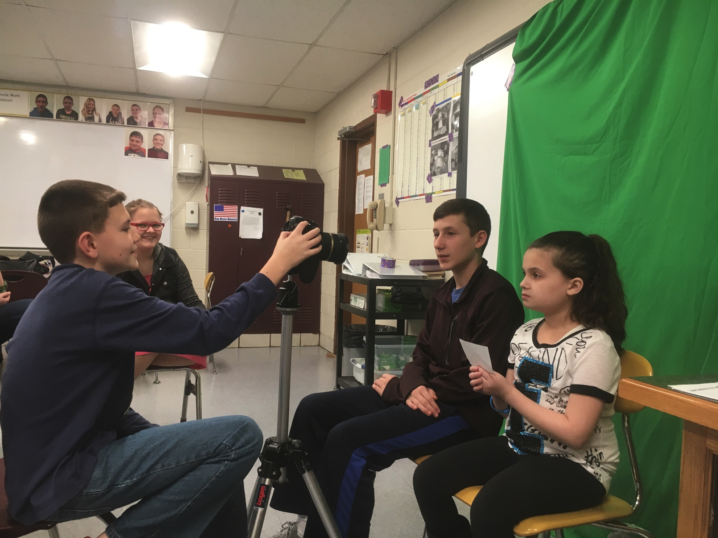
Students video and edit projects that are uploaded to YouTube and shared on Twitter and The Holler.

Slide 12
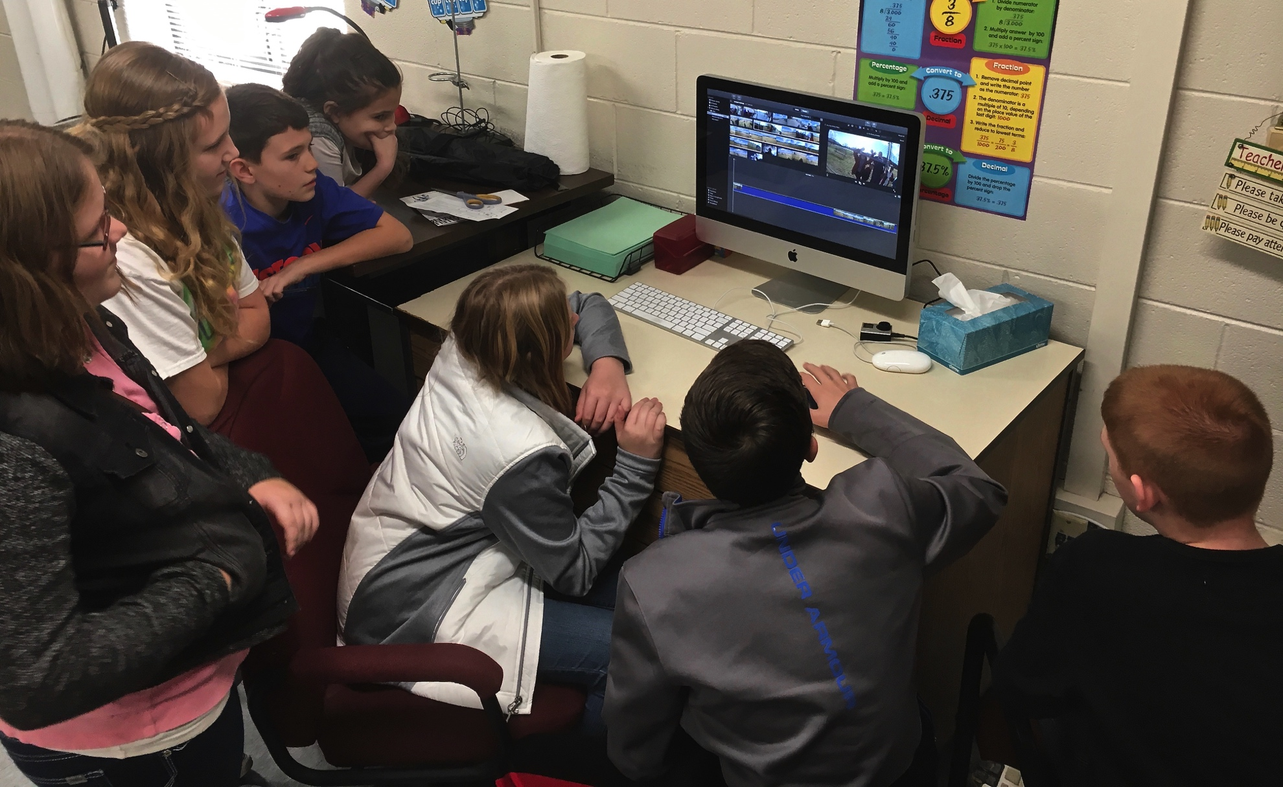
Students learned to create iMovies.

Slide 13
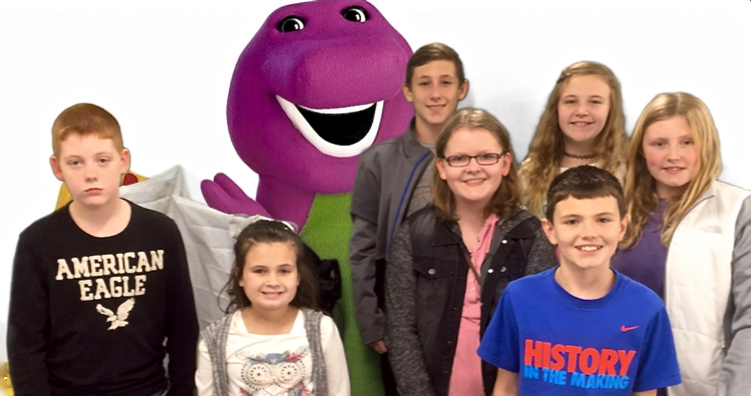
We had fun with green screen.

Slide 14
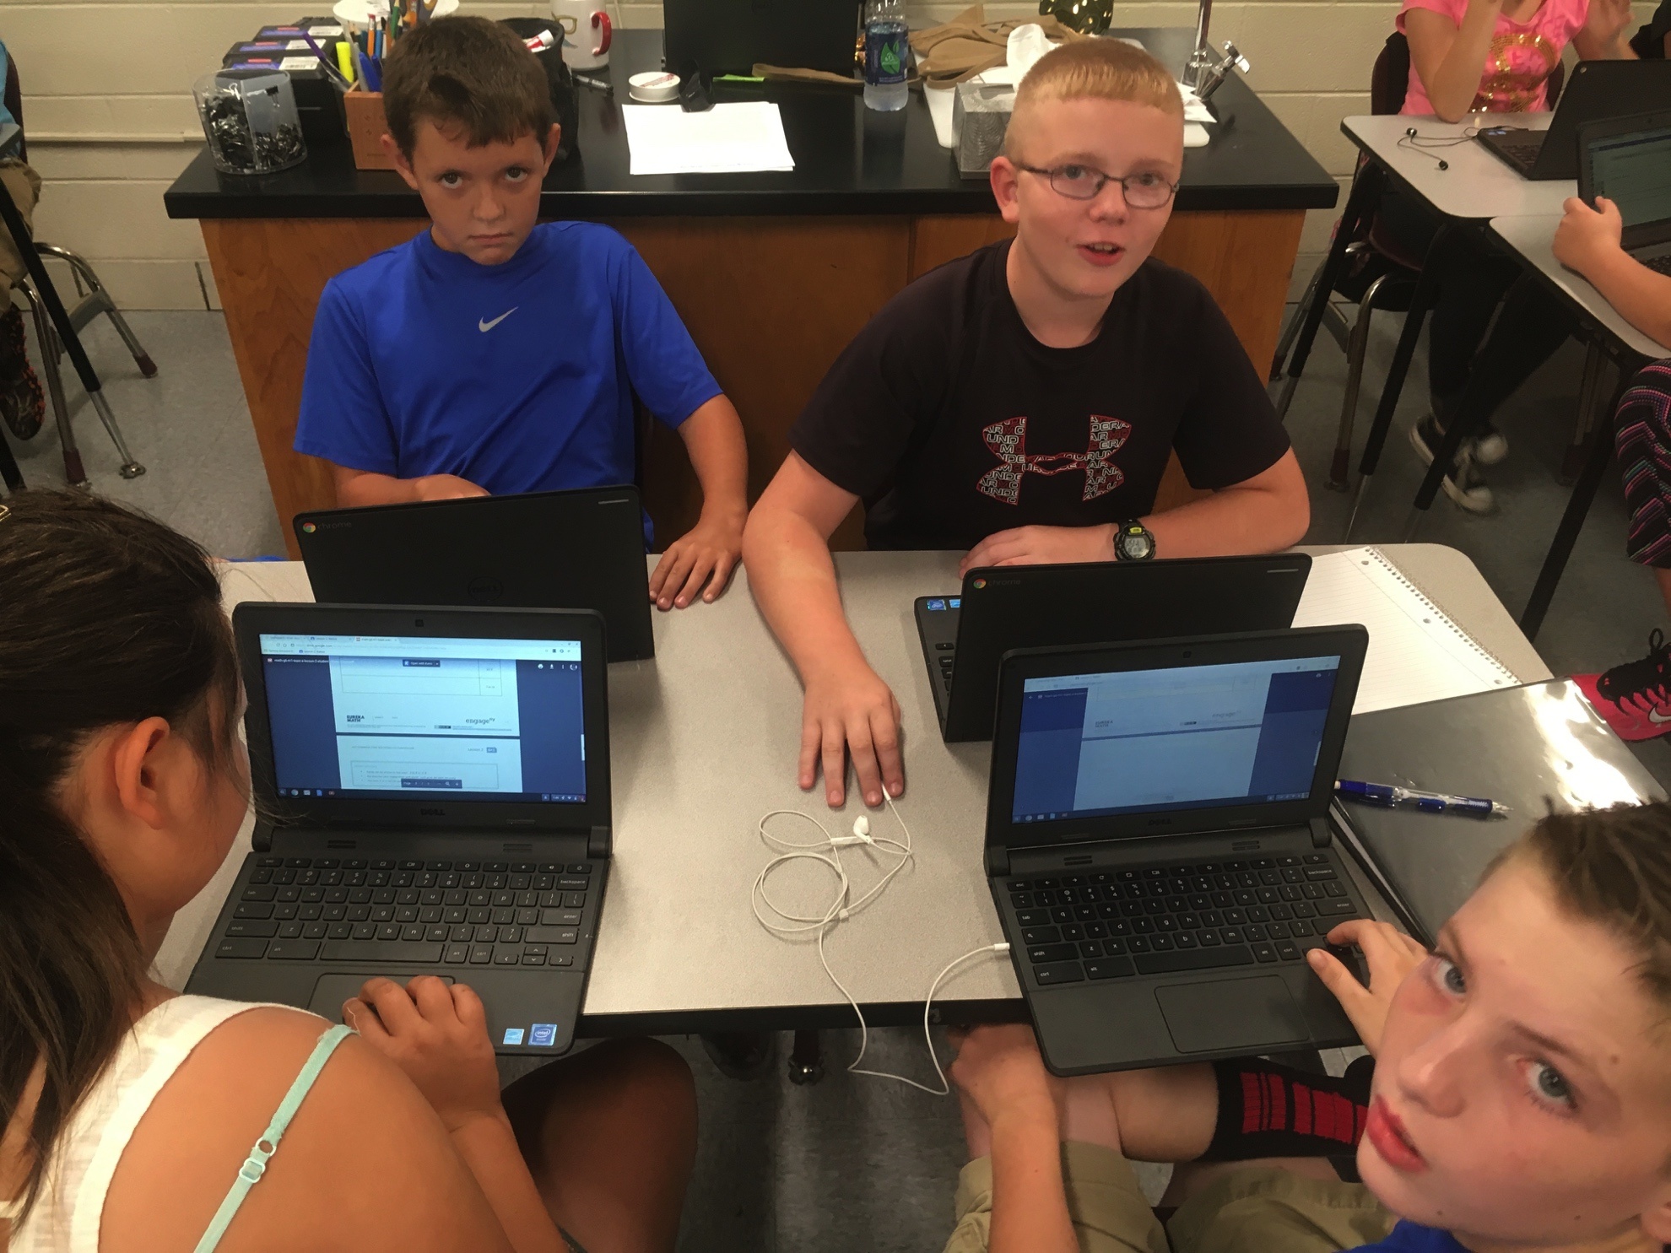
All math work is in Google Classroom

Slide 15
Sample of results
Lesson 1 | Lesson 2 | Lesson 3 | Lesson 4 | Lesson 5
83.3% | 69.2% | 71.8% | 75.9% | 82.4%
Exit tickets had at least 10 items that students had to respond to. They were permitted to make their responses outside of class. The data presented shows the results of the 50+ students who responded.
While students as a class did not routinely score >80% on exit tickets, I do feel that the project was beneficial. The students who did create the videos did learn the content they were presenting at high levels. On only one occasion did a presenter score less than 80% on the exit ticket for her video.

