Slide 1
#MathTechs
ARI Innovation Grant
Kalaiah Gilley
Millard School
7th & 8th grade Mathematics

Slide 2
#MATHTECHS
Students often lack an interest in mathematical concepts and recently our administration asked us to use more project based learning techniques to teach concepts.
Thus my project was implemented in order to enhance student understanding, comprehension, and interest in all mathematical concepts through increasing the use of technology.

Slide 3
#MATHTECHS
Strategy: Implement Chrome books into my 7th and 8th grade math classes to increase project based learning as well as enhance student understanding, comprehension, and interest in mathematical concepts.
The chrome books were used in students slope projects, access Google classroom, Kahoot, Moby Max, Quizlet live, as well as MAP testing.

Slide 4
Slope Projects
8th grade students (group projects)
Took pictures of objects around school using the chrome books.
Used the chrome books to transfer the picture to graphs.
Students found the slope, y-intercept, and wrote the equation for each object they took a picture of.
Students used the chrome books to write the steps to finding the equation of their graphs.
Students organized the information onto poster boards.

Slide 5
Slope Projects

Slide 6
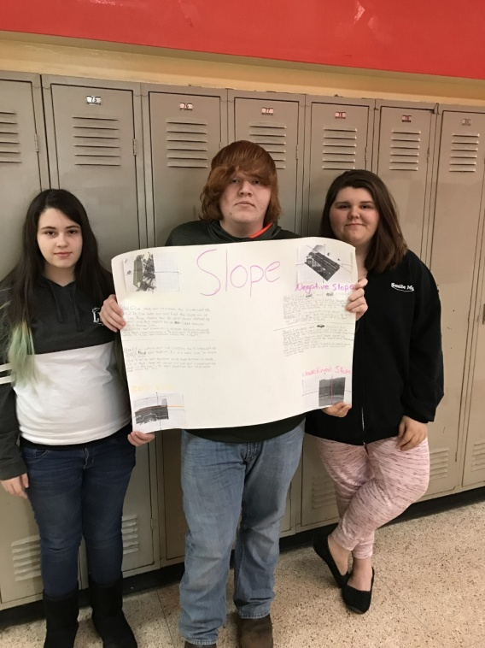
Slope Project

Slide 7
Slope Project Video
http://www.youtube.com/watch?v=Vi7RjMGNknI

Slide 8
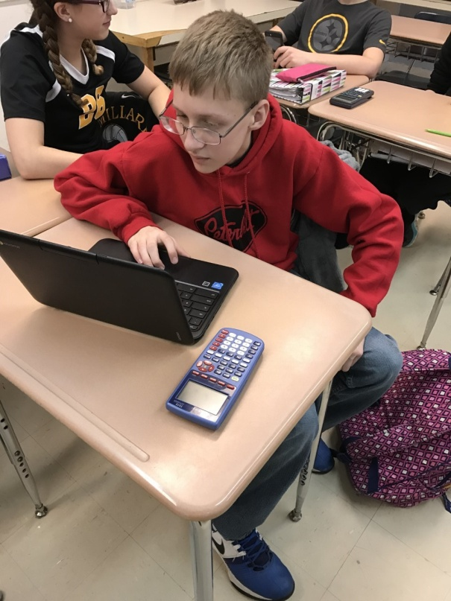
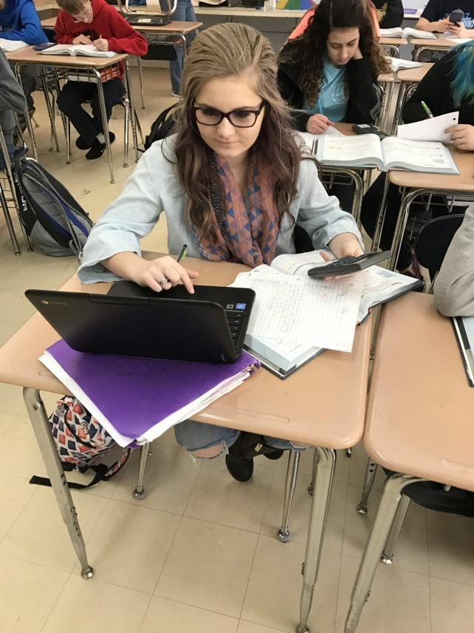
Flipped Classroom
8th grade Honors Algebra Students (independent learning)
Algebra students used the chrome books to access their Google classroom.
In Google classroom students watched flipped class instructional videos, completed quizzes, and completed entrance slips.

Slide 9
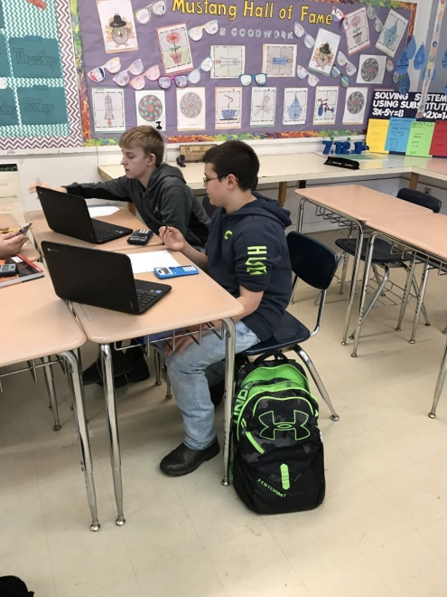
7th and 8th grade students (whole group competition and independent practice)
Students used the chrome books to review mathematical concepts on Kahoot.
Students also, used the chrome books to review mathematical concepts on MobyMax as an enrichment activity if they finished assignments early.

Slide 10
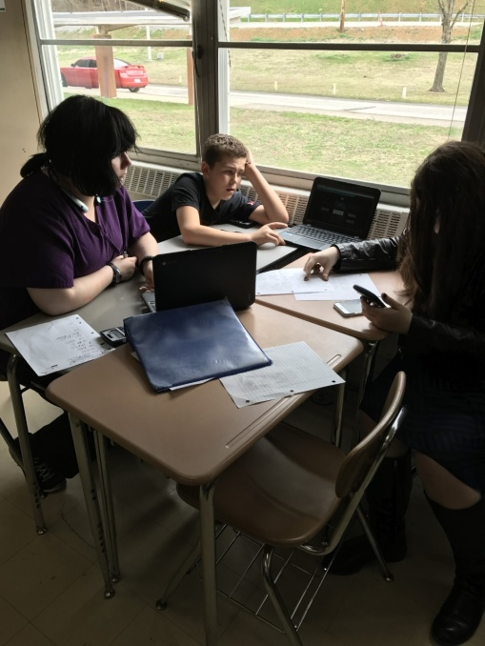
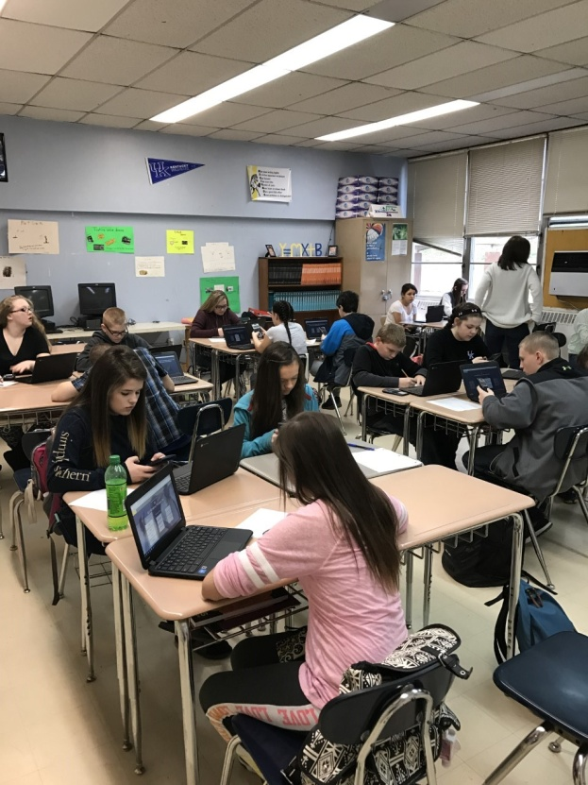
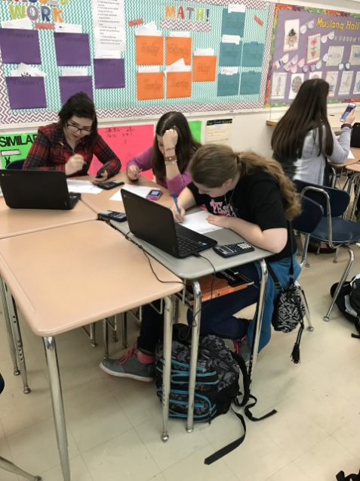
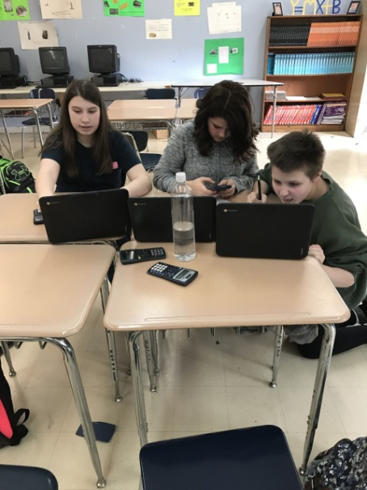
Quizlet Live
7th and 8th grade students. (small group competition)
Students used the chrome books to complete Quizlet live activities to practice mathematical concepts.
Quizlet was also used to help review concepts before quizzes and test.

Slide 11
Quizlet Video
http://www.youtube.com/watch?v=JSlSImoEYl8

Slide 12
Student Growth

Slide 13
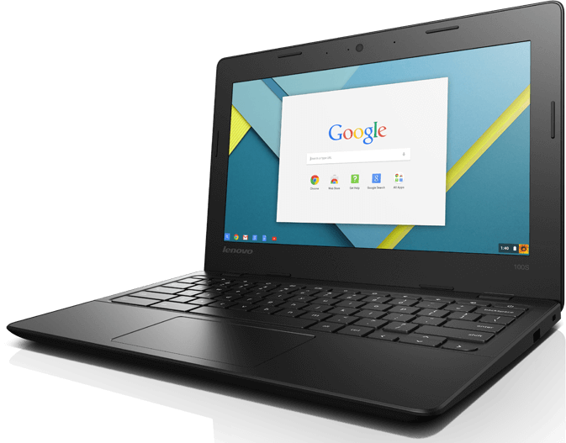
#MATHTECHS
Successful Outcomes:
Students are excited to use the chrome books to learn, practice, and review mathematical concepts.
Students have gained a better understanding of the concepts.
Students assessment scores have improved.
I have increased the use of technology in my instruction.
My classroom instruction is more student lead.
I have increased project base learning in my classes.

