Slide 1
Roam Around the World: Without Wings, Without Wheels
Becoming Globally Competent Without
Leaving the Classroom

Slide 2
Area of Focus
Individualized instruction that utilizes 21st century skills to help students become a proficient learner in global competency and world language.
Skills Targeted:
Creativity & Innovation
Critical Thinking & Problem Solving
Communication
Collaboration

Slide 3
Research Question
How can I plan a more personalized and individualized approach to learning activities that will allow my students to use 21st century skills to understand and address global issues?
Using 21st century skills to understand & address global issues
Understanding other nations and cultures, including the use of non-English languages

Slide 4
Project Highlights
Students complete a long-term project at their own pace (PBL)
Integration of content standards already in place
Presents the learner with real-world opportunity application
Provides student choice
Technology focused

Slide 5
Action Plan
Pre-Survey
Student Project Planning
Implementation of Project
Project Presentations
Post Survey
Student Reflection

Slide 6
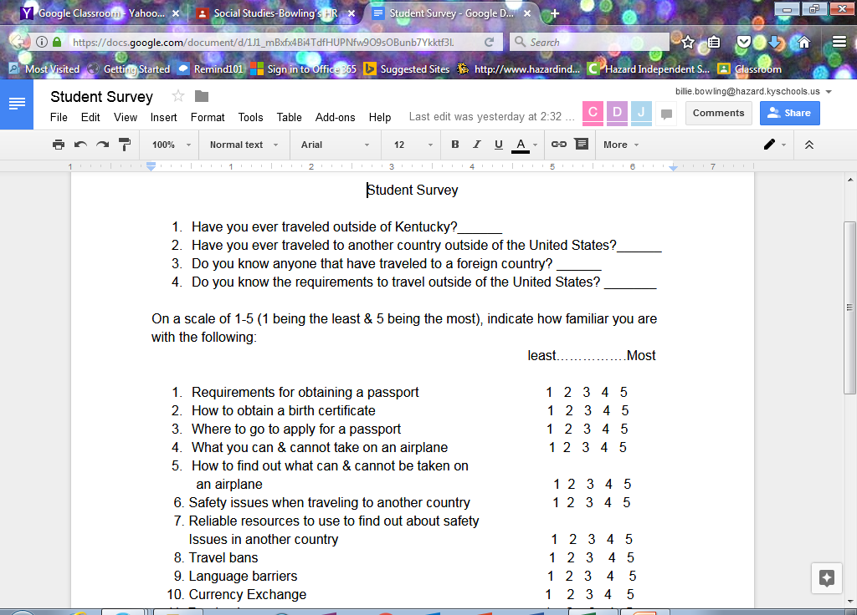
Findings
Pre-Survey Results
62 students surveyed
Only 6% of the students have traveled outside of the U.S.
All of the students have little to no familiarity with concepts involved with foreign travel

Slide 7
Instructional Impacts of the Project
Increased use of technology
Student centered/facilitated instruction
More individualized approach to learning
Google Classroom
Collaboration
Increased use of formative assessment to guide planning of instructional activities
Increased student engagement

Slide 8
Benefits of Google Classroom Assignments
Increased use of technology
Paperless
Students can research & create documents simultaneously
Allows for immediate feedback
Increased student engagement

Slide 10
Student Reflection
“Projects are easier using chrome books because I don’t have to write & I can type my research as I look it up”
“The project is fun & makes class more exciting”

Slide 11
Student Reflection
“Before this project I didn’t know what a passport was or how to get one.”
“The project has helped me learn about different cultures than my own.”

Slide 12
Student Reflection
“Google Classroom makes class work more fun and easier.”
“This project helps me learn about what it is like in different parts of the world and different lifestyles.”
“I like PBL better than traditional paper & textbook assignments.”

Slide 13
Student Reflection

Slide 14
