Slide 1
“The Miracle of life”
Valerie Pugh
First Grade Teacher at Jackson Independent
Valerie.pugh@jacksonind.kyschools.us

Slide 2
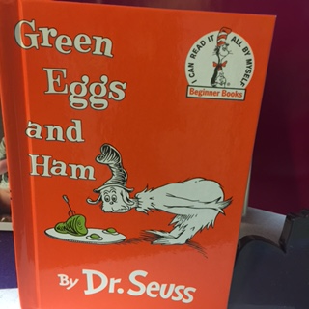
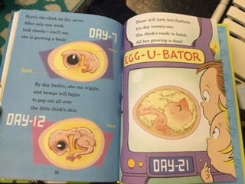
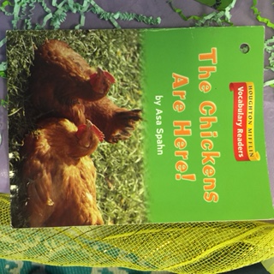
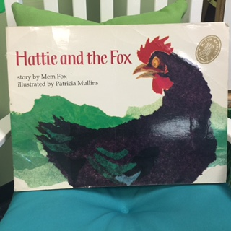
Books read throughout the project
Notes:
Dr. Seuss “Green Eggs and Ham” From Egg to Chicken, The Chickens are Here, Dr. Seuss, Who Hatches the Egg Hattie and the Fox, Not pictured, Junie B. Jones has a peep in her pocket, Tippy-Toe-Chick-Go

Slide 3
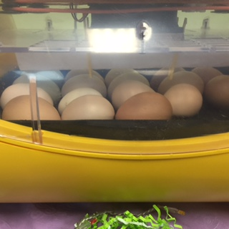
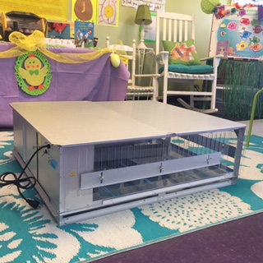
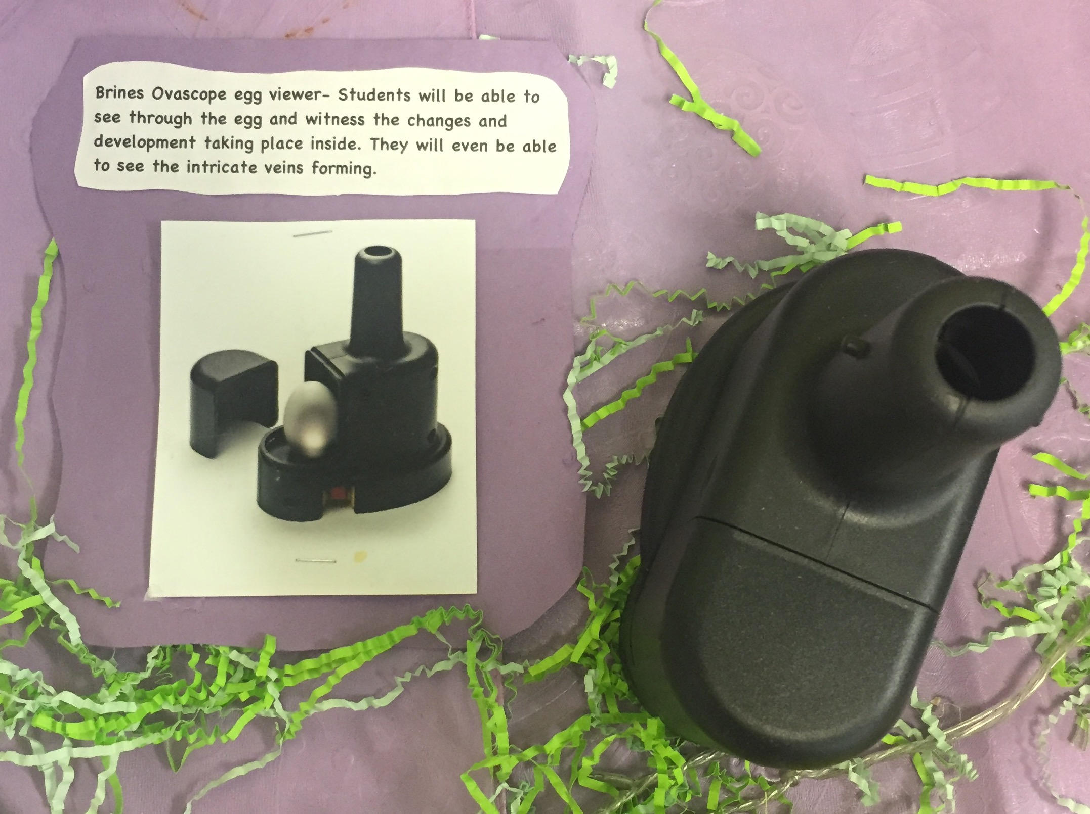
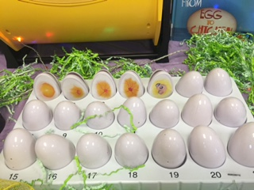
Items Needed
Notes:
Some items needed for this project was incubator used last year to compare with our new digital incubator purchased with my ARI grant money. Also, we used a brooder box to keep the chicken warm and fed after they hatched, a egg development explorer set, and an ovascope the kids used to look inside the egg at the actual development of the chicks. This was a big improvement from last year thanks to my ARI grant money. Last year we simply used a flashlight to candle the eggs.

Slide 4
Pre-assessment
Where does a chick come from?
How long does it take a chick to hatch?
Does a chick develop inside every egg?
What are the parts of an egg?
What are the parts of a chicken?
Notes:
AS a pre-assessment I asked the following questions to help guide my instruction and give me some insight on the students’ prior knowledge about lifecycles in particular the life cycle of a chicken.

Slide 5
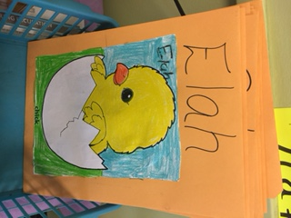
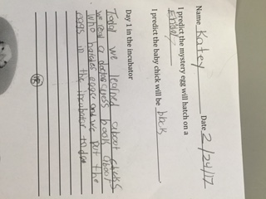
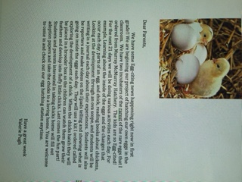
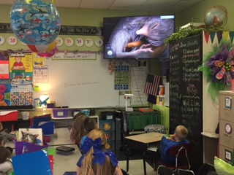
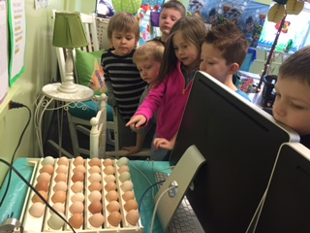
Beginning the Project-Day 1
Notes:
Some of the activities we did on the first day includes picking an egg, marking it with an X, and allowing students to make a prediction about what day it will hatch, and what color the chick will be since I ordered a variety of eggs. Students also made a chicken folder for them to keep/story everything we did with this project that they should keep. This way we would be able to go back and read predictions and read some writings completed throughout the project.I also sent home a parent letter to explain our project and to just give them a heads up that we will be hatching chicks to which students would have an opportunity to adopt and bring home at the end. We also watched youtube video about the development and daily changes that take place inside the egg, as well as carefully placed our eggs on the egg turner to leave and settle for 24 hours after being shipped.

Slide 6
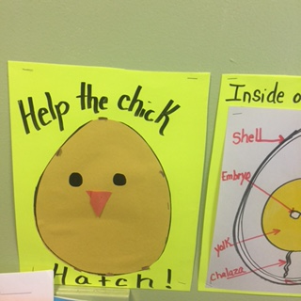
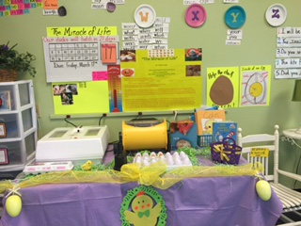
Our egg station
Notes:
Our egg station was located in the back of the classroom. This is where everything was located that pertained to our project. We made a calendar and count down where each day we cut our pictures of that day’s development on the number, and pull a card off counting down to the 21st day. We also had a thermometer to show the ideal temperature for the incubator to be in order for the hatching to be a success. Each day a different child would check the temperature inside the white incubator and chart it. The new incubator purchased with my ARI grant is digital and kept it’s temperature where it should be along with humidity. It’s hatch rate was far better than that of the old incubator that had to be manually adjusted each day.

Slide 7
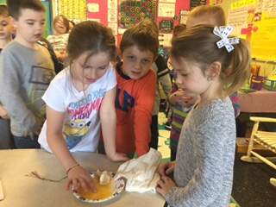
Exploring parts of an egg and helping the chick hatch.
Notes:
Each day a child would tear off a small piece of the paper egg until the day the real eggs began to hatch then our paper chick was completely uncovered.
We also discussed after looking in the ova scope that not all eggs were developing into chicks. This happens sometimes especially with shipped eggs or not all eggs have been fertilized. The students were curious about the eggs without chicks developing inside, so we cracked one open to discuss the different parts of the egg.

Slide 9
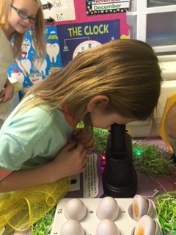
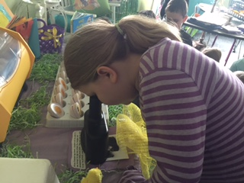
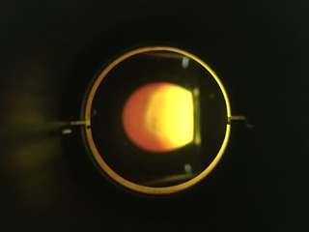
Looking in the ova scope beginning on day 7.
Notes:
Beginning on day 7 the students were able to look inside the ova scope to see the chick starting to develop as well as the veins forming. On day 12 students could actually see the heartbeat and lots of movement.

Slide 10
Video looking inside the ova scope on day 12.
Notes:
Using the ova scope you can actually see movement inside the egg. You can see the eyes which are dark black and round, the heartbeat, and movement of feet and beak as the chick moves around.

Slide 11
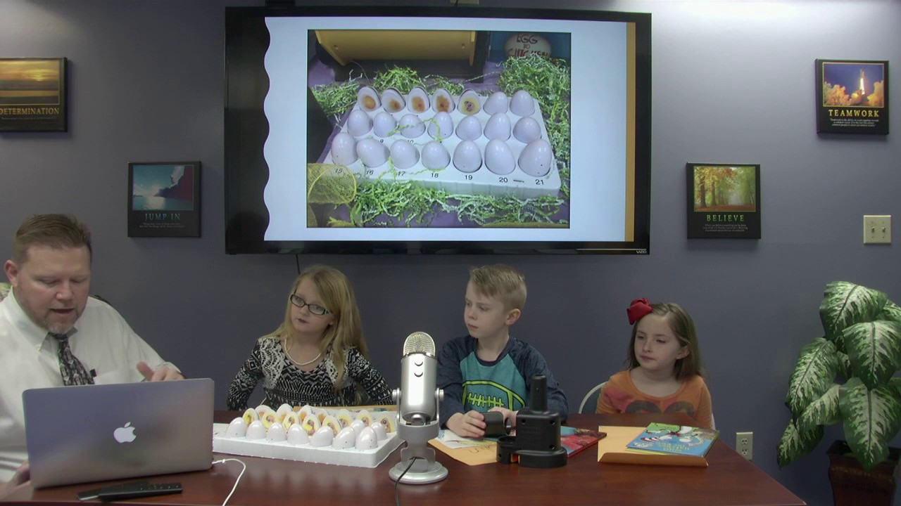
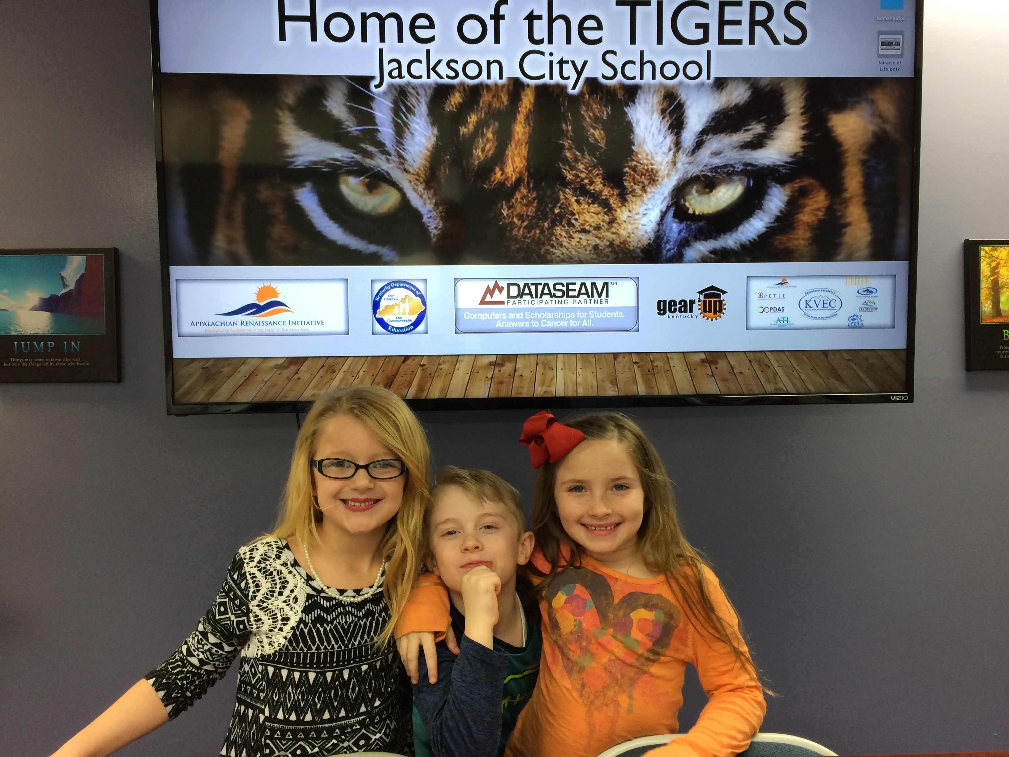
Interview with Students about “The Miracle of Life”
https://youtu.be/Avk9x-aLdVY
Notes:
This is a video of three first grade students being interviewed by Mr. Coots and discussing our project and things that have happened thus far. This was filmed on day 12 of development.

Slide 12
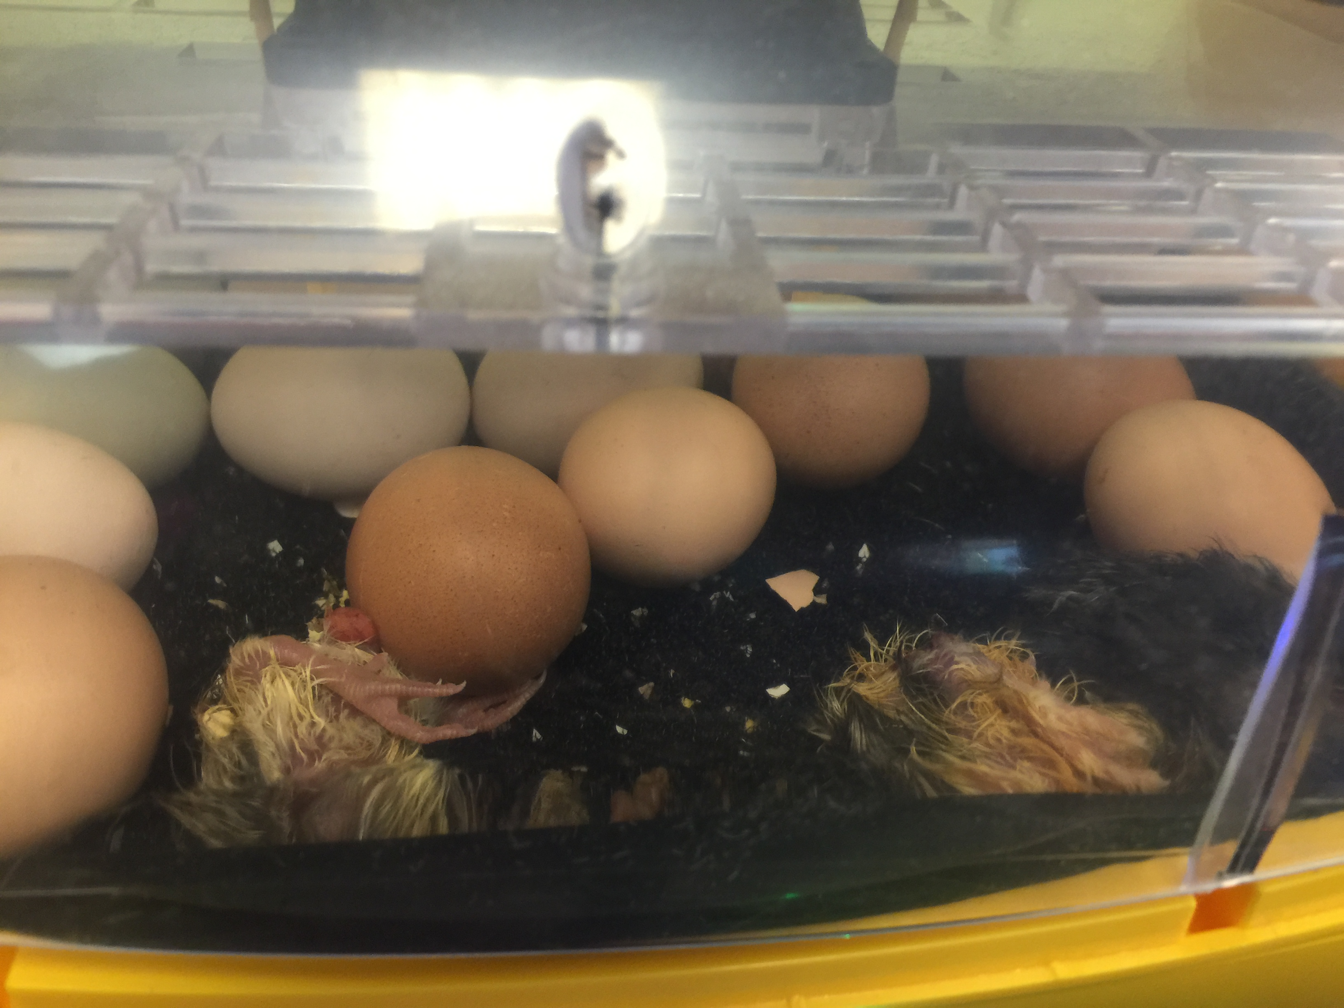
Let the Hatching Begin!!
Notes:
This is a video capturing the eggs beginning to hatch and movement of chicks inside.

Slide 13
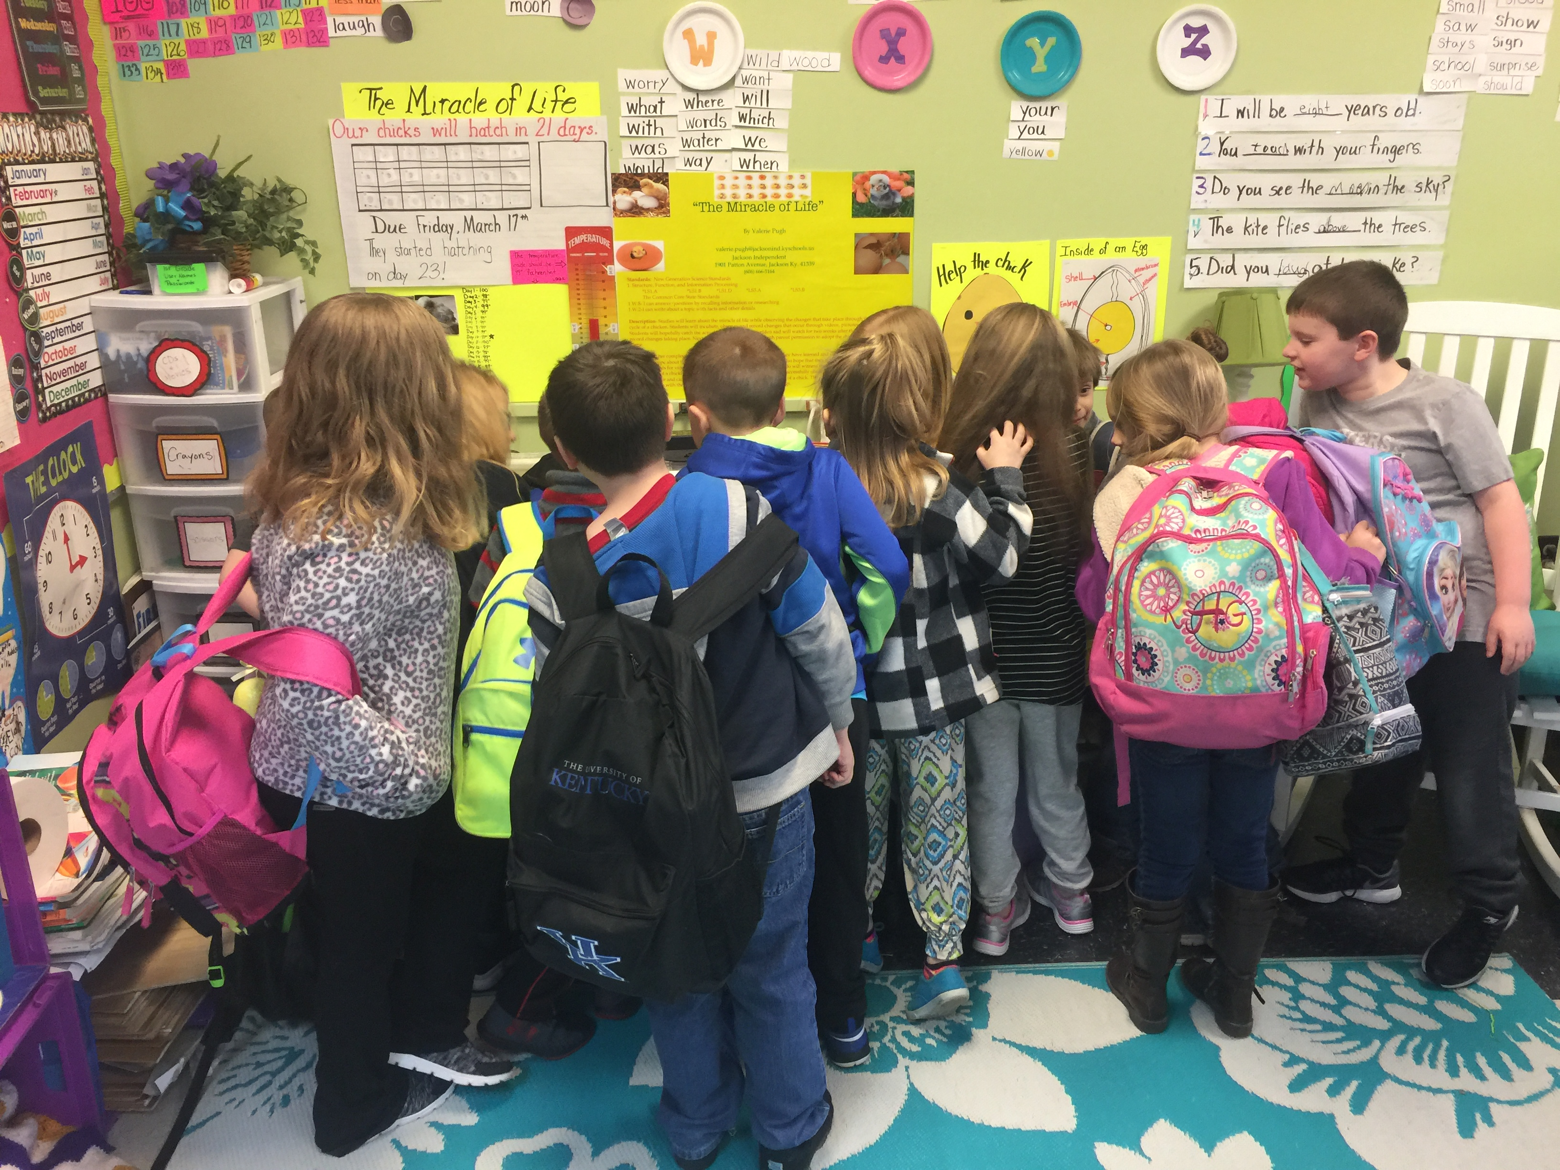
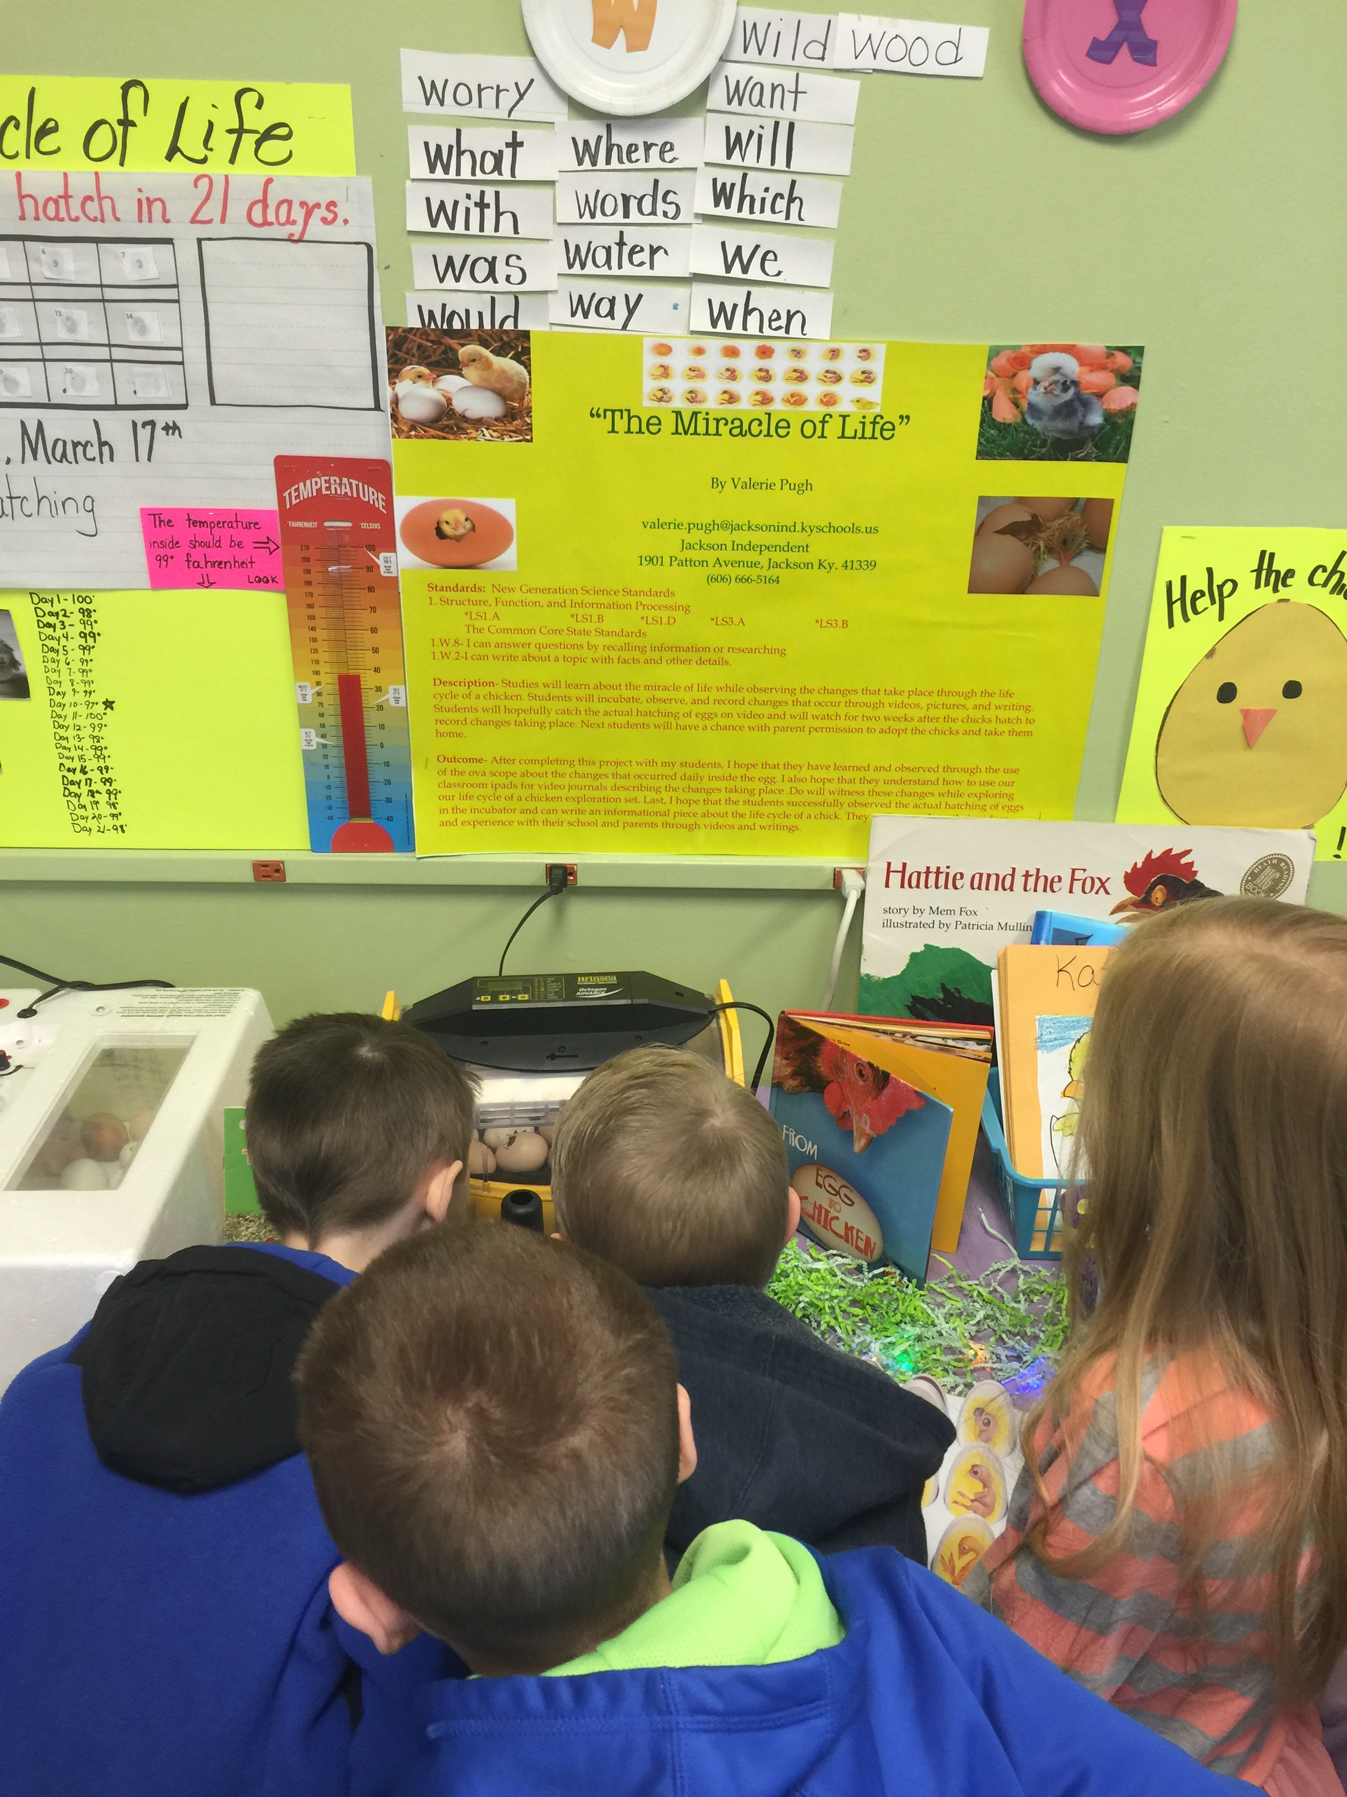
An EGG-citing day in first grade!!
Notes:
Students came in the classroom on Monday, March 20th to some very exciting news and the sights and sounds of newborn baby chicks.

Slide 14
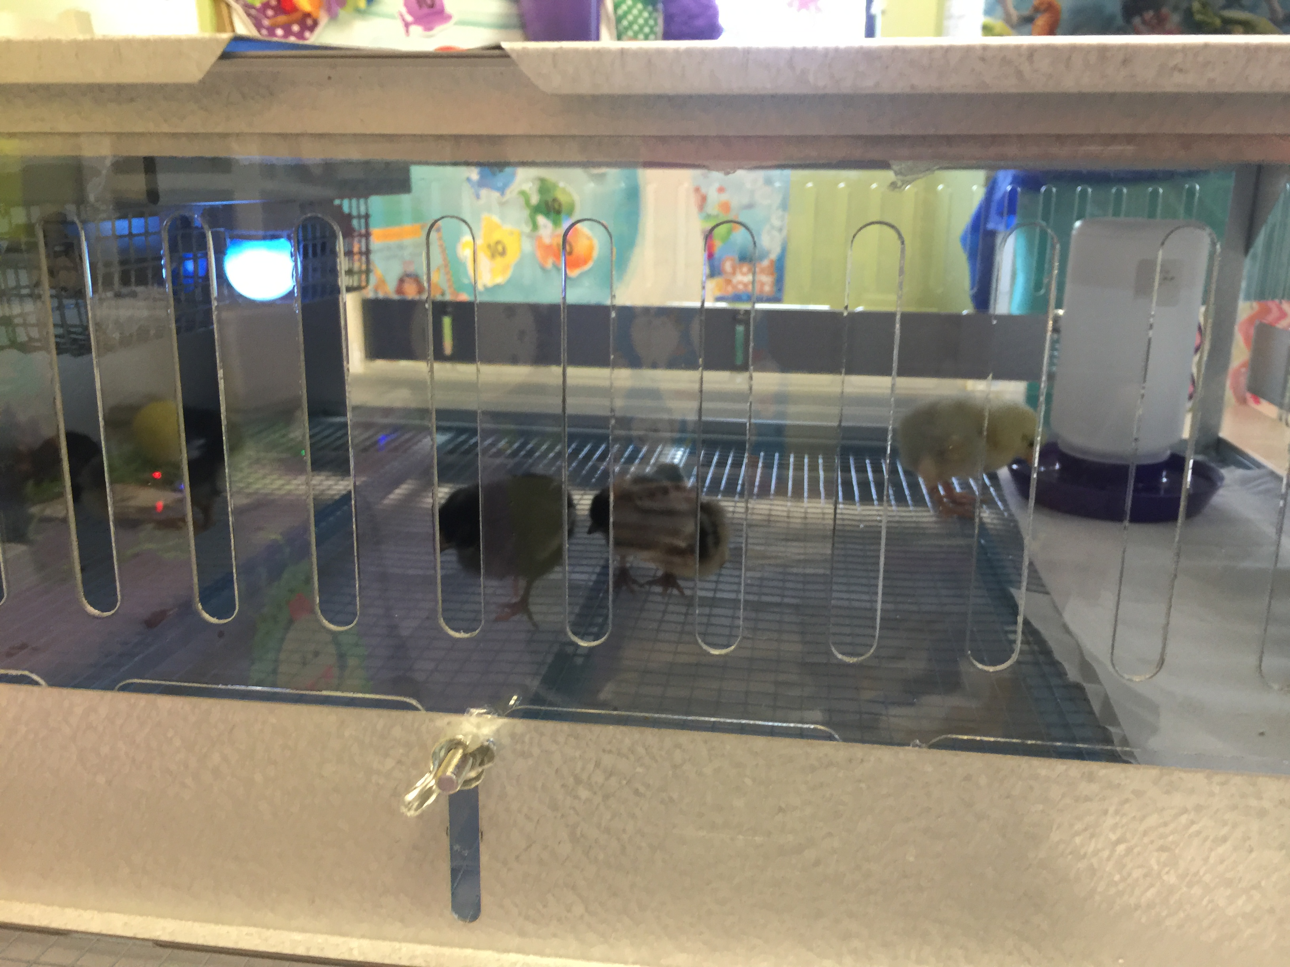
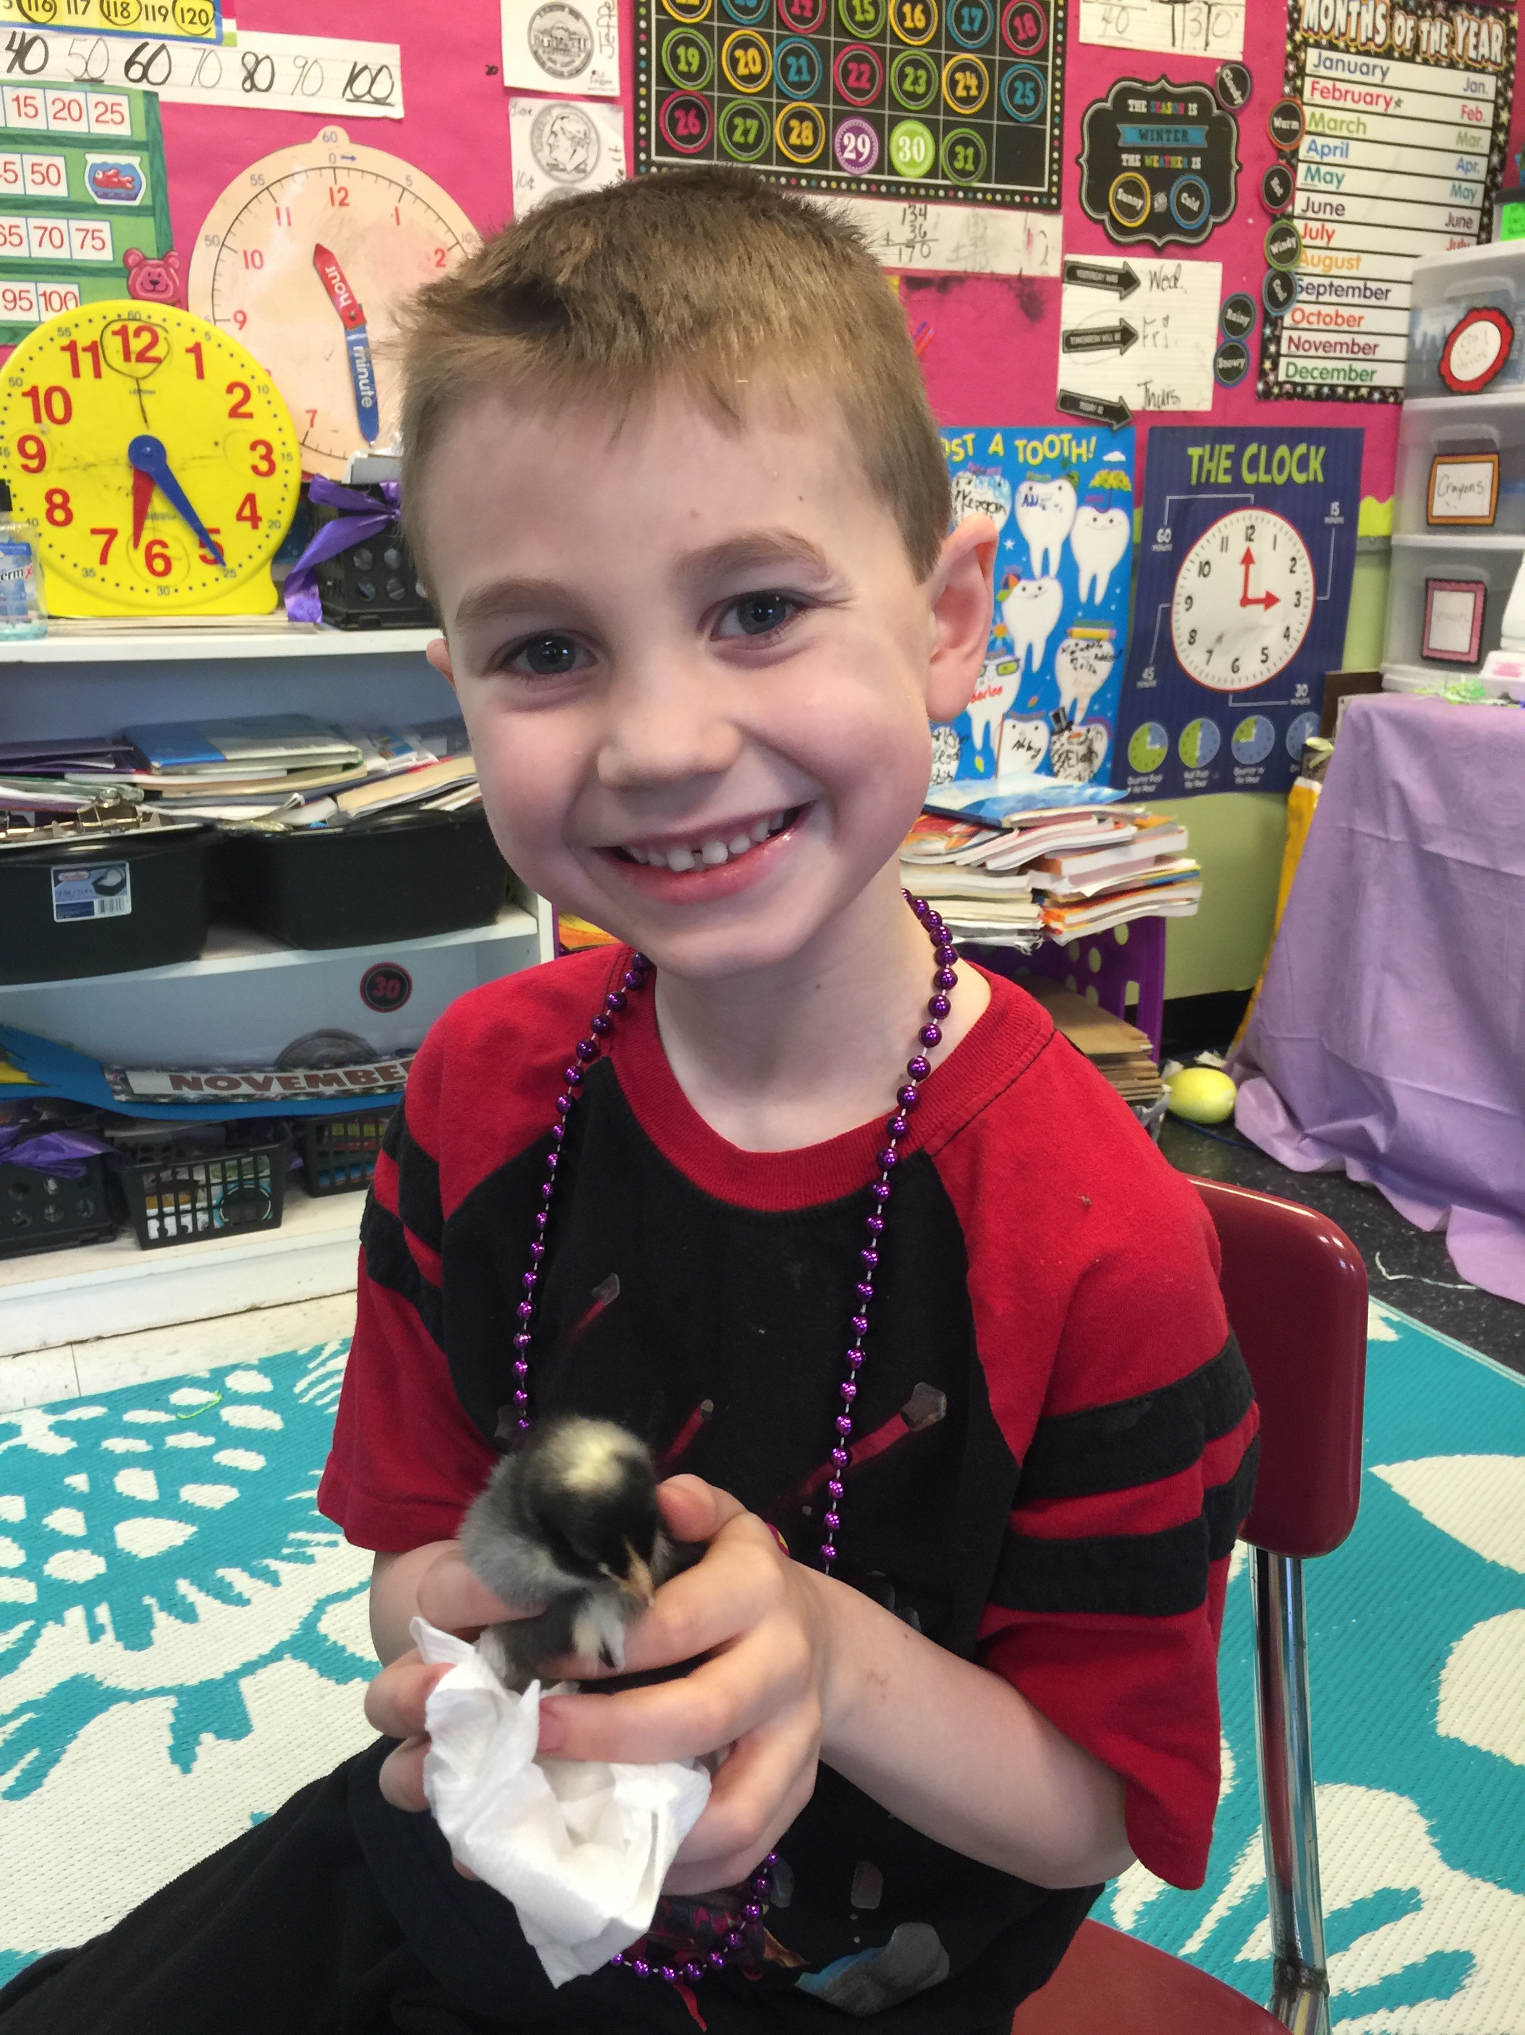
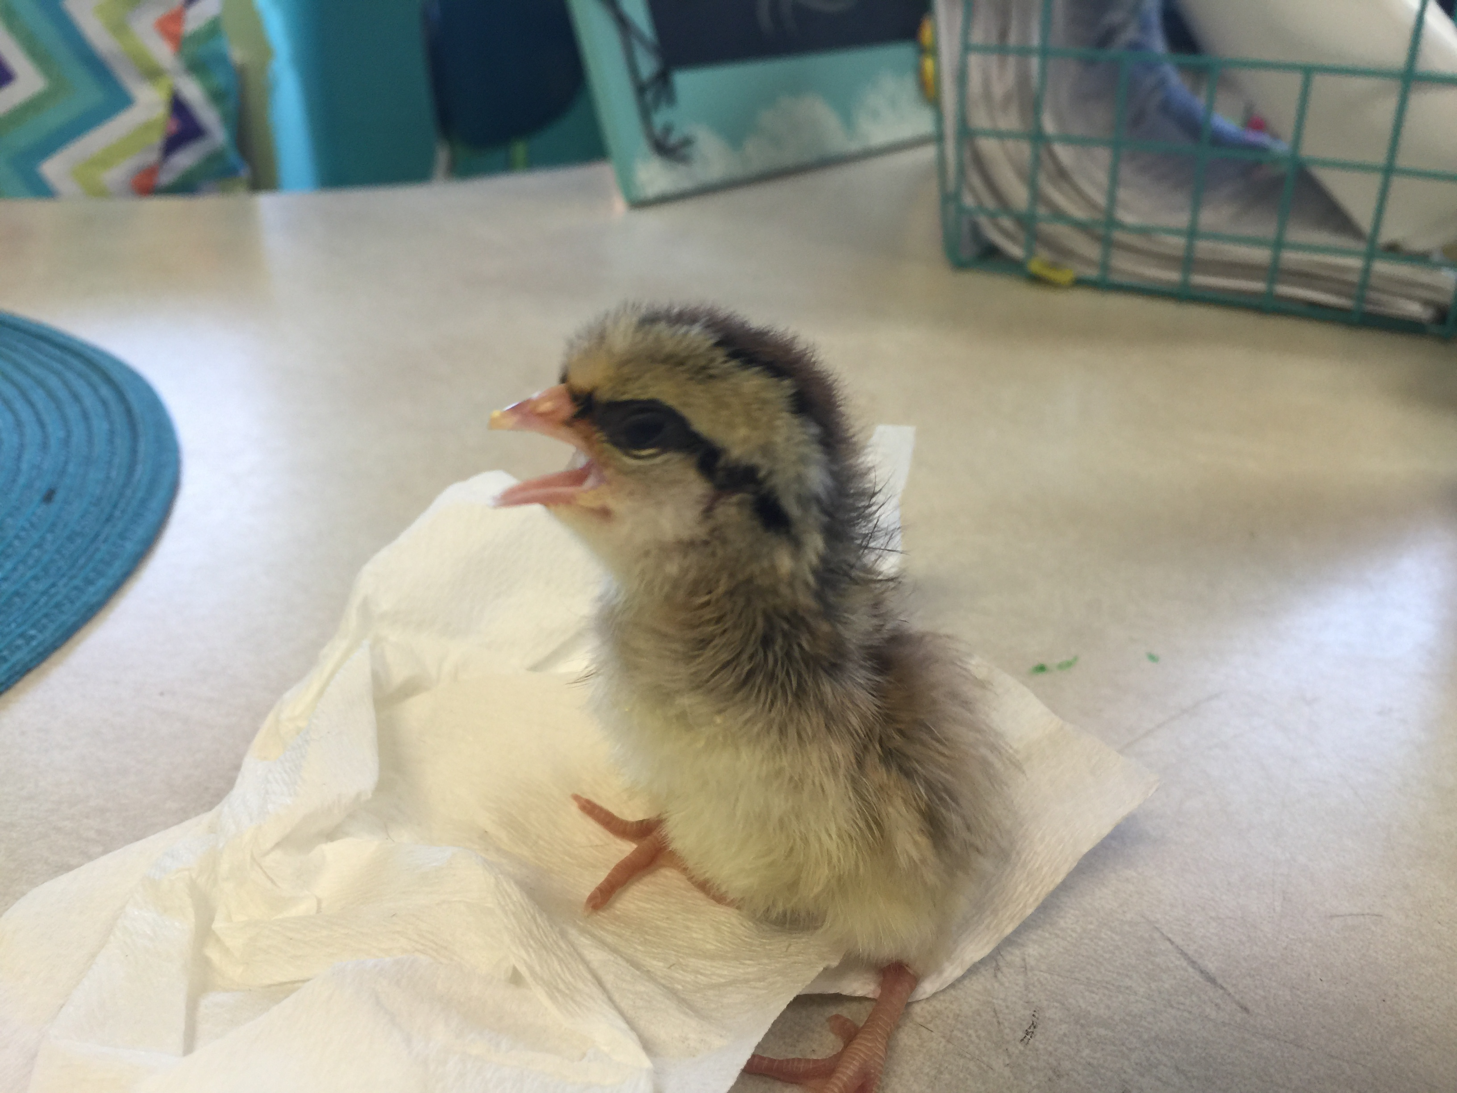
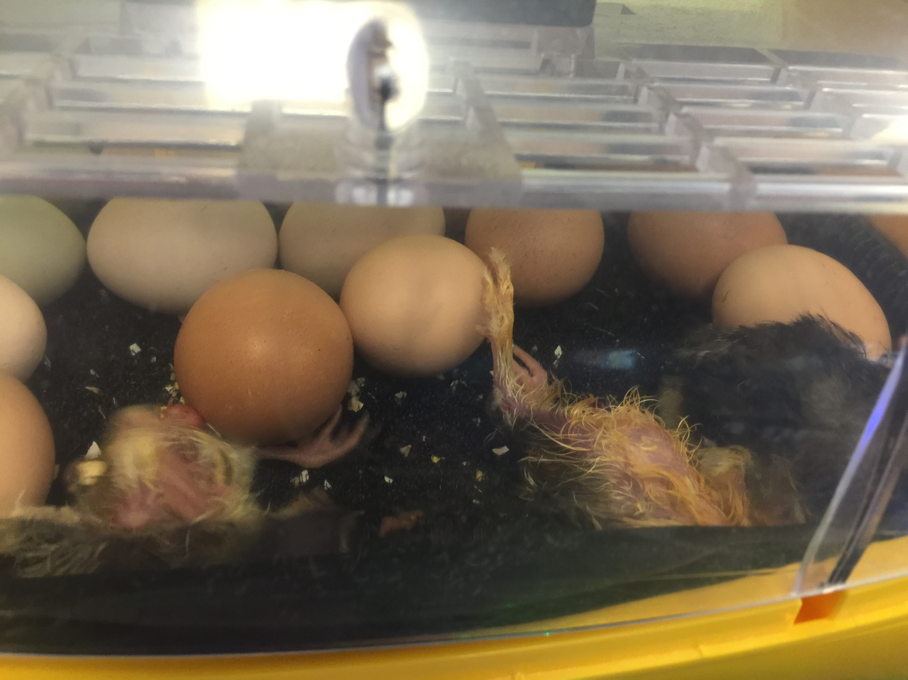
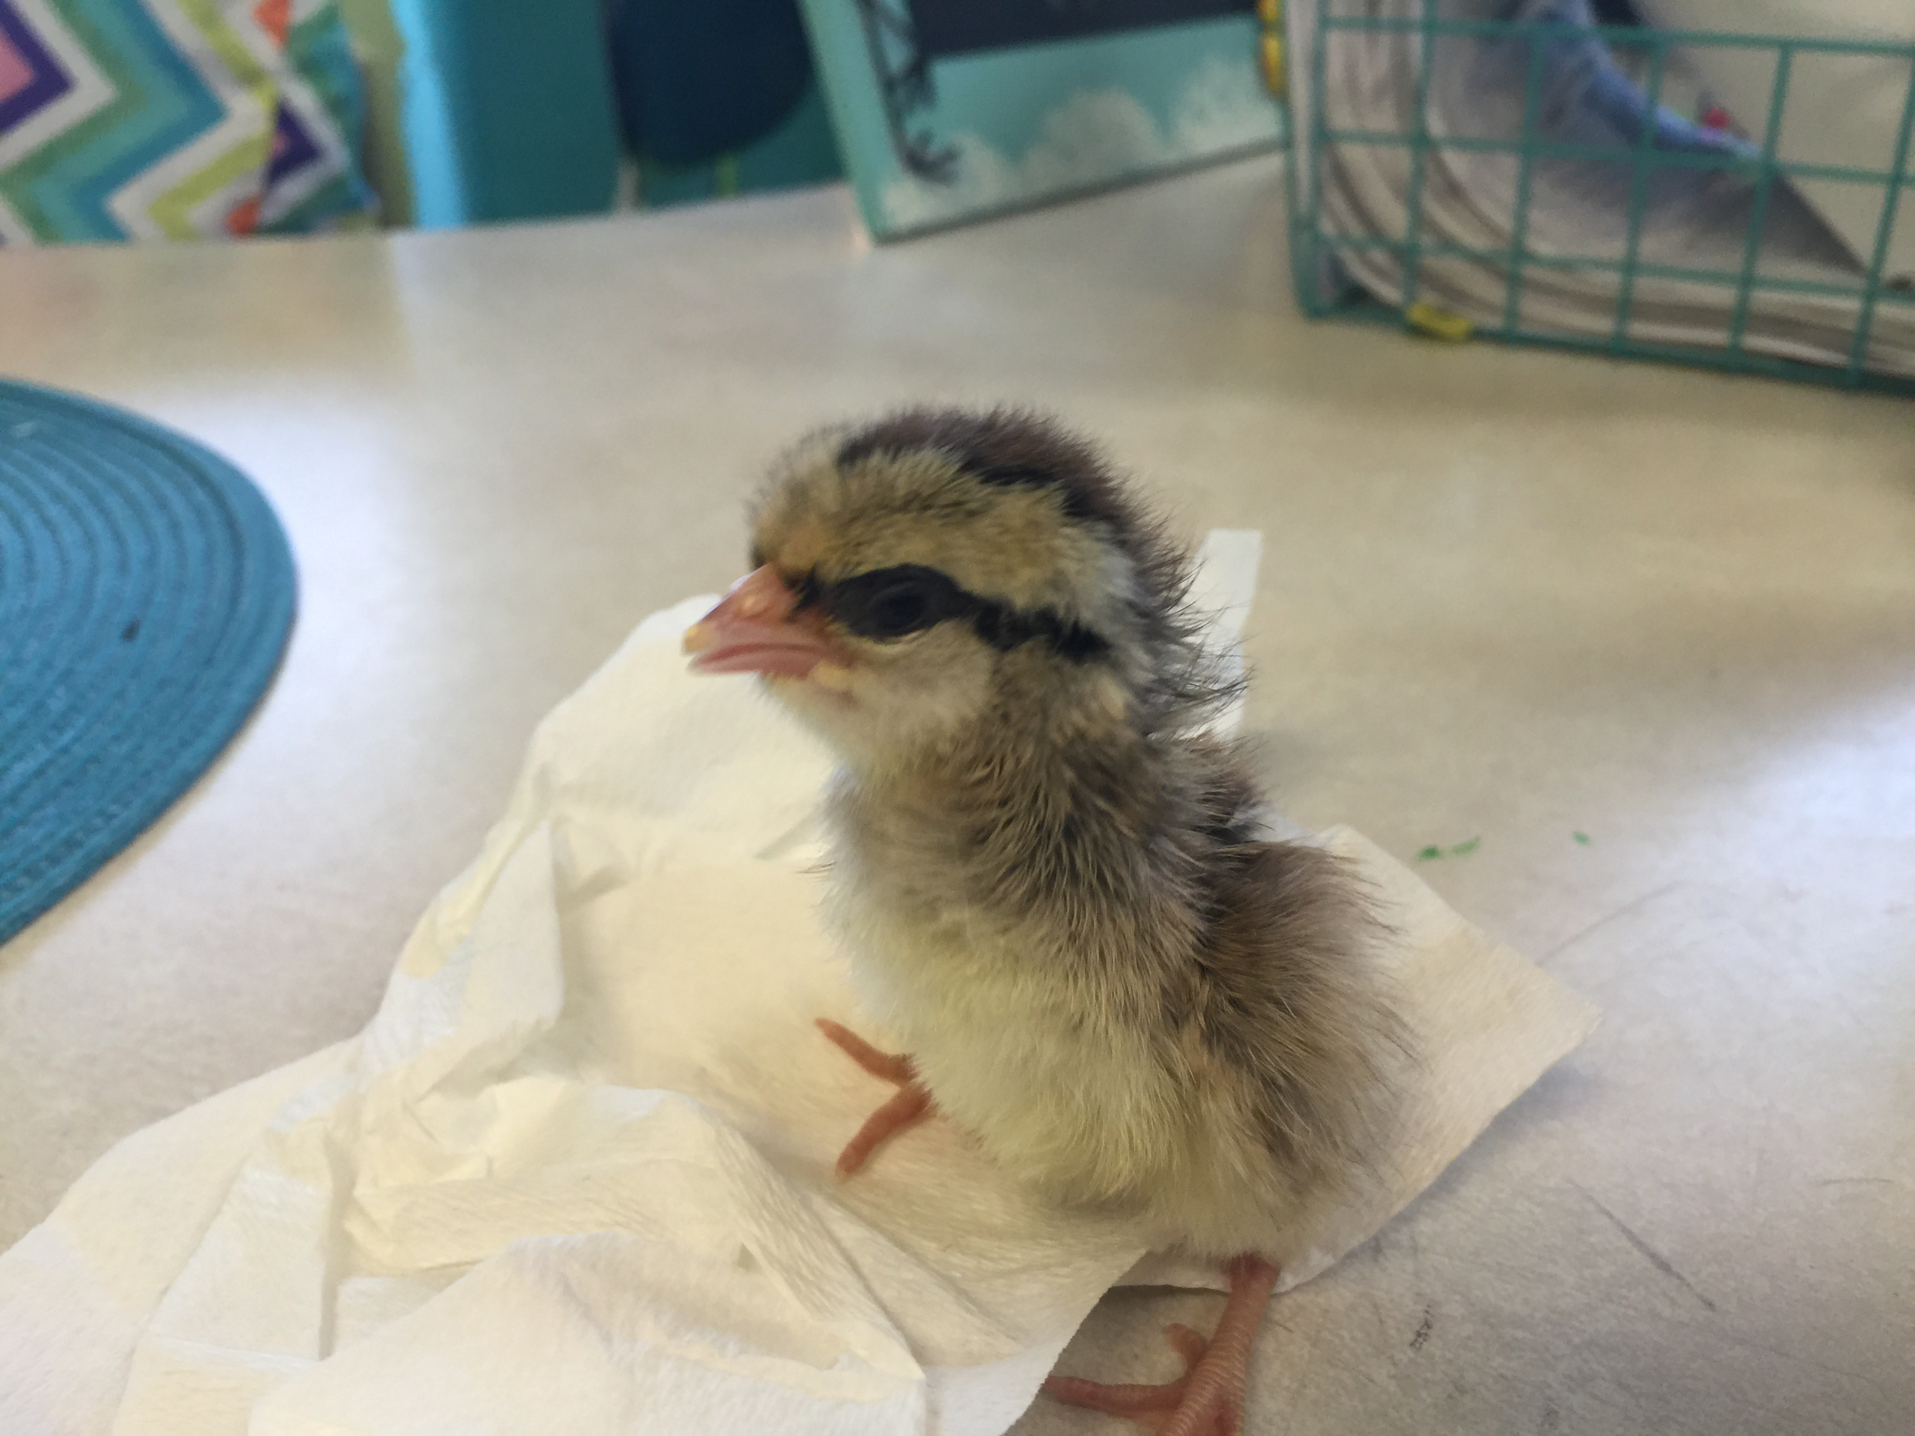
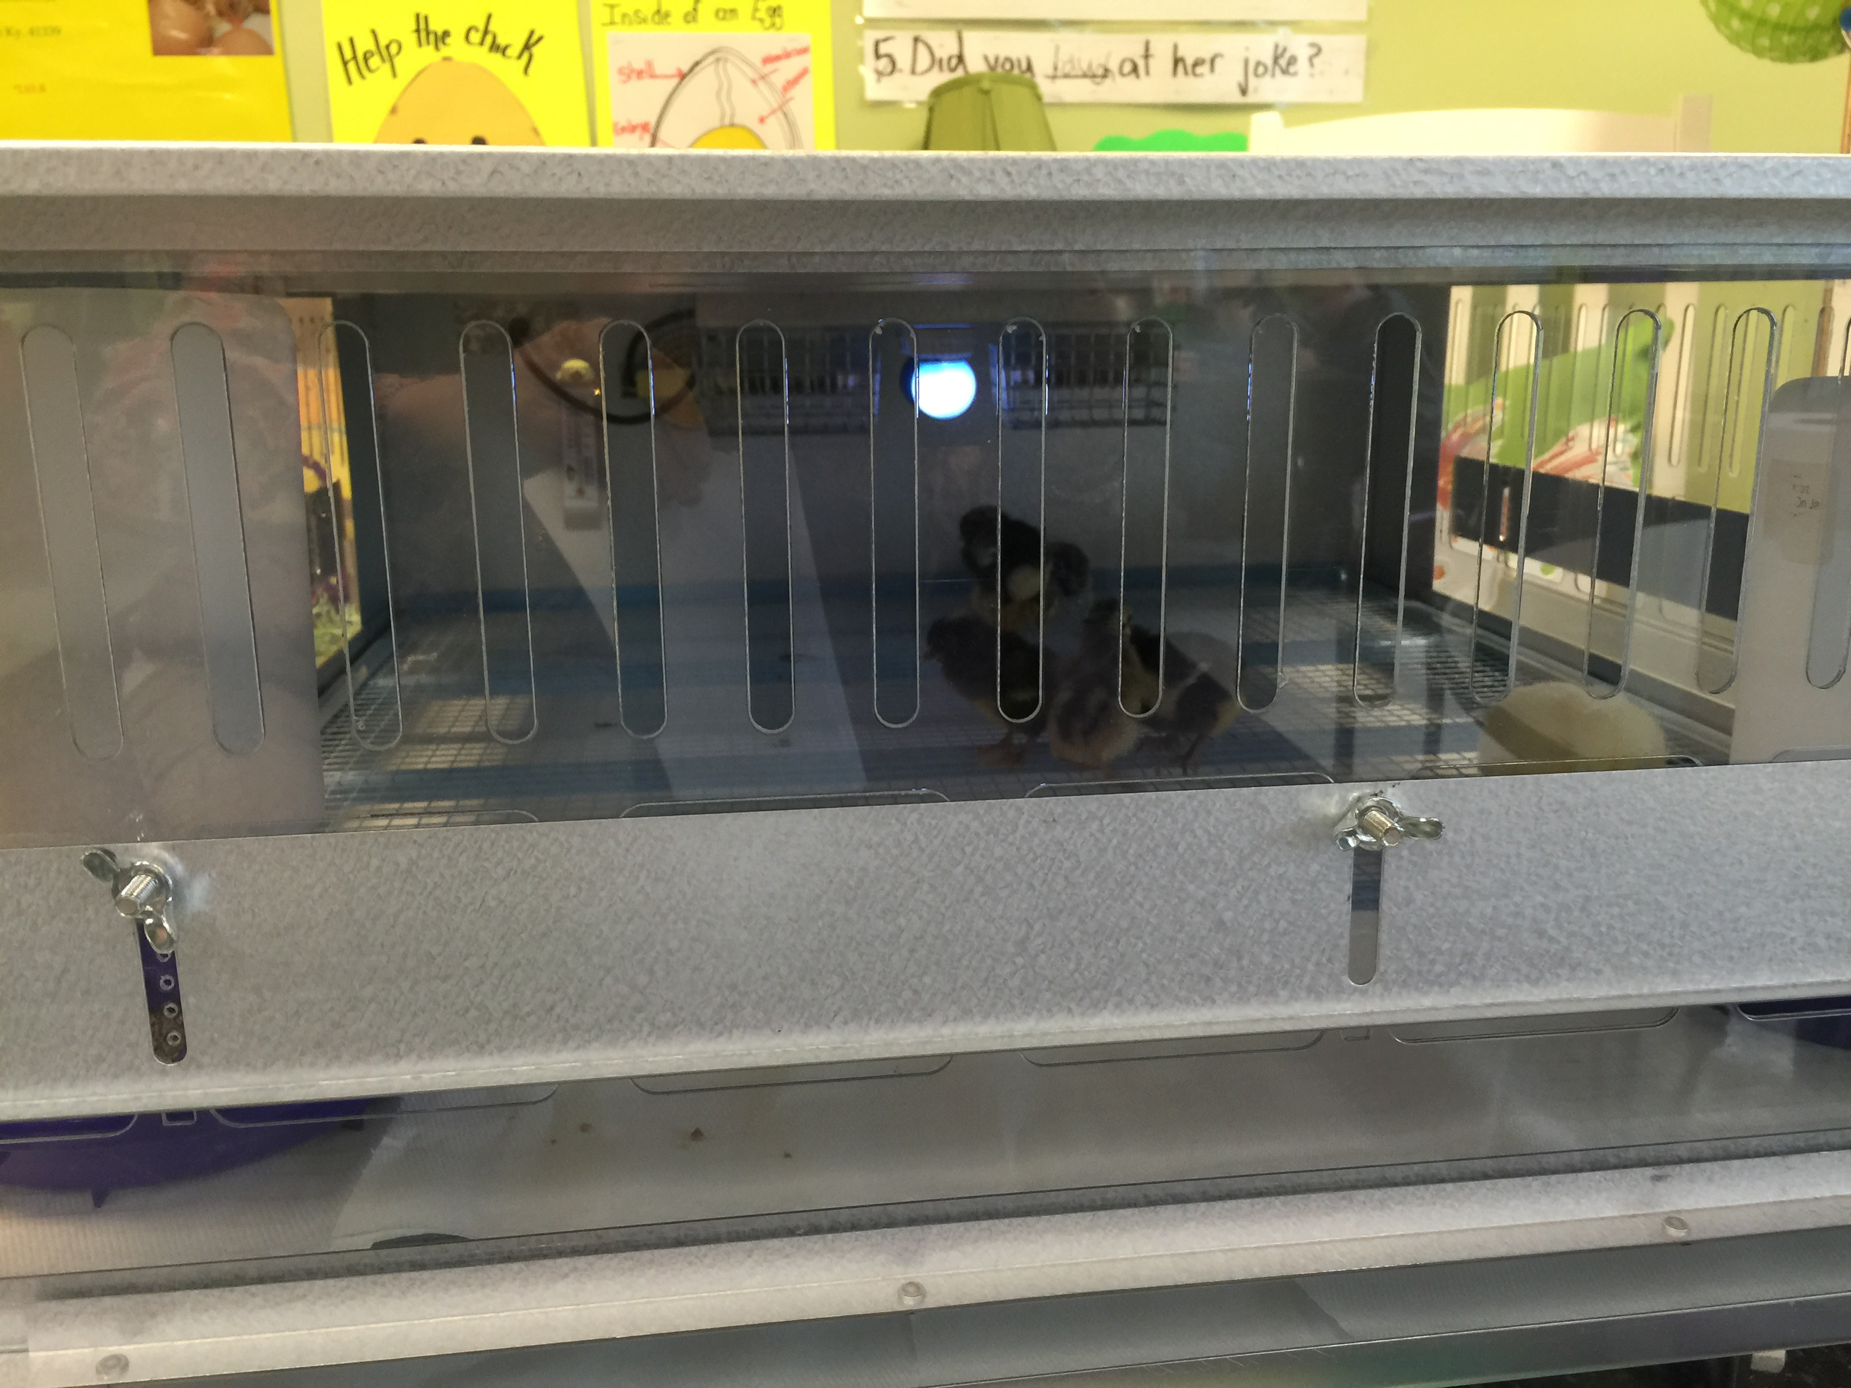
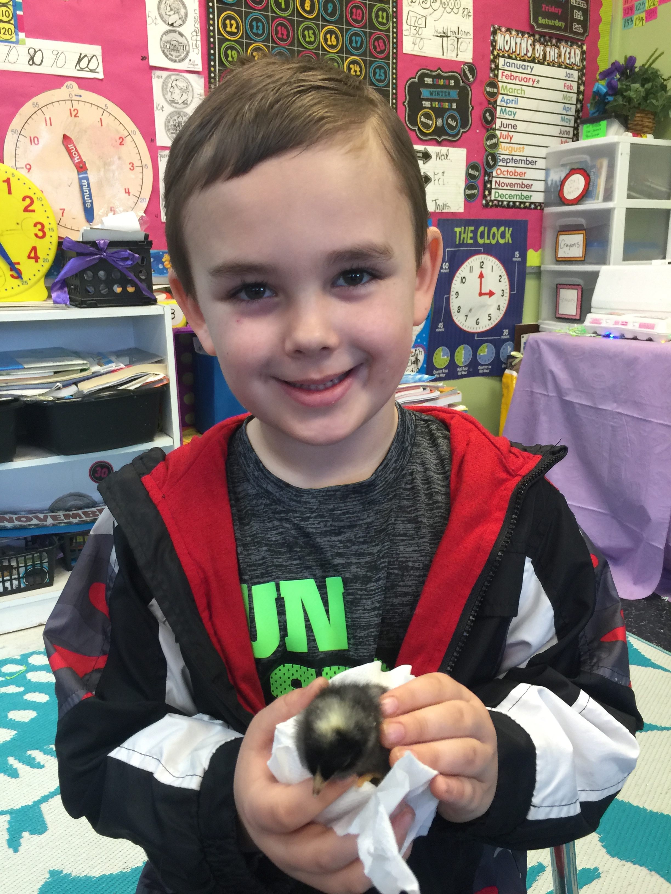
Hatching is a long, tiresome process!
Notes:
Babies hatching. This little striped chick seemed to be the class favorite. The kids all thought it looked like a chipmunk.

Slide 15
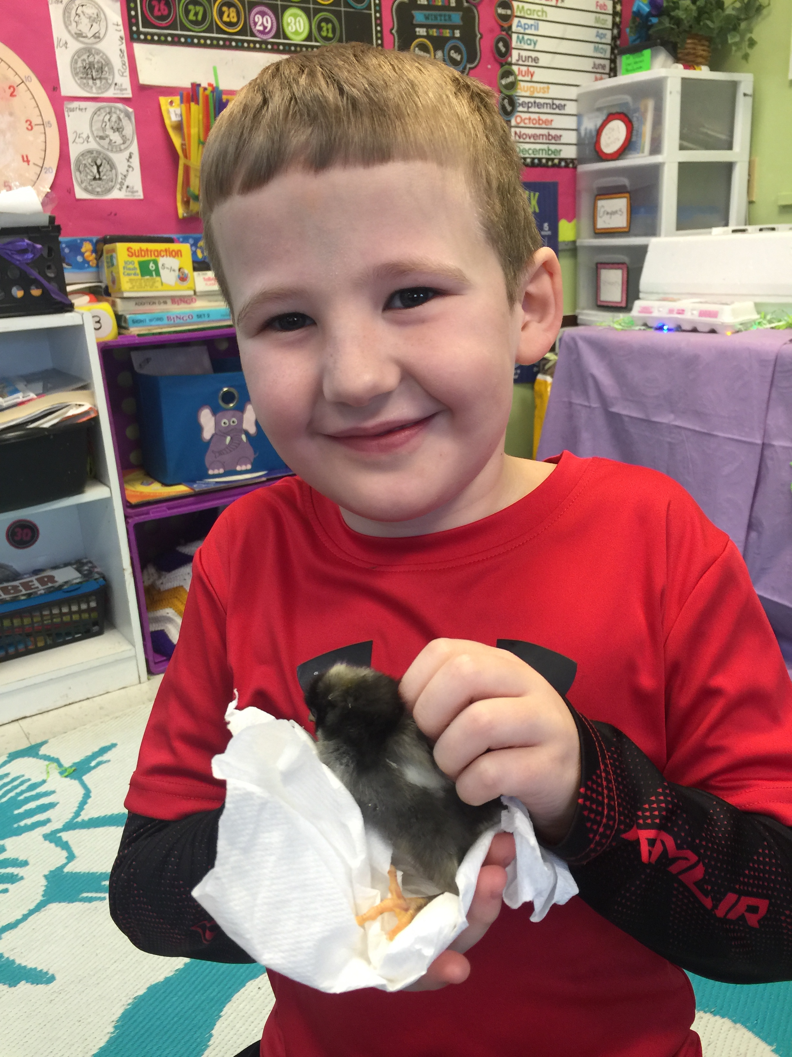
These boys love their chicks!

Slide 16
The Brooder Box is “Home Sweet Home” for the next two weeks.
Notes:
After the first 24 hours being out of the shell, baby chicks were placed in the brooder box to stay warm and safe. They lived here for two weeks while students watched them change and grow. Students also helped feed and water the chicks while they were in the box.

Slide 17
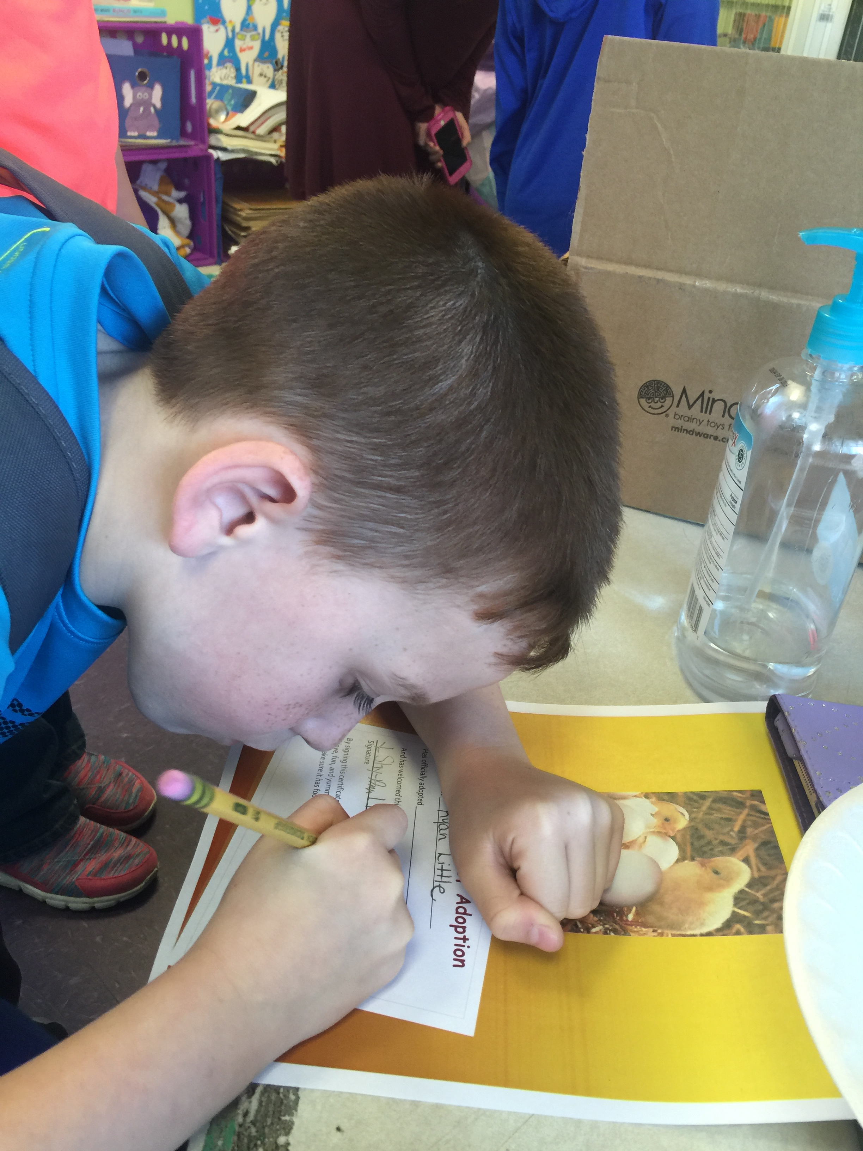
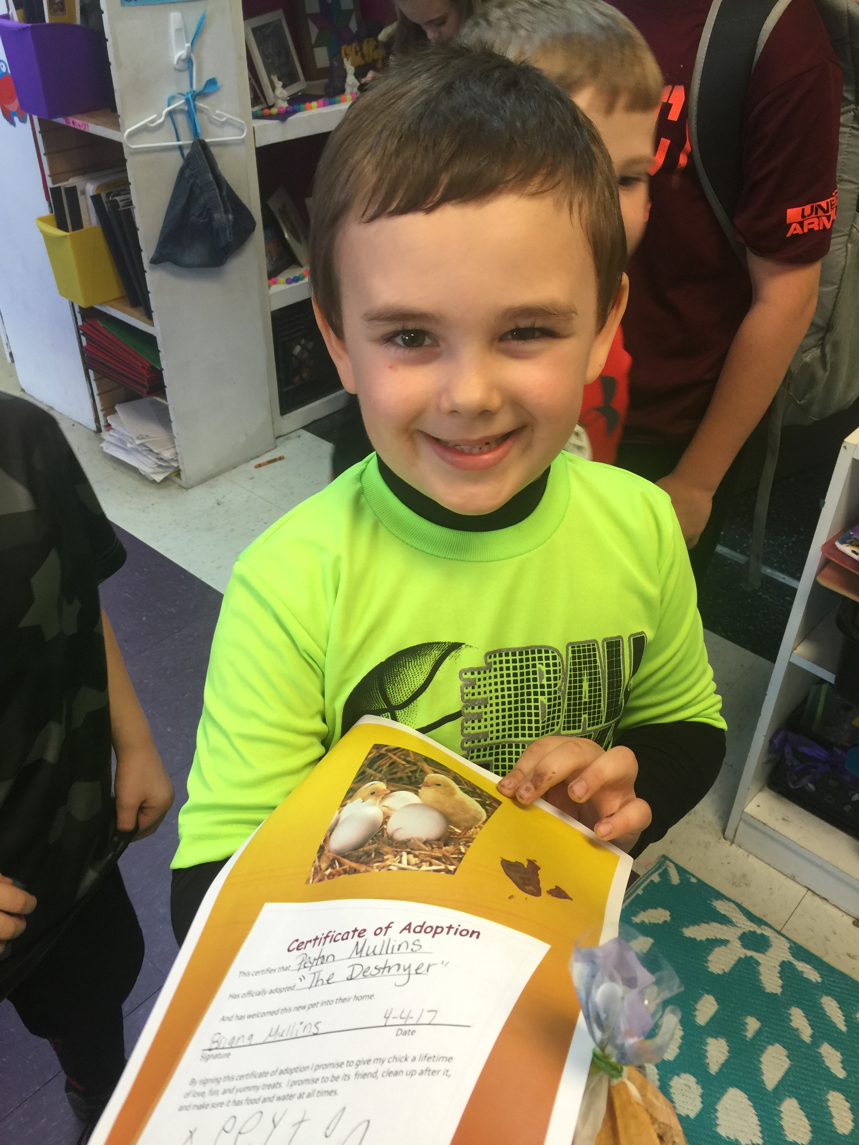
Family Adoption Night!
Notes:
We had a family night where students came with their parents to pick out a chick, learn about how to care for their chicks, and sign the adoption paper giving their chick a name. Also included on their adoption sheet was a footprint of their baby chick that was dipped in nontoxic paint. Parents were also invited to watch videos children made throughout the project and view pictures. Snacks and drinks were provided and each child also took home a small bag of chicken feed to get them started.

Slide 18
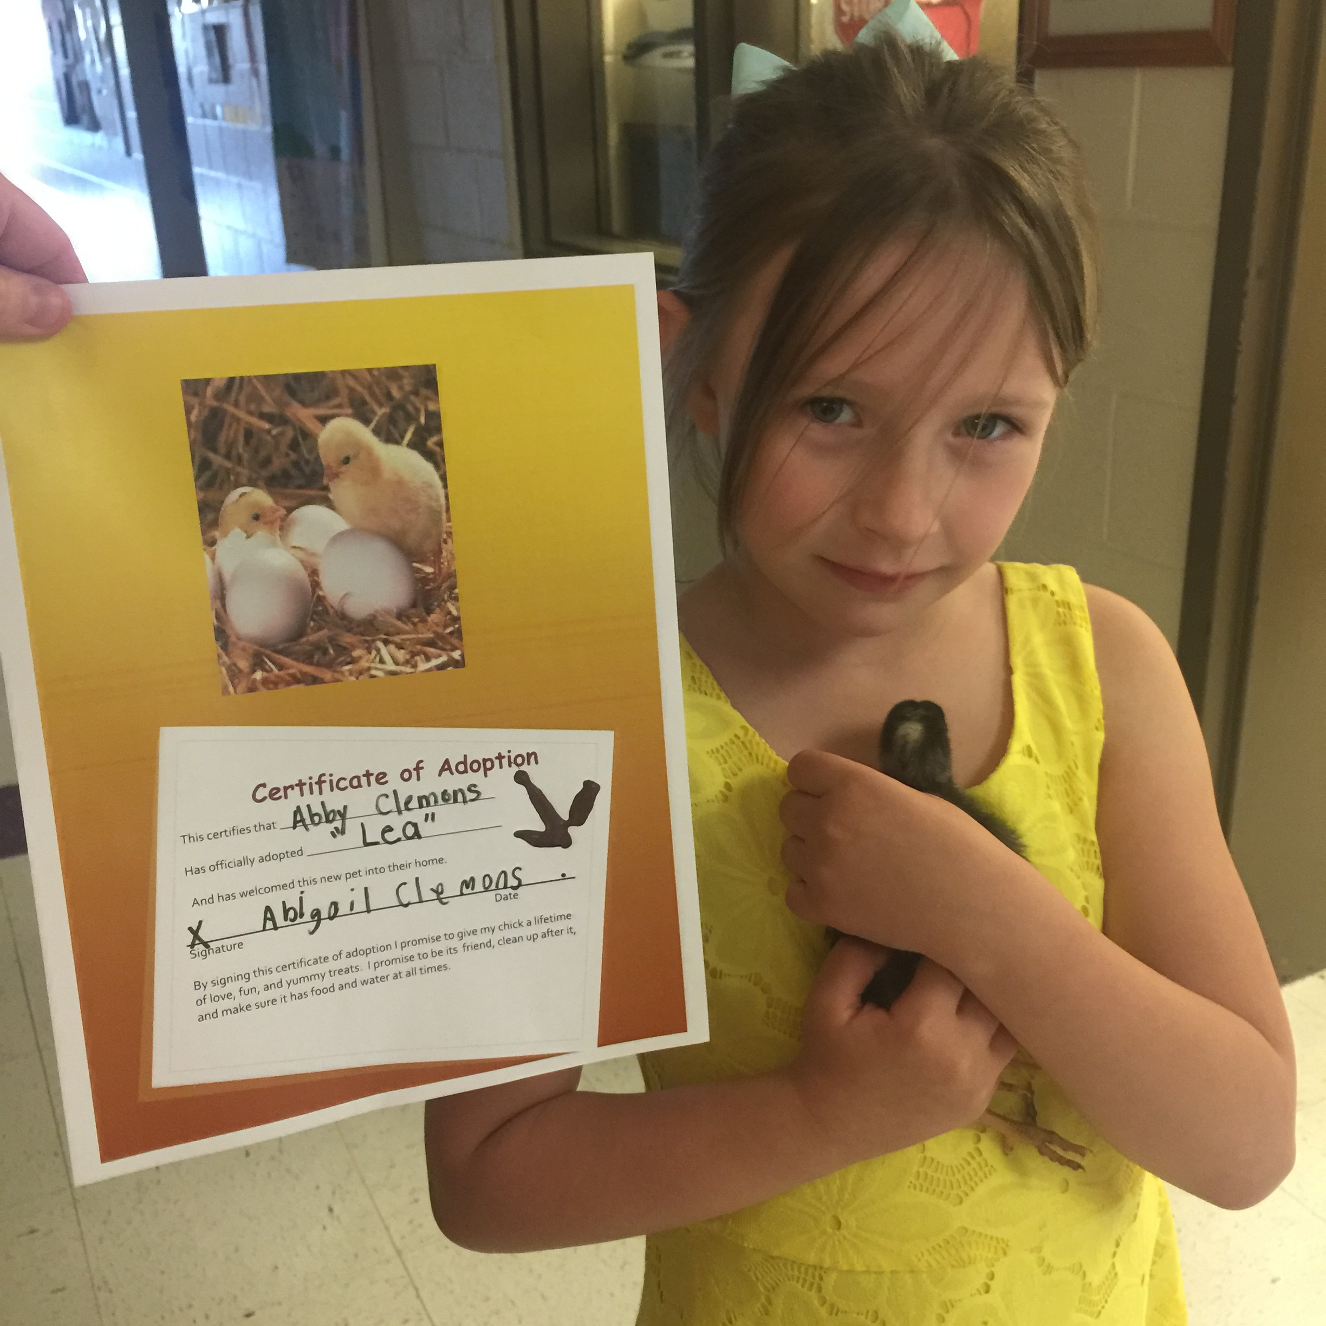
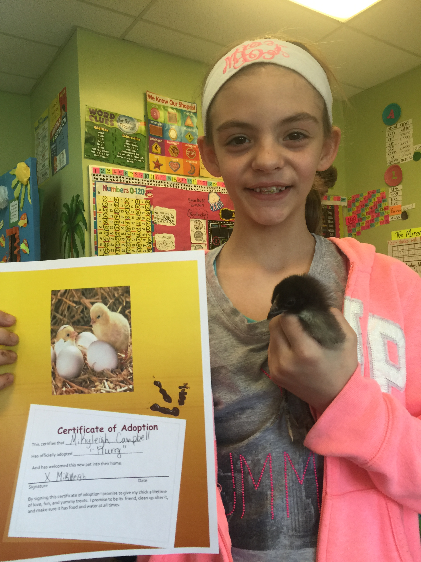
The chicks are getting a new home. Good-bye little ones!
Notes:
Pictures of some of the students with their adoption sheet and baby chick.

Slide 19
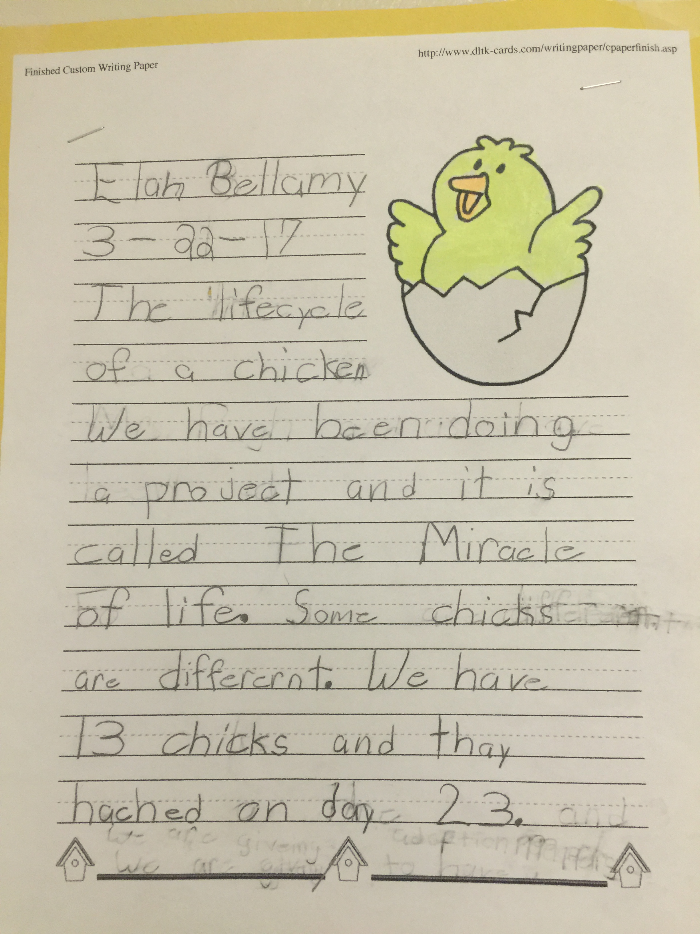
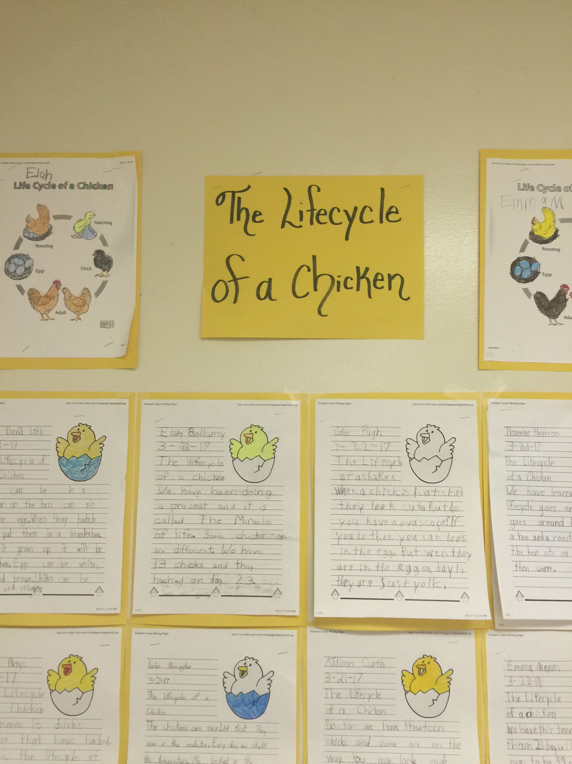
Students write about the Lifecycle of a chicken and the Miracle of Life Project.
Notes:
After the chicks were taken home, we reviewed the stages of the lifecycle of a chicken and some of the activities the children participated in. Next students used their writing rubric to write about their experience. Writings were displayed in the hallway.

Slide 20
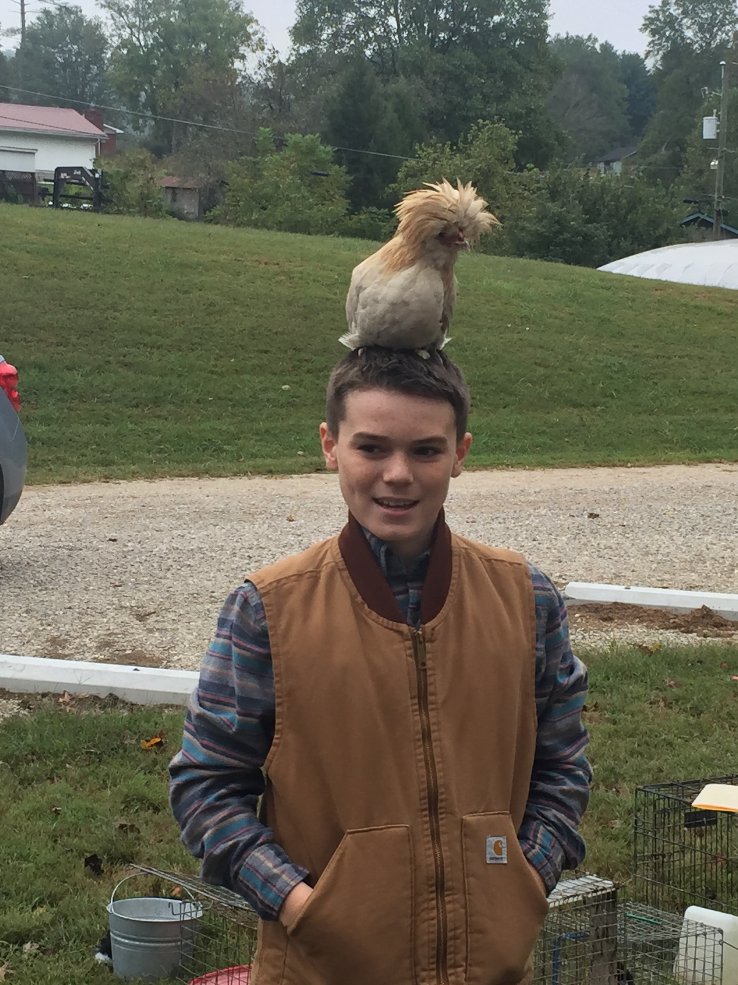
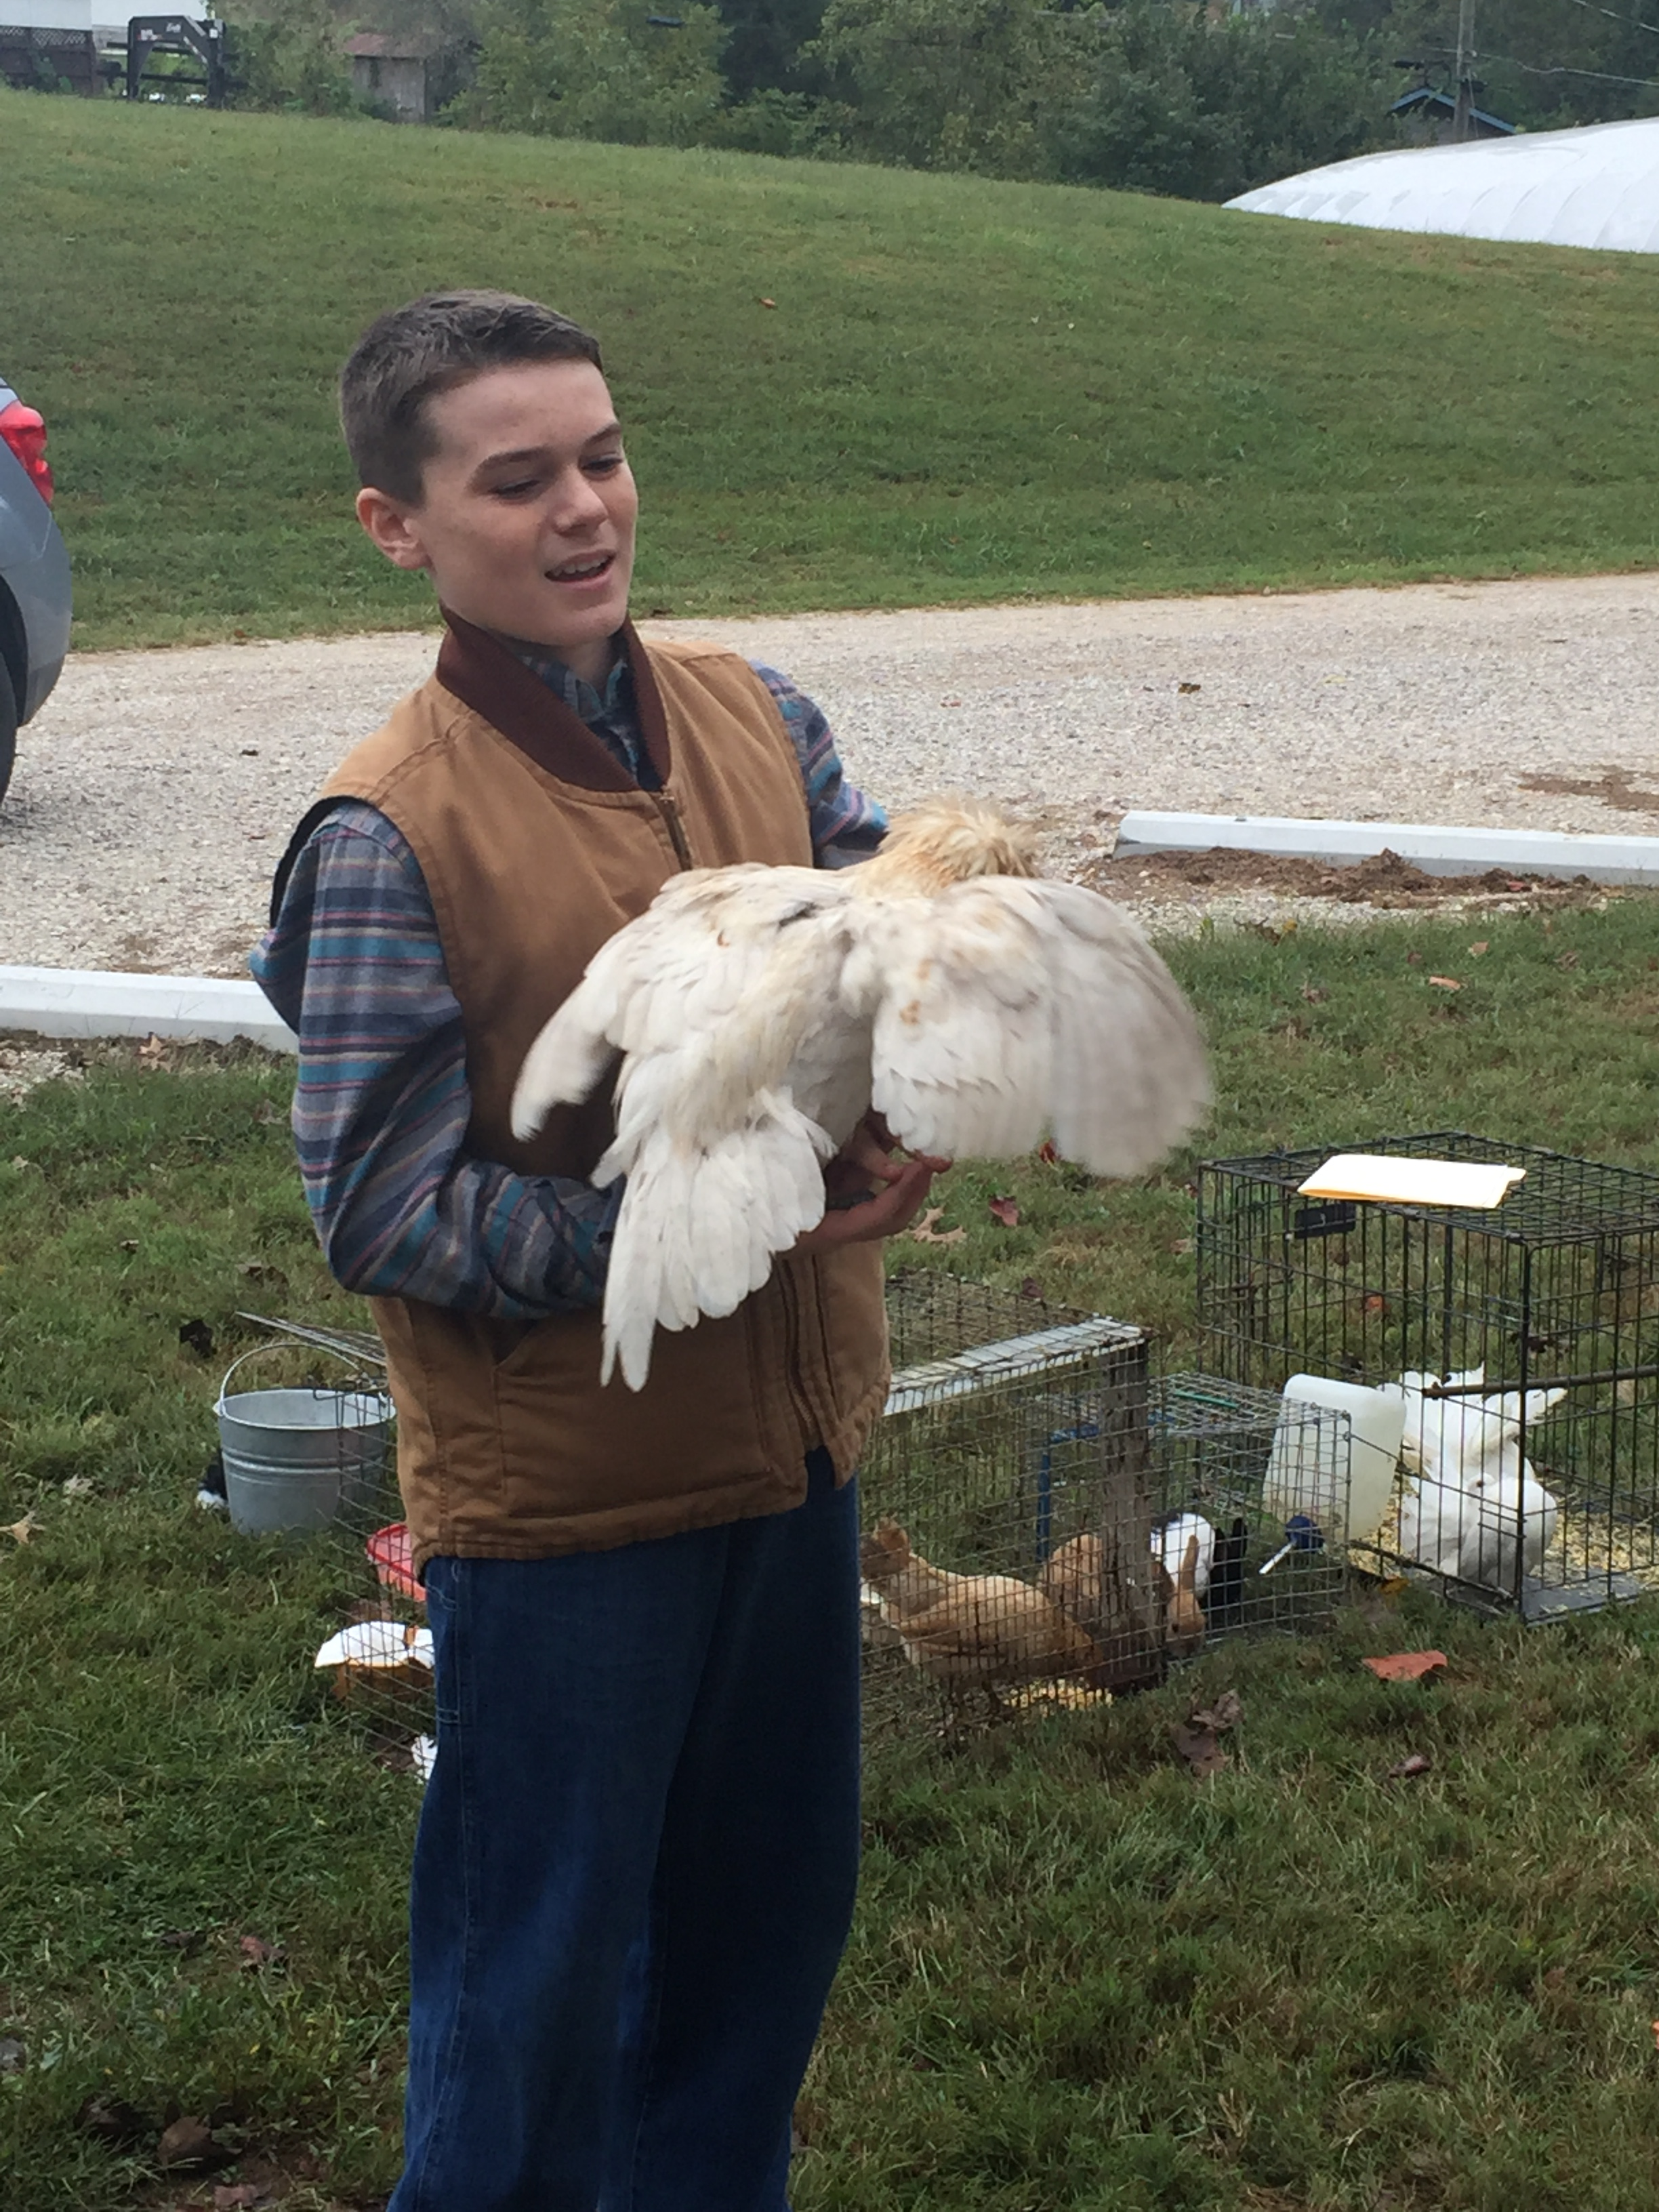
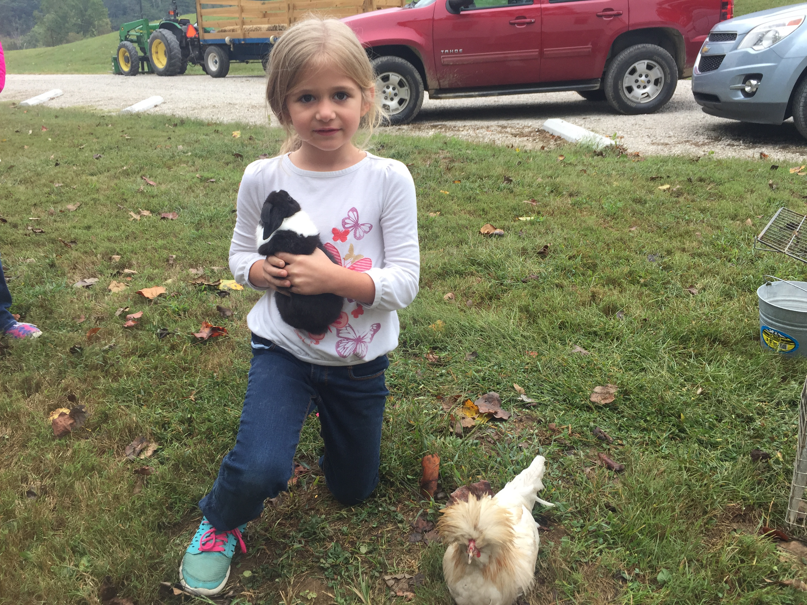
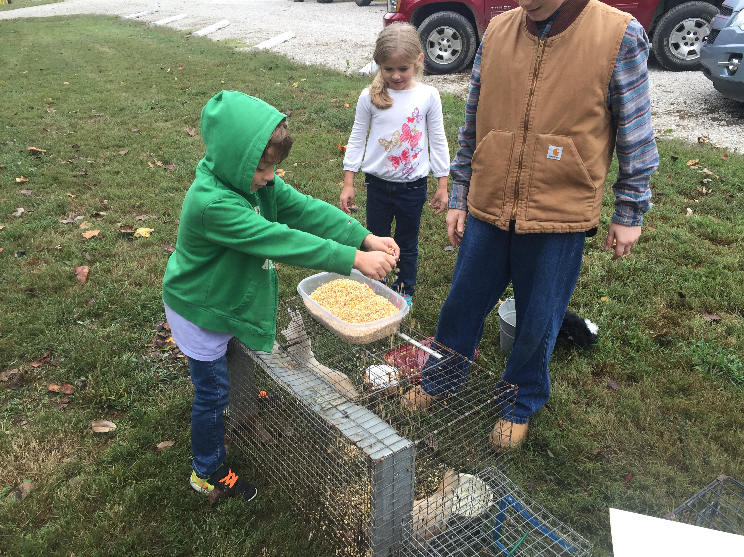
THE END
Questions????
The Miracle of Life
valerie.pugh@jacksonind.kyschools.us
First Grade- Jackson Independent
Notes:
Thank you for allowing me to share my project with you. In conclusion I wanted to leave you with a few pictures of my son when he brought some chickens from school to show the students. He discussed important things they should know how caring for chickens, showed them how to feed a chicken, hold a chicken, and they all had their pictures made with a chicken and a rabbit.

