Slide 1
Get Fit Phelps!
Kellie McLellan
Phelps High School

Slide 2
Area of Focus
Student Physical Fitness

Slide 3
Research Question
Will physical fitness improve if students have access to more resources and equipment?

Slide 4
Action Plan
I implemented various sports and other physical activities that were new to students. The goal was to allow the students an opportunity to find an activity that interests them enough to keep them physically active.

Slide 5
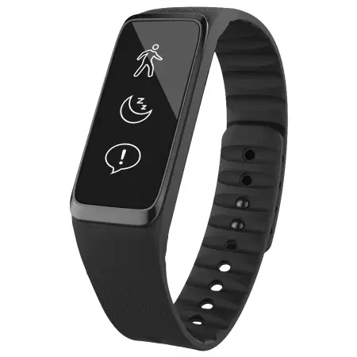
Fitness Bands
Track activity
Students said the activity bands made them more aware of how very little physical activity they were getting each day.
Students reported that they would purchase and use these in the future to help remind them to be active.

Slide 6
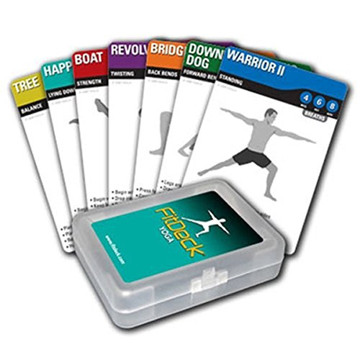
Yoga Playing Cards
Students were at first concerned that yoga would be too difficult and that it was not something they would enjoy.
After learning basic yoga positions, students began to ask to do these in class and their interest levels increased.

Slide 7
Bodyweight Playing Cards

Slide 8
Badminton
Badminton became the favorite activity and was requested on a daily basis.

Slide 9
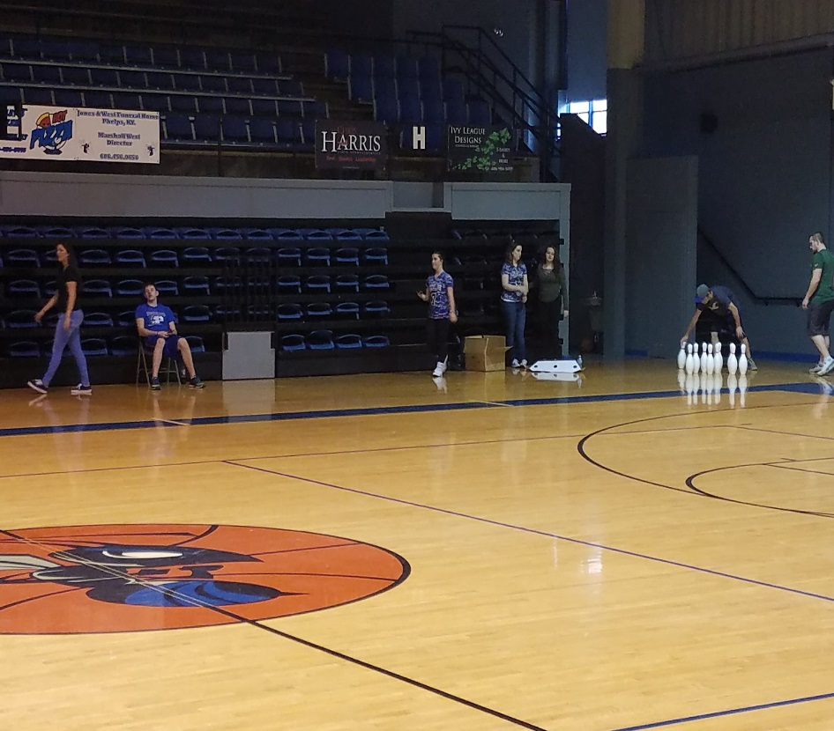
Bowling

Slide 10
Mini Golf
We practiced golf and bowling in the hallways so they could learn better control in a limited space.

Slide 11
Table Tennis
Another activity that all students loved.

Slide 12
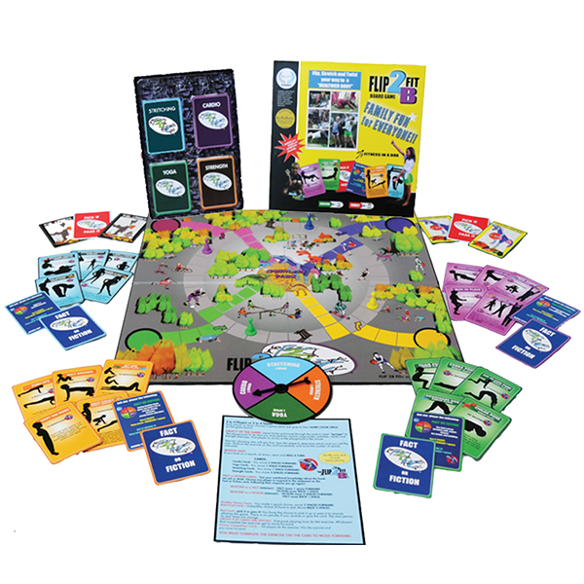
Flip2BFit
Students liked the board games because they had options on the types of activities they were doing that day.

Slide 13
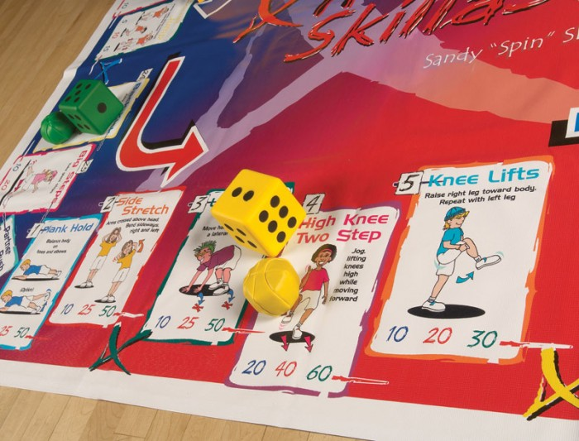
Skillastics Fitness

Slide 14
Physical Education & Activity Survey
Before
After
9/9 had heard of yoga but had not participated.
6/9 had participated in mini-golf and bowling
4/9 had played badminton before
0/9 had participated in Zumba or any type of aerobic dance activity
5/9 enjoyed yoga and will participate in the future.
9/9 enjoyed mini-golf and bowling and will participate in the future.
9/9 will play badminton in the future and believe it is a good routine to add to their physical fitness activities.
8/9 said they would participate in Zumba in the future

Slide 15
Physical Education and Activity Survey
Before
After
Numbers of minutes per Day of Vigorous Physical Activity (outside school): 7/9 = less than 20 minutes and 2/9 = 30 to 60 minutes
How many days of the week do you participate in some type of physical activity outside of school time? Average = 2 days
How interested are you in being physically active? 2/9 hate being physically active…. 6/9 are somewhat interested in being physically active….1/9 is very interested in being physically active
7/9 increased physical activity outside the school setting to 30 to 60 minutes at least 3 days per week
8/9 were very interested in keeping up with their physical activity and planned to be more active in the future

Slide 16
Conclusions
Introducing students to sports and activities that they were not familiar with helped to increase their interest in being physically active. Giving the students the knowledge and skills is the first step in helping them to become healthy adults.

