Slide 1
Sit Down and FOCUS!!
Megan Byers ARI Grant 16-17
megan.byers@jacksonind.kyschools.us
Notes:
Hi, My name is Megan Byers. I am from the Jackson Independent School District in Breathitt County. I teach grades 3-5 math, and 5th grade on-demand writing. We are a k-12 school, with about 400 students. My grant project is called “Sit Down and Focus!”

Slide 2
Problem/Question:
Engagement
Student Voice Survey
504 Modifications
Notes:
When I looked at what I wanted to apply for with the ARI Grant, I focused on some of the problems in my classroom. From some data, I knew that engagement was an area I wanted to improve on. In the TPGES system, we do the student voice survey and then create professional growth goals based upon the results. From last school year, engagement was my lowest area. While engagement can be improved through different activities, I also looked at how my classroom was set up. I wanted a more inviting area that was conducive to center activities. Another factor in my presentation was looking at my body of students. I have several students that have 504 plans that include modifications that help them focus and become more engaged. From thinking about all of this, I decided I wanted to apply for Flexible Seating.

Slide 3
Flexible Seating
Choice
Engagement
Focus
Kentucky Framework for Teaching Instrument
Notes:
The idea behind flexible seating is that students have a choice of where they sit. The seating is flexible in that there are multiple seating choices. In a moment, I’ll show you some of the different seating choices that I purchased. But really the idea is that students are going to be more engaged, focused on their work. In the Kentucky Framework for Teaching, some components that flexible seating focuses on is engagement for student learning, and organizing your physical space to enhance student learning.

Slide 4
Study Survey
Questioning
“I cannot concentrate because of the people around me sometimes.”
“Our desks are uneven.”
“I’d like a workout ball or yoga ball.”
“I would like to be by myself so I can concentrate more.”
Notes:
So, to begin I did a survey about my classroom and gave it to my 5th graders. They are my homeroom group and I have them the longest of the day, so I focused in on them with the purpose I wanted the flexible seating to serve. I thought a lot about questioning and ended up asking them questions like, “Are you comfortable in this classroom?” “Are you able to focus throughout the day?” What are things that distract you? What are your feelings about desks vs. tables? If you had the option, what different kinds of seating would you like to see in the classroom? So I jotted a few of the quotes down from this survey on my presentation. I knew I didn’t like the desks because they weren’t conducive to the structure I wanted in my classroom, but I did not previously have a good idea of what my kids thought about their seating and the atmosphere in the classroom. This survey really allowed me to see what my students thought about the correlation between seating and their concentration.

Slide 5
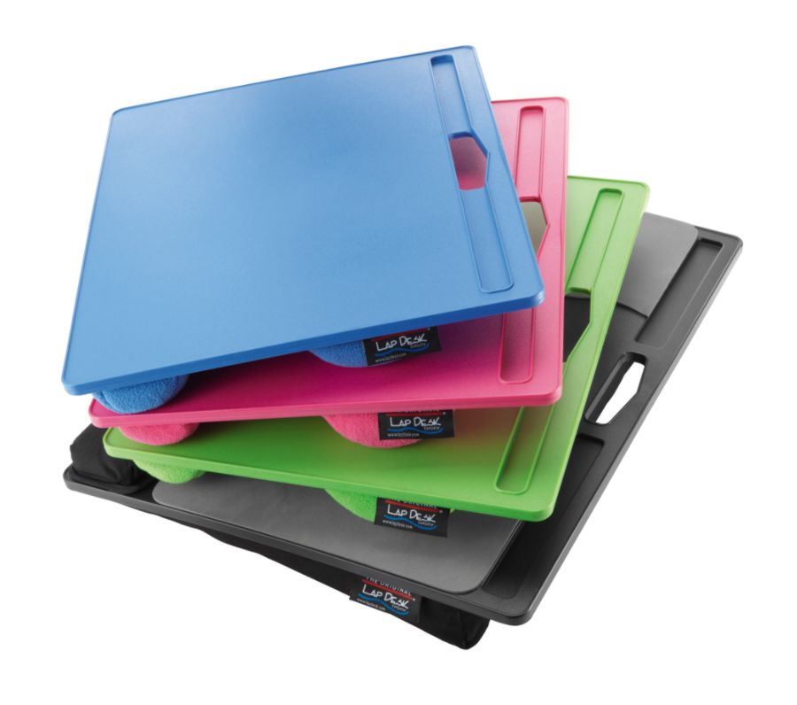
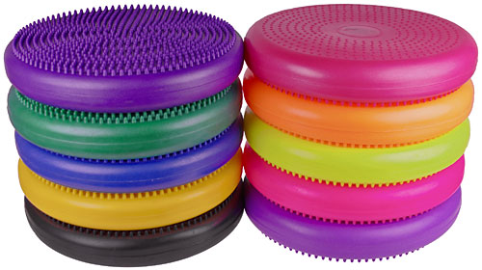
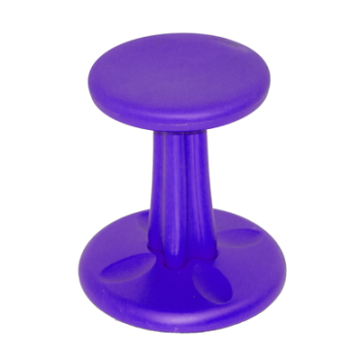
Ideas:
Notes:
So then, I started to look online at flexible seating options. There are a lot out there. Some require a lot of craftiness and not a lot of money, and others are pricey but convenient. I did a lot of looking on pinterest and had an idea of what I thought would work in my class. The first thing I searched for was tables. I found the gorgeous purple and yellow tables that you can see above and had to have them because those are our school colors. I purchased 5 of those tables. Some of the other options you can see are lap desks, butterfly chairs, wobble seats, yoga balls, and cushions. I ended up purchasing 2 yoga balls, 3 wobble seats, and 5 cushions. I already had a couple of butterfly chairs in my room as special seating and just incorporated them into the new seating arrangement.

Slide 6
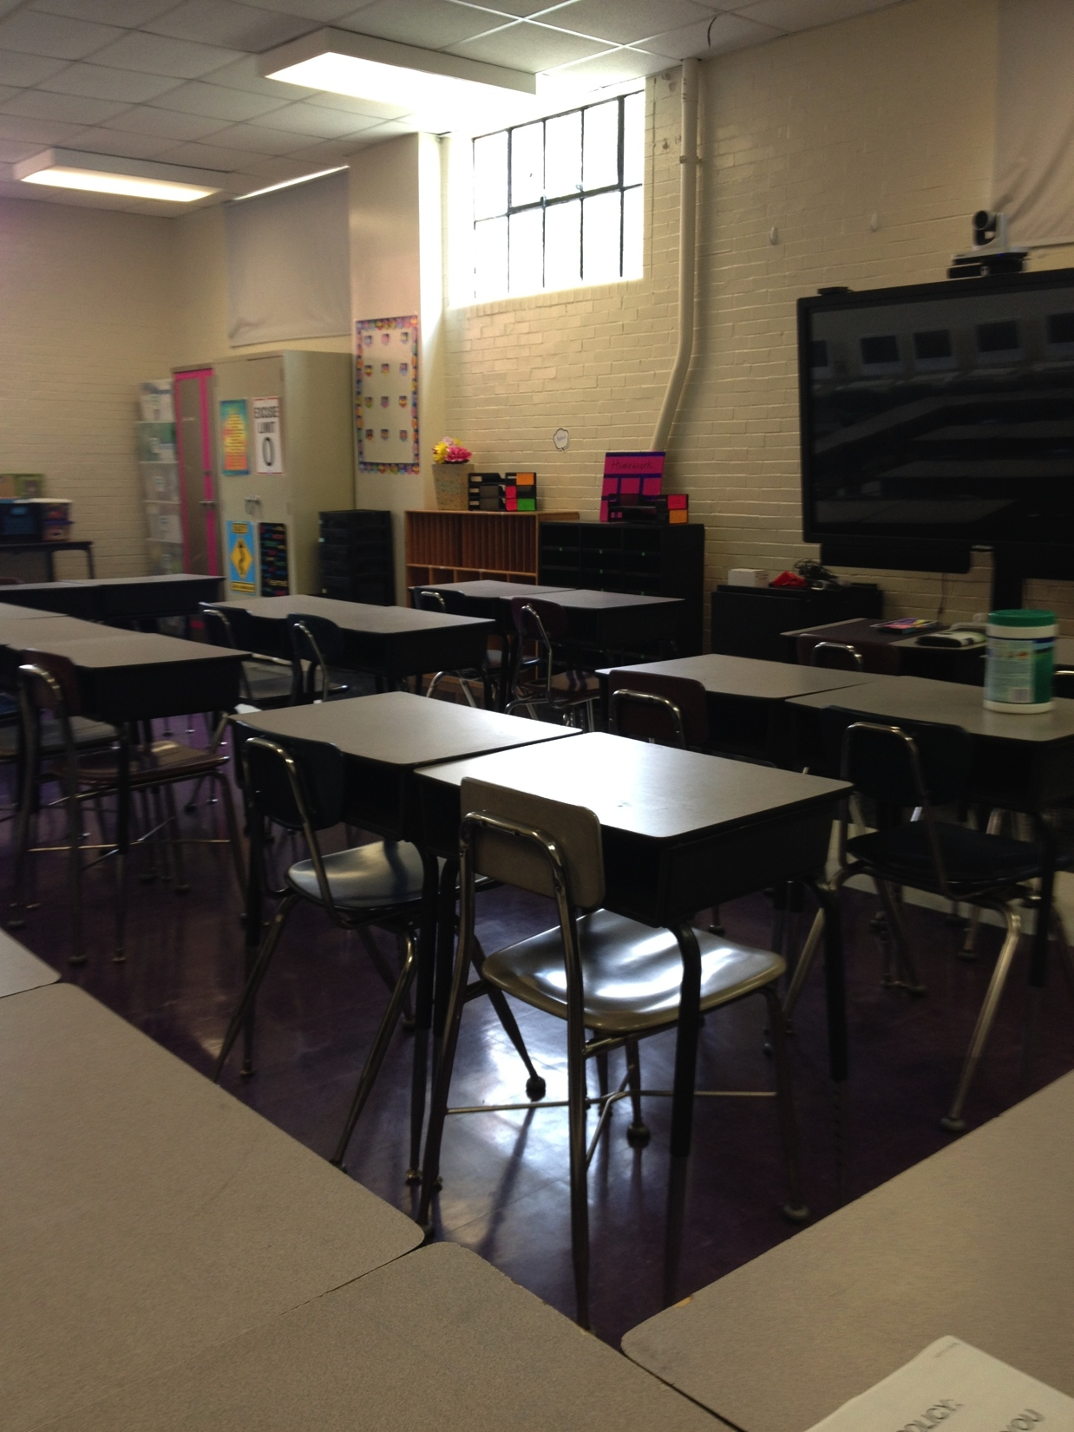
Notes:
I searched and searched through my computer, and I guess I tried to block that part of my year out because this was really the only before picture I could find. The biggest thing I disliked about my room, as I’ve said a couple of times, were the desks. I tried to set them up in pairs or groups, but it’s just not the same as having separate work areas for math stations or centers. So, this kind of helps you see the before.

Slide 7
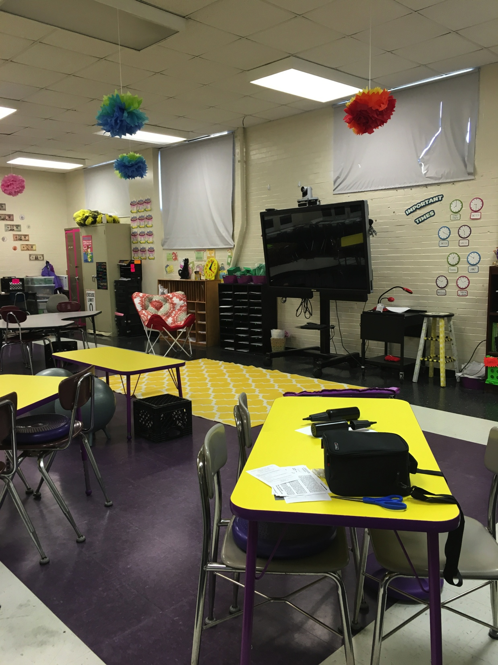
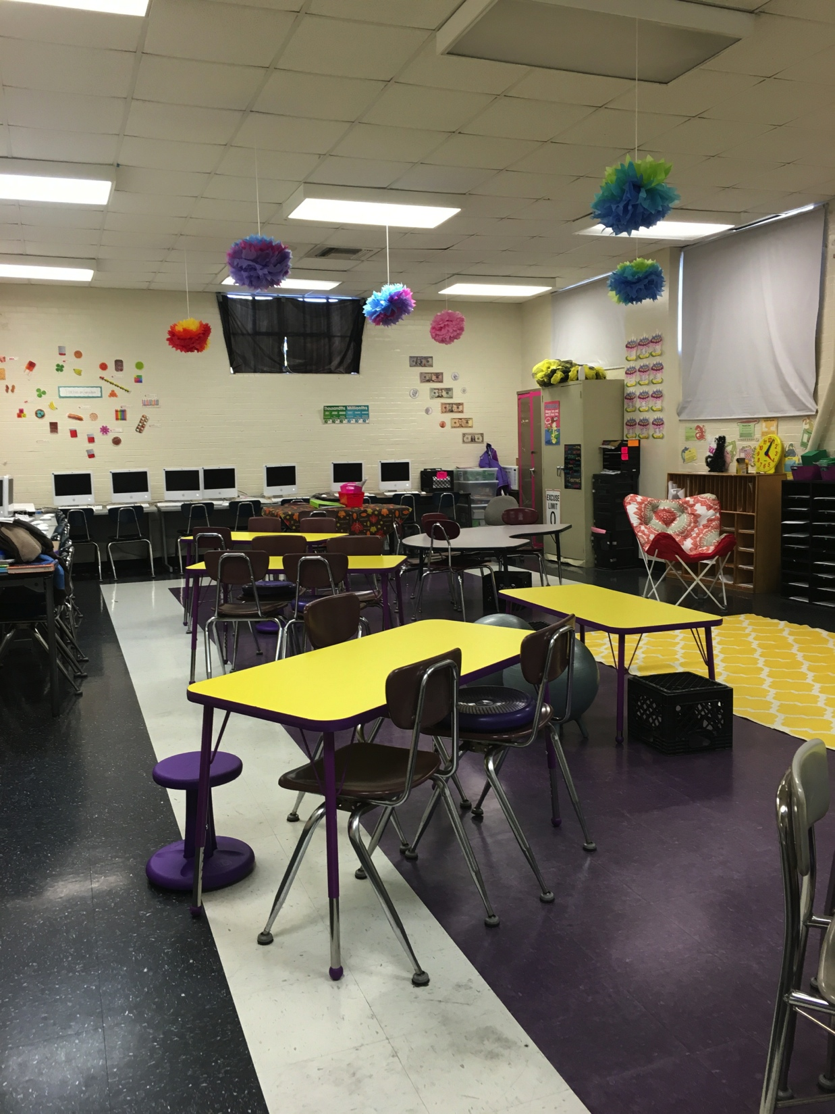
Notes:
Here are a couple of my “after photos” My tables are spaced out pretty well, and I feel like I have so much more room for students to move around. It also helps so much with rotating center work. You can see a few of the wobble seats and cushions in this picture too. The wobble seats and cushions just give a lot of range of motion for the kids who need to rock or swivel and they’re very quiet too. I also have a rug in the front that’s used more for whole group instruction or small group using the MondoPad.

Slide 8
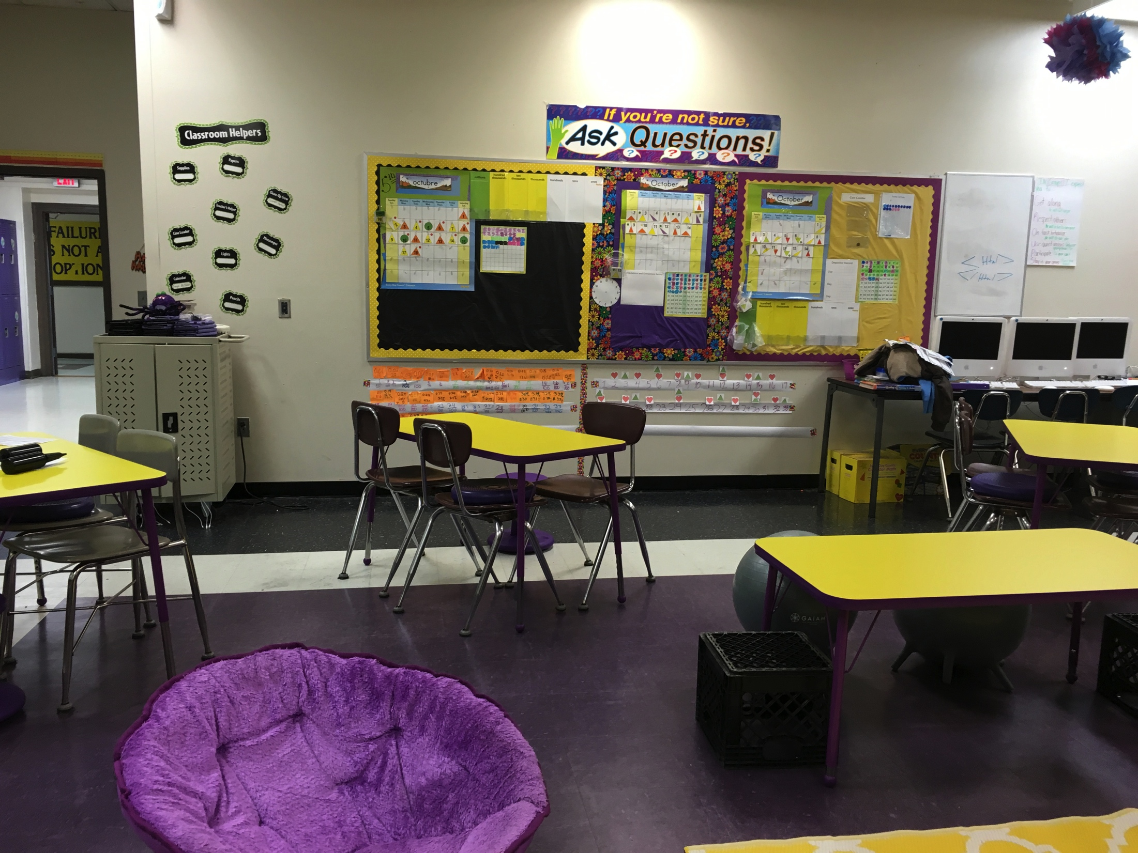
Notes:
Here’s one of my comfy butterfly chairs- lets the student be a little more isolated for better concentration or individual work. And anytime we do stations or group work, I just have them go to a table that has an open spot to work with that group. You can also see my yoga balls in the back of the room. These and the crates are at a lower table in the front. It’s probably my favorite table when I sit at it, because I feel like I’m down on the kids’ level. The students love the yoga balls and honestly they aren’t that distracting at all. Every now and then I have to say, “okay chill out with the bouncing” and that’s it.

Slide 9
Notes:
So I’ve added here a video of students’ feelings about our seating arrangement. I’ll let you listen to it. The kids really do love coming in and having a unique place to sit. I will be honest. It has been really hard for me to relinquish control of where every single individual sits in the room. There’ve been times when I’ve said- nope you’ve got to move- but I made that clear at the beginning. Students signed a contract that stated the rules of our flexible seating.

Slide 10
Outcomes
Student Voice Survey
Student reactions
Notes:
So I’m really basing the effectiveness or the outcomes of this grant by students’ reactions. I know that they are more engaged. I know that individual students have performed much better and listened much better during whole group instruction because of the seating. Hopefully, my student voice survey results will show an increase in the positive responses about my classroom atmosphere and student engagement. I definitely won’t be getting rid of the seating and am excited to incorporate even more ideas into my room next year. Thank you. Are there any questions?

