Slide 1
Letcher County Public Schools
Appalachian Leadership Lab

Slide 2
Our Team:
Wendy Madden – Principal at LES
Joshua Tyree – Teacher at LCCHS
John Tyler Watts – Teacher at LES
Denise Yonts – Director of Curr/Instruction
Wendy.madden@letcher.kyschools
Joshua.tyree@letcher.kyschools.us
John.watts@letcher.kyschools.us
Denise.Yonts@letcher.kyschools.us

Slide 3
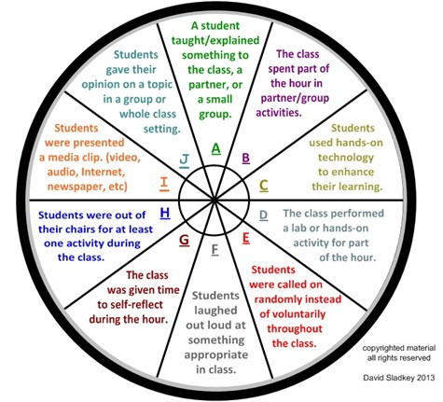
Student Engagement Wheel by Eric Sladkey
http://www.letcher.kyschools.us/administrativeDepartment.aspx?aid=8

Slide 4
LCPS Student Engagement Wheel
LCPS Student Engagement Wheel

Slide 5
Next Steps:
Create videos of exemplar models of the strategies in action.
Add possible formative assessments for each spoke of the wheel.
Work with principals to target staff needs

Slide 6
Impact/Evaluation
We will use the Instructional Rounds process in the fall to monitor the use of engagement wheel strategies.
During Instructional rounds, we visit all nine schools with a team of administrators and principals, collect classroom observation data, and create next steps for improvement.
We will then use the data collected to determine needs/areas of improvement from the student engagement wheel.

