Slide 1
By: Alice Tackett and Jill Maynard

Slide 2
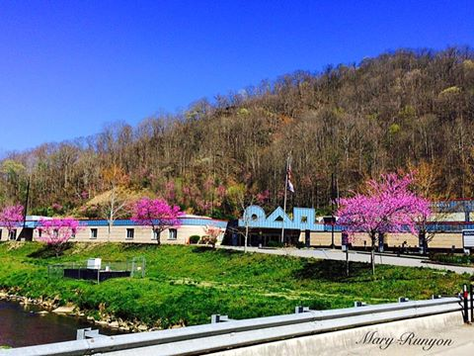
Southside Elementary School
Theory of Action – Southside Elementary School needs a comprehensive ELA curriculum that is rigorous, aligned and researched-based to improve student achievement.

Slide 3
If the District Instructional Administrator…
• Walkthroughs to look for Authentic Engagement and Formative Assessment Strategies that guide instruction
• Identify lesson adjustments based on formative assessment strategies
• Walkthroughs to observe higher level questioning
• Feedback to principal and teacher on findings during walkthroughs and next steps for improvement

Slide 4
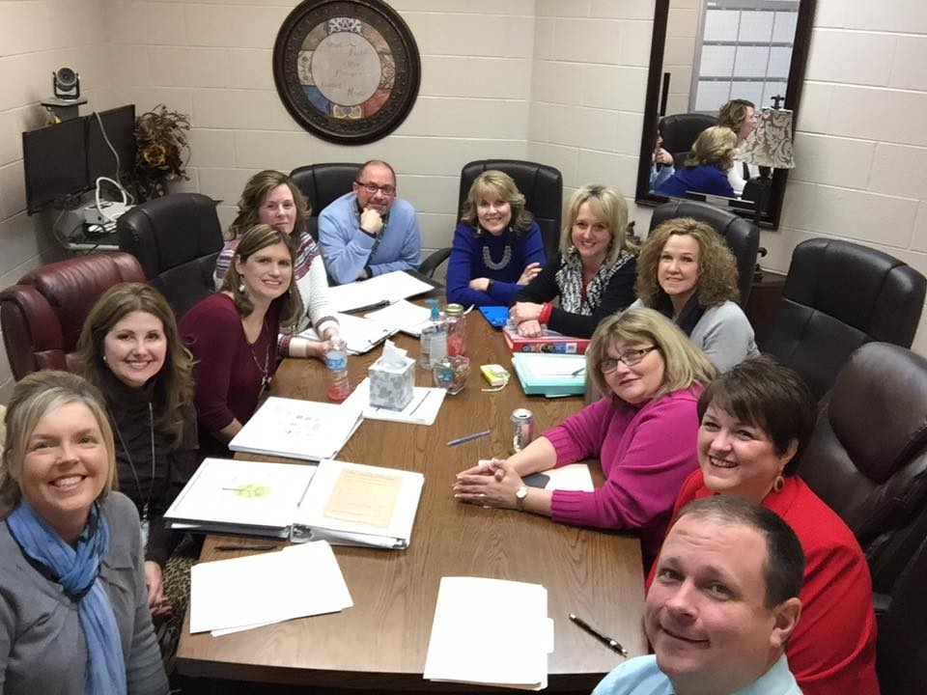
District Walk Through Visit
After our district team conducted several walk throughs using our District Walk Through Document, they presented their findings from various areas including active engagement, formative assessments, and questioning.

Slide 5
Walk Through Data Results
Student Engagement
Formative Assessments
August – September | October – January | February – March
2.63 | 2.70 | 2.89
August – September | October – January | February – March
2.63 | 2.55 | 2.89
***Questioning – Continue to work
August – September | October – January | February – March
2.05 | 2.29 | 2.61

Slide 6
Principals will be able to…
• Teachers formative feedback on lessons aligned to Engage NY
• Professional learning through PLCs on Engage NY
• Staff PLC on Engage NY curriculum and strategies
• Immerse 2nd, 4th, 5th in Engage NY
• Continue development with K, 1st, 3rd grades
• Teachers freed up for peer observation
• Lead teachers through analysis of formative and summative assessments
• RTI focuses on students who are not at mastery

Slide 7
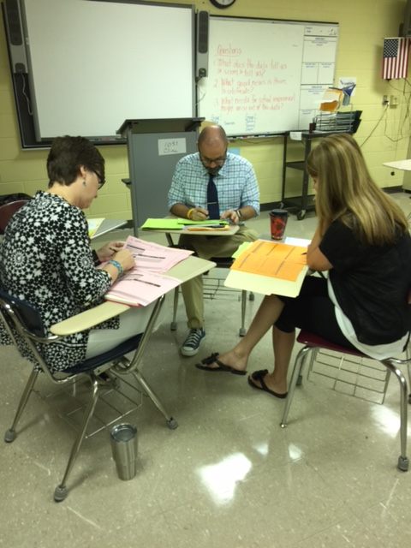
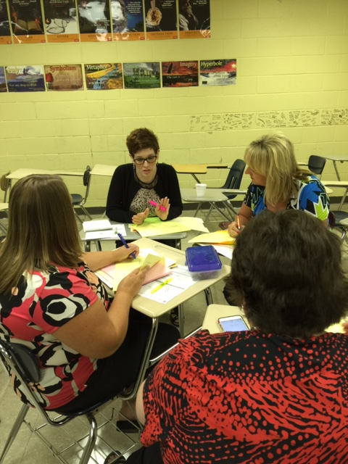
PLC’s meet to provide weekly feedback on the implementation of Engage NY.

Slide 8
Then Teachers will be able to…
• Continue to align curriculum to Engage NY
• Use standards mastery document to ensure tight alignment to Engage NY
• PLCs will engage in common lesson planning to ensure consistency using PDSA
• Implement Engage NY curriculum
• Engage in PLC to better implement Engage NY
• Access and use online Engage NY resources

Slide 9
So that students will be able to…
• Students will have improved vocabulary
• Students will engage in aligned lessons that are rigorous and at grade level
• Students will be actively and authentically engaged in instruction
• Students will self-assess to ensure targets are met and identify next steps in their own learning
• Students will have improved phonemic awareness in K-3
• Students will engage in aligned writing
• Students will have improved reading fluency
• Students will be able to self-identify reading strategies that will allow them to better make meaning of text
Students will be able to identify needed skills through Lexia (technology implementation)

Slide 10
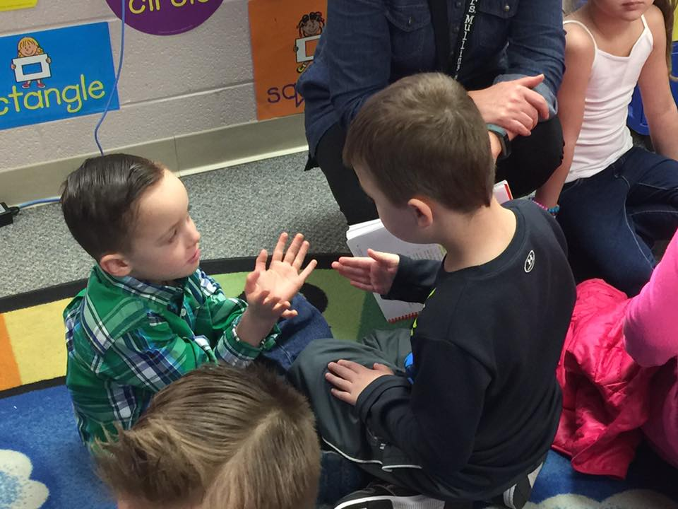
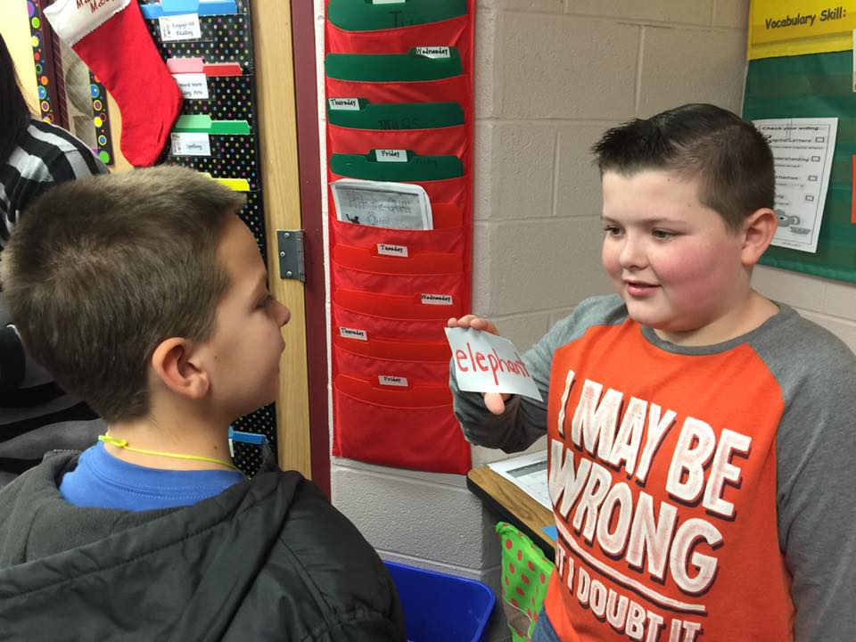
Student Engagement

Slide 11
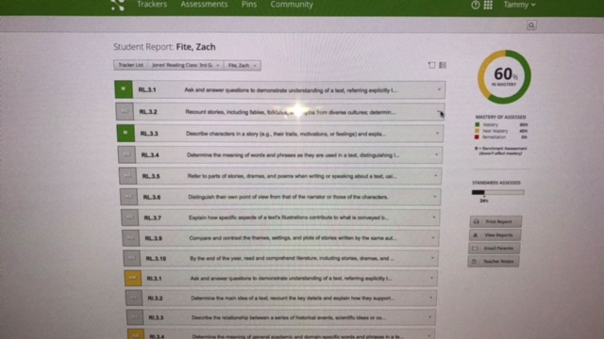
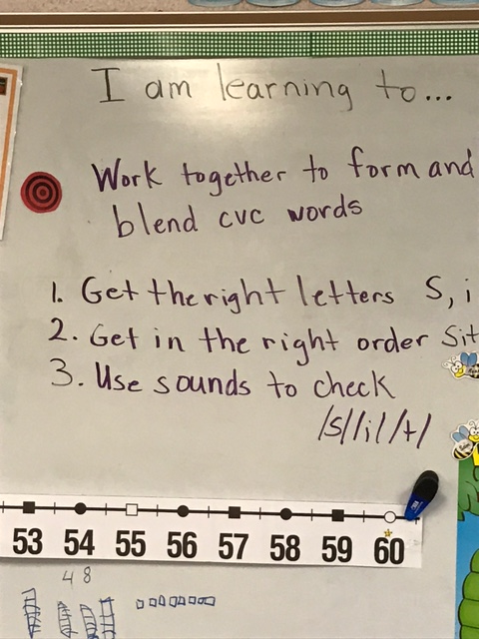
Students Self Assessing
Mastery Connect
Success Criteria

Slide 12
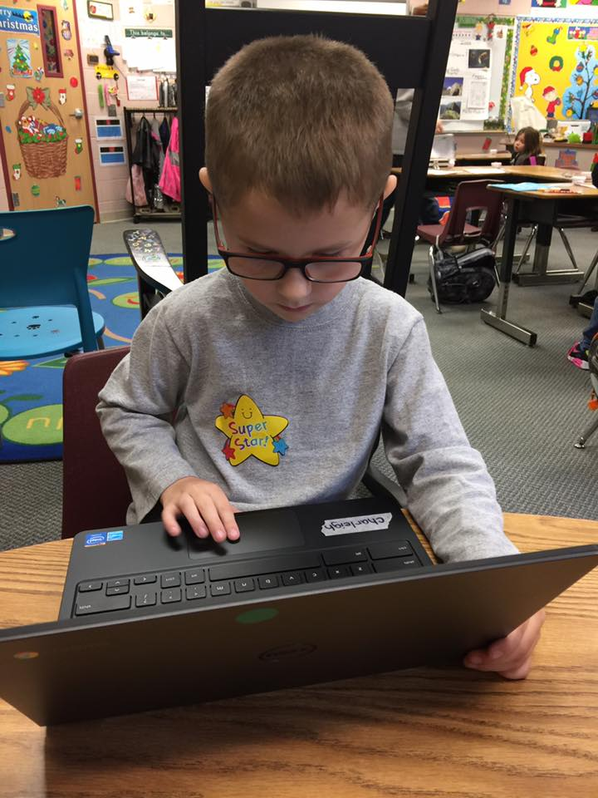
Lexia Meeting Individual Needs

